Slide 1
Unemployment Compensation for Federal Employees (UCFE)
United States Department of Labor
Office of Unemployment Insurance
Notes:
Hello and welcome to this training on Unemployment Compensation for Federal Employees (also known as UCFE).

Slide 2
Background
Federal-State Partnership
Financing
Responsibilities of DOL/Federal Agencies/States
UCFE Claims Process
  Determinations
  Appeals
  UCFE Forms
Resources Available to Federal Agencies
Notes:
Today I will provide some background on the UCFE program, an explanation of the federal-state partnership, how the program is funded, responsibilities of the US Department of Labor, Federal agencies and state unemployment insurance agencies, an overview of the UCFE claims process, which will include the importance of eligibility determinations, how to appeal a decision, and the forms used in UCFE claim filing, and lastly I will provide some resources available to Federal agencies.
I would also like to mention the terms unemployment compensation or UC and unemployment insurance or UI mean the same thing. I’ll mostly be using the term UI throughout this presentation.

Slide 3
Background
The Social Security Act was enacted in 1935 as a response to the ill effects of the Great Depression of the 1930's.
Intended to provide general welfare benefits for elderly persons, the disabled, dependent children, and the framework for the Federal/state unemployment insurance system.
In 1954, Public Law 83-767 added Title XV, added the Unemployment Compensation for Federal Employees to the Social Security Act.
UCFE provides benefits for eligible unemployed former civilian Federal employees.
Notes:
The UI Program was one of several programs created by the Social Security Act in 1935.
It was designed as a temporary source of financial assistance for individuals to help them meet their basic needs while looking for a new job. The program also helps to stabilize the economy by maintaining an individual’s purchasing power which allows them to continue to spend money within their community.
The UCFE program was established in 1954 and provides benefits to eligible unemployed former civilian Federal employees. UCFE is operated under the same terms and conditions that apply to regular state UI.

Slide 4
Federal-State Partnership
The UI program is based on federal law but administered by states under state UI law.
The program has broad coverage - applicable to about 98% of all wage and salary workers in the U.S.
All 50 states, the District of Columbia, Puerto Rico, and the U.S. Virgin Islands operate individual UI programs.
States act as agents of the Federal government in administering the UCFE, UCX and certain other federal UI programs.
Notes:
The UI program functions as a federal-state partnership. The program is based on broad Federal requirements, but states create specific laws for the administration of the program. As long as the state’s laws conform to the Federal Guidelines, the state is free to run the program.
Almost all wage and salary workers are covered for UI purposes.
All 50 states plus the District of Columbia, Puerto Rico, and the U.S. Virgin Islands have UI programs.
For Federal UI programs, states act as agents of the Federal government in administering the program.

Slide 5
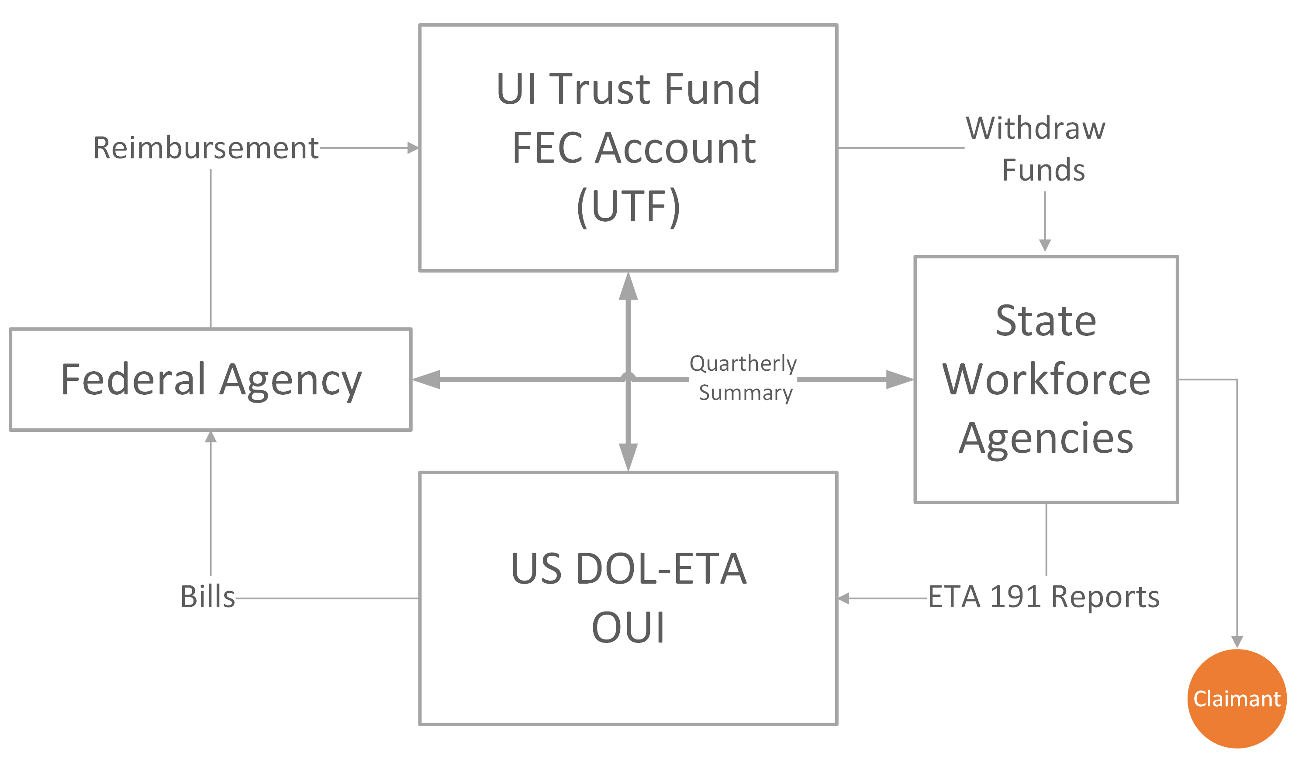
UCFE Financing & Billing
Notes:
This slide provides a diagram of how the UCFE program is financed.
When a claim is filed and the individual is determined eligible for benefits the state will withdraw funds from the Federal Employees Compensation Account or (FECA) to pay benefits. The FECA is part of the Unemployment Trust Fund, which is a revolving account held by the US Department of the Treasury.
Quarterly, all states transmit to the Department of Labor’s Office of Unemployment Insurance (also called OUI) a quarterly billing summary report using form ETA 191 titled “Statement of Expenditures and Financial Adjustments of Federal Funds for Unemployment Compensation for Federal Employees and Ex-Servicemembers.” This form does not show an itemized payment history by individual beneficiary but the aggregate total attributed to a specific agency. This report is due to OUI 25 days after the end of the quarter.
To help Federal agencies reconcile the quarterly bill from the ETA 191, states send each agency detailed benefit payment data, which may include the claimants’ name, Social Security Number, and the amount paid as well as other information. Federal agencies should receive this quarterly Detailed Benefit Payment Data 25 days after the end of the quarter. If an agency is not receiving this information, it should contact the state. If the problem persists, the agency should notify the Department of Labor.
The Department of Labor will bill the appropriate Federal agencies dollar-for-dollar for UCFE benefits paid. After receipt of the ETA 191, OUI aggregates the benefit payments from each state for quarterly consolidated billing to the Federal agencies. Each Federal agency submits payments back to the Department of labor for Unemployment Trust Fund replenishment using the Intra Governmental Payment and Collection system also called IPAC. Payments from the Federal agencies are due within 30 days after billed. The Secretary of Treasury is authorized to automatically transfer funds from a non-compliant Federal agency to the FECA.
Upon receipt of the payments from the Federal agencies the Department of Labor will reimburse the FECA.

Slide 6
U.S. Department of Labor Responsibilities
Oversight of the UI programs;
Ensure state laws conform to federal law;
Provide administrative funds to states;
Set broad policies for administration of program, monitor state performance, and provide technical assistance; and
Maintain a directory of all Federal agencies’ contact information for UCFE purposes.
Notes:
Now I want to briefly talk about the responsibilities of the Department of Labor, other Federal agencies and the states as they relate to the UI program.
The U. S. Department of Labor provides the administrative funding to states to administer the states’ UI programs, and the OUI ensures that state laws conform to federal law.
OUI also sets broad policies for the administration of the program, and provides leadership, direction and assistance to states in the implementation and administration of state UI programs and Federal UI programs.
To help ensure states have the correct contact information for Federal agencies for UCFE purposes, the Department of Labor maintains a directory of Federal agencies. The Directory of Federal Agencies contains the mailing address and a contact person for each Federal agency. This contact person should know how to respond to states request for wage and separation information and should be able to answer any other questions the state may have in order to determine a former Federal employee’s eligibility for UCFE benefits.

Slide 7
Directory of Federal Agencies
Federal Agencies are assigned unique Federal Identification Codes (FIC) and Destination Codes for UCFE purposes.
The FIC and Destination Codes are maintained by the USDOL in a database known as the Directory of Federal Agencies (aka, UCFE Directory).
States access the UCFE Directory to find the appropriate Federal agency to provide a notice of claim filed and to request wage and separation information when a UCFE is filed.
Notes:
In addition to maintaining contact information for the Federal agencies in the Federal Agency Directory, the Department of Labor is also responsible for creating and assigning unique Federal Identification Codes, or FICs, for each Federal agency for UCFE purposes.
The states use the FIC code to identify the Federal employer for UCFE claims processing.
All Federal agencies also have a sub-code called a destination code. The destination code tells the state where to send UCFE forms, determinations, or other correspondence. Some Federal agencies have one destination code to designate an agency. However, some Agencies, like the Department of Veterans Affairs have over 150 unique destination codes with each representing a different location, which is why it can be challenging for states to identity the correct location to send information.

Slide 8
Federal Agencies Responsibilities
Notify the Department of Labor of address and UCFE contact information changes;
Provide a SF-8 to all separating Federal employees;
Respond to requests for wage and separation information within 12 days of the mailing date; and
Reimburse the Federal Employee Compensation Account.
Notes:
So what are your responsibilities as a Federal agency?
In order for you to ensure that your agency’s account is not incorrectly charged for UCFE benefits, your agency should:
Notify the Department of Labor of any address or UCFE contact information changes. Since we maintain the Federal Directory that contains the addresses where your agency wants information sent, it is extremely important to inform us when any of the contact information for your agency changes. We all know that positions are fluid; people come and go, retire, take promotions, and agencies also relocate, consolidate, etc. So if you need a change to your address or your point of contact, please get in touch with us to let us know of the change. It’s in your agency’s best interest to keep the directory updated in order to protect your account and avoid improper payments.
Your agency should also be providing SF-8s to all separating Federal employees. I will discuss this form in more detail a little later.
When you get requests for wage and separation information, you must respond to the request within 12 days of the mailing date. These requests come in the form of the ETA-931, 931A, and 934. I will discuss these forms shortly. Your agency should also respond quickly to all other UCFE related requests from the states.
Finally, you must reimburse the FECA account in the full amount of the quarterly bill for benefits paid within 30 days of receipt of the bill. Any issues with the charges should be resolved with the state as soon as possible.

Slide 9
State Responsibilities
Devise operational procedures to administer its UI programs;
Process applications, determine eligibility and ensure timely benefit payments;
Collect state UI taxes from employers for regular UI;
Submit summary detailed benefit payment data to Federal agencies; and
Submit the ETA 191 form to the US Department of Labor.
Notes:
As mentioned before, each state administers its UI program within guidelines established by Federal law.
Each state:
Establishes its own operational processes and procedures
Takes and processes UI claim applications, determines eligibility and ensures timely benefit payments;
Collects employer taxes for the regular UI program, and
Prepares and sends quarterly detailed benefit payment data to the Federal agency and also sends an aggregate summary of the benefits paid to the US Department of labor via the ETA 191.

Slide 10
Federal Claims Control Center (FCCC)
Maintains system of “claims control records” for the UCFE and Unemployment Compensation for Ex-Servicemember’s (UCX) programs.
Used by states to transmit records of UCFE and/or UCX claims filed and/or established (or canceled).
Serves to help maintain integrity in these federal programs
Notes:
To ensure the integrity of the program, the Department of Labor established the Federal Claims Control Center (also called the FCCC).
The FCCC keeps a record of where wages are assigned to prevent wages being assigned to multiple states.
These controls serve to help maintain integrity in the UCX and UCFE programs.

Slide 11
Assignment of UCFE Wages
In general, individuals will file a UCFE claim in the state where they last worked.
An individual's Federal civilian service and Federal wages will be assigned to the State in which the individual had his or her last official duty station prior to filing a claim unless: 1) the individual performed other covered employment in another state, 2) or the individual performed his/her Federal service outside the United States.
Notes:
An individual’s Federal civilian service and Federal wages will generally be “assigned” to the state in which the individual had his or her last official duty station prior to filing the UCFE claim. When a former Federal employee files a claim for unemployment benefits, the state UI agency will request wage and separation information from the Federal agency via an ETA-931. This is where the Federal agency will report the last official duty station., which will determine where the wages should be assigned. If the last official duty station was in a state other than the state where the claimant is attempting to file the claim, the state will advise the claimant that he or she must contact the state where the last official duty station was located to file the claim.
There are two exceptions to the rule of wage assignment based on last official duty station: If the individual moves to another state and goes to work in the private sector in that state and later files a claim, UCFE wages could be assigned to the state where the individual last worked for the private sector company, or if the individual’s Federal employment was performed outside of the U.S.

Slide 12
Provisions of State Law
State UI Law determines both monetary and non-monetary entitlement:
Monetary Entitlement
  Earnings and length of employment needed to quality for benefits;
  Benefit amounts;
  Duration of benefits; and
  Eligibility and disqualification provisions.
Nonmonetary Entitlement
  Job separation is non-disqualifying according to state law;
  Must be able to work/available for work and actively seeking work; and
  Must Meet other state UI eligibility provisions.
Comparison of State Unemployment Insurance Laws: http://www.unemploymentinsurance.doleta.gov/unemploy/comparison2016.asp
Notes:
To qualify for benefits, individuals must meet both monetary and non-monetary eligibility requirements under state law.
To monetarily qualify for benefits the individual must earn sufficient wages in a recent one-year period called the “base period” (usually the last 15-18 months; in many states, it is the first four of the last five completed calendar quarters of wages). Each state has its own formula for qualification. The amount of benefits an individual can receive is based on his or her past work and wages. States set the weekly benefit rates and duration of payments. For example, the weekly benefit amounts can range anywhere from $5-$1,103/week with dependent allowances and can last up to 30 weeks (although most states have durations of between 20-26 weeks).
States also determine non-monetary entitlement, which I will discuss in more detail on the next slide.
If you want to know more about various state laws, the US Department of Labor publishes an annual Comparison of State Unemployment Insurance Laws. This publication is available on the Department of Labor Website, which shows the different provisions of state UI laws. A link to the document is shown here.

Slide 13
Nonmonetary Determinations
In general, a non-monetary determination by the state(s) is
A decision made by the initial authority based on facts related to an “issue.”
An “issue” is an act, circumstance or condition potentially disqualifying under state/federal law.
Issues fall into two categories: separations and non-separations.
Notes:
States must determine whether an individual is unemployed for non-disqualifying reasons under the state UI law. The determination of a claimant’s eligibility for UI benefits is a critical UI program function. Individuals must be determined to be able to work, available for work, actively seeking work, and must meet any other eligibility requirements under state law. Individuals must submit weekly or biweekly a claim certification to certify that they meet these requirements.
A nonmonetary determination is a decision made by the initial authority based on facts related to an issue. An issue is an act, circumstance or condition potentially disqualifying under state or Federal law.
Issues fall into two categories: Separation issues which are separations due to reasons other than lack of work (for example, quits or discharges) and Non-separation issues, which constitute everything else. Examples of non-separation issues include ability to work, availability for work, refusals of work, not meeting the state’s reporting requirements, not looking for work as required, etc. I will discuss in more detail about separation issues later.
When issues are detected at initial claim filing or throughout the continued claim lifecycle, such determinations may also affect an employer’s liability for benefit charges.

Slide 14
Forms Used for UCFE
Employee Forms
  SF-8: Notice to Federal Employee about Unemployment Compensation
  SF-50: Standard Form 50
Federal Employer Forms
  ETA-931: Request for Wage & Separation Information
  ETA-931A: Request for Separation Information for Additional Claim
  ETA-934: Request for Additional Information or Reconsideration of Federal Findings-UCFE
Affidavit Form
  ETA-935: Claimant’s Affidavit of Federal Civilian Service, Wages and Reason for Separation
Notes:
Now I would like to discuss the forms used in the UCFE claims process. While I am discussing the forms, I will touch a little more on non-monetary determinations and the information the states need to make accurate determinations of eligibility.
There are several forms used in the UCFE claims filing process.
The SF-8 is provided to an employee by the separating Federal agency to inform the employee of his/her right to file for UI. The form also has the Federal agency contact information. This form is especially important for large Federal agencies to hand out to separating Federal employees, such as the Department of Veterans Affairs which has a large number of Human Resource offices that process UCFE claims. This form helps to ensure states send requests for wage and separation information to the correct Federal agency location.
The SF-50 documents a Federal employee’s personnel action affecting position and pay. The latest SF-50 usually has the individual’s employer information, the individual’s latest grade level, pay schedule and employment status. This form might be used by the state to establish monetary entitlement if the Federal agency does not respond to the ETA-931.
The ETA-931 is used to Request Wage and Separation Information from the separating Federal employer.
The ETA-931A is used to request only separation information on an additional claim. An additional claim occurs after a break in filing weekly claims. The state only needs separation information in this instance because it is not establishing a new claim.
The ETA-934 is a request for additional information from the Federal agency or a reconsideration of the wages the Federal agency indicated that the claimant earned. This form is used when the claimant disagrees with what the Federal agency provides as wages or if additional separation information is needed.
The ETA-935 is used when no response to an ETA-931 is received. The state will take an affidavit of Federal civilian service from the claimant, like a pay stub, W-2 or an SF-50.

Slide 15
ETA-931, Request for Wage & Separation Information
(STATE AGENCY IDENTIFICATION) REQUEST FOR WAGE AND SEPARATION INFORMATION- UCFE
1. State Agency Address: | 2. Name of Federal Agency, 3 Digit Agency Code, and Address:
3. Local Office/Call Center ID: 4. Date of Request: 5. Date claim taken: 6. Effective Date of Claim:
7. Name (Last, First, Middle Initial) | 8. Social Security Number
Complete and Return Within 4 Workdays
9. Location of Official Duty Station. If outside U.S., enter Country: ______________________________________ 10. Did this person perform Federal Civilian Service, as defined for UCFE purposes, for your agency at any time on or after the base period begin date shown in Item 11a below? Yes No If No, Complete Items a – e below. a. Under what legal authority was the individual hired?_______________________________ b. What funding Source was used for salary payments? c. Were payroll deductions made for Federal and State taxes? Yes No d. Was Employee eligible for: (1) Annual and Sick leave? __Yes __No (2) Health and Life insurance? __Yes __No (3) Civil Service or FERS retirement? __Yes __No e. Did the Federal agency provide direction and control? Yes __No
11. Are base period wages provided electronically? __Yes __No If “Yes,” go to Item 12. If “no,” report all Wages from base period begin date to separation date. a. Base period beginning date____________ b. Report wages for quarters ending after date in “a” above. # of Weeks # of Hours Qtr. Ending Worked Worked Gross Wages ________ ____ _____ $_______ ________ ____ _____ $______ ________ ____ _____ $_______ ________ ____ _____ $_______ ________ ____ _____ $_______ ________ ____ _____ $______ ________ ____ _____ $_______ ________ ____ ____ $_______ ________ ____ _____ $_______ | 12. Separation, Lump Sum Annual Leave, and Severance Pay Information a. Did this person receive payment for annual leave on or after the date of separation? __Yes __No If ”Yes” or if currently entitled to such a payment, enter below: Amt of payment : $_______ Date of payment: __/__/__ Number of days of Leave: ___ b. Date of Separation __/__/__ c. Reason for separation: ______________________________________________________________________________________________________________________________ ____________________________________________________________________________________ d. Did this person receive or is he/she entitled to receive severance pay provided by Federal law or agency employee agreement? __Yes __No If “yes,” complete the following information: Total Amount: $_________ Beginning date: ___/___/____Ending Date: _/___/____
Print Name_____________________________ Signature______________________________ ETA- 931 (Revised 1/2003) | Title___________________________________________ Telephone Number (_____) ___________________ Date____/___/____
Notes:
The main form that you, as a Federal Agency will receive from the state is the ETA 931.
This is an example of an ETA-931. I know the form is hard to see but in the next few slides I will provide a closer look at the different sections of the form. Currently each state has its own version of the form; however, the elements are the same.
States use the completed ETA 931 to make monetary and non-monetary eligibility determinations when a claim is filed. A response from the Federal agency is due 12 days after the mailing date from the state agency.
The completed ETA 931 form provides the Federal agency the opportunity to manage costs by providing accurate and complete wage and separation information that is sufficient to allow the state to properly determine a former employee’s eligibility for benefits when a claim is filed.
Issues related to job separations require sufficient detail on the ETA 931 to allow the state to understand the circumstances or reason(s) that led to the job separation in order to make a proper determination of eligibility. This is why it is so important for Federal agencies, to provide details and documentation for cases where the individual was separated for a potential disqualifying reason.

Slide 16
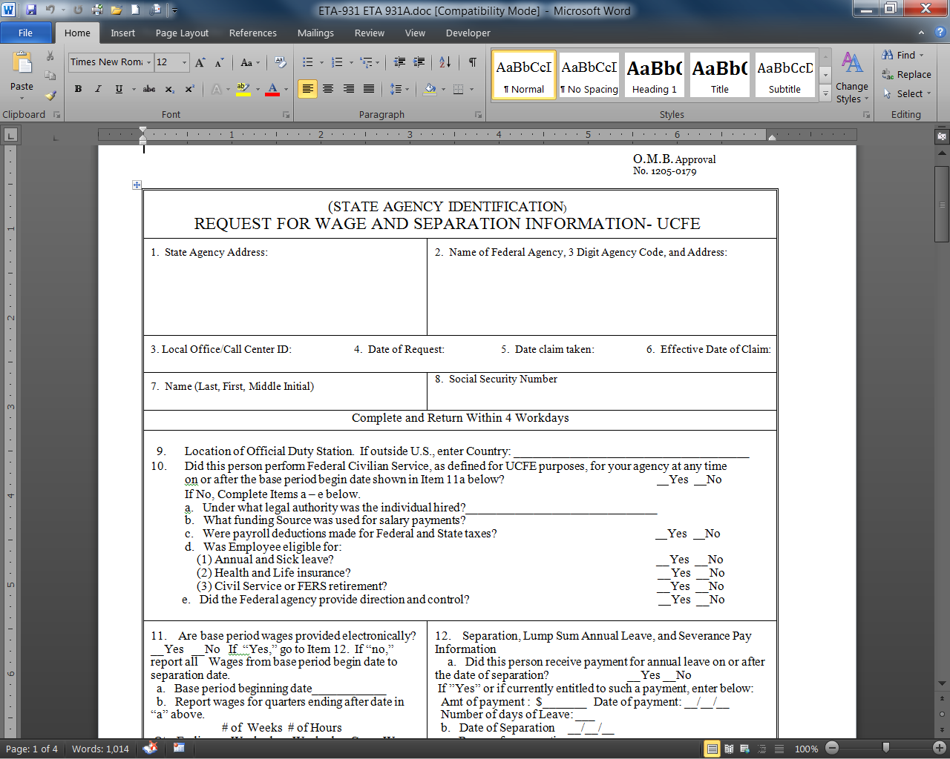
ETA-931, Request for Wage & Separation Information
Notes:
This is the top portion of the ETA-931. Items 1 through 8 require some basic information about the Federal agency and the claimant such as the name and address of the Federal agency and the claimant’s name and social security number. This information is pre-filled by the state.

Slide 17
ETA-931, Request for Wage & Separation Information
Notes:
Item 9 asks for the location of the Official Duty Station. As I mentioned before, this is important because it determines where the Federal wages should be assigned. Item 10 is used to determine if the claimant performed Federal civilian service that is covered under the UCFE program.

Slide 18
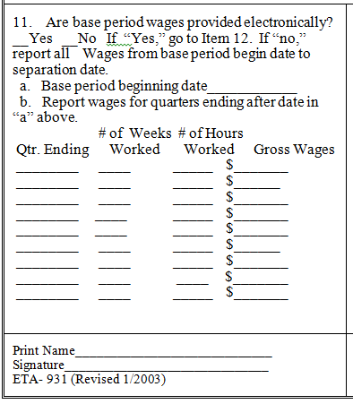
ETA-931, Request for Wage & Separation Information
Notes:
In this section of the form the Federal agency provides the most recent 9 quarters of wages paid to the individual. The state will use this information to determine monetary entitlement (including whether or not the individual earned enough wages to qualify for a UI claim, and if so, the weekly benefit amount, the maximum benefit amount, and the duration of the claim (in states with variable durations). The wages provided in this section should not include severance pay or lump sum annual leave, even though these are considered Federal wages. This information should be supplied in item 12. The state will provide the Federal agency with the period for which wages are needed in 11a.

Slide 19
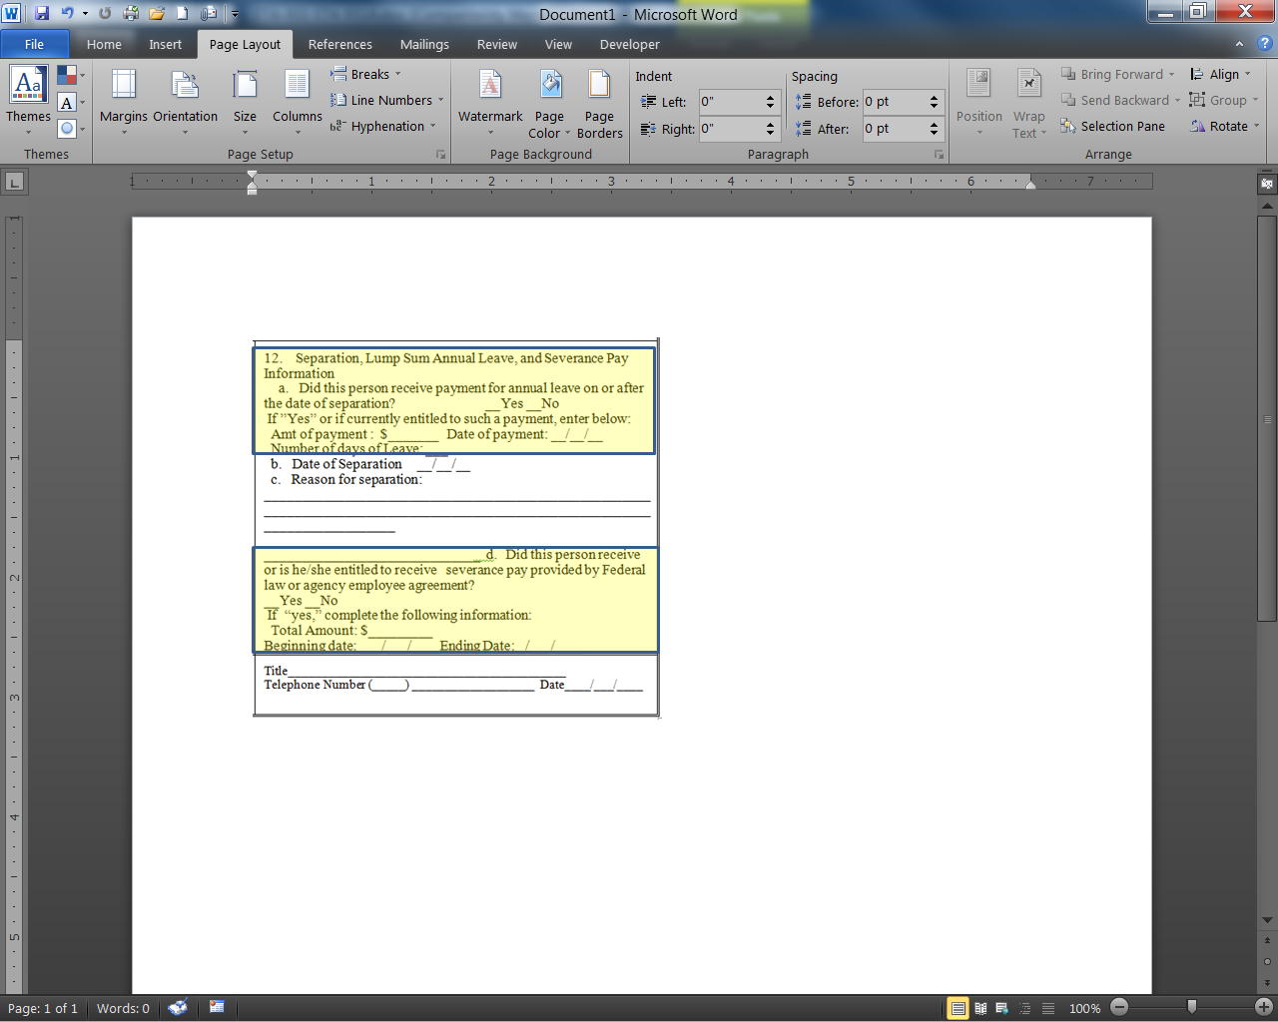
ETA-931, Request for Wage & Separation Information
Notes:
Part of section 12 of the ETA-931, the portions highlighted on the slide, asks about payments received for lump sum annual leave and severance pay. These wages are separated from the gross wages provided in item 11 because they will not be used to determine monetary eligibility, however they may be deductible from the claimant’s weekly benefit amount under state UI law.

Slide 20

ETA-931, Request for Wage & Separation Information
Notes:
This highlighted portion of section 12 asks for the reason for separation. If additional space is needed to provide this information, the Federal agency should attach a separate document with a detailed explanation of the reason for separation.
As noted before, non-monetary issues fall into two categories Separations and Non-Separations: There are generallly three types of separations (layoffs-due to lack of work, discharges and quits). Discharges occur when the employer terminates the employment relationship for reasons other than lack of work, and quits occur when the employee leaves his/her employment voluntarily. Discharges for misconduct and voluntary quits require the state to determine if the separation is disqualifying, this is done through fact-finding. It is incumbent upon, you, the employer to be responsive to the state agency’s request for information to ensure the integrity of the program and help to ensure that the Federal agency is charged appropriately.
Non-separation issues are anything other than separation issues. The primary non-separation issues are not being able and available to work, not seeking work, refusing suitable work, having deductible income, and failing to report as required. If you know that your former employee might have a non-separation issue you should also advise the state of that issue when you respond to this form (use a separate sheet of paper if needed).
Also, a determination is necessary if there is a question on whether the claimant’s activities constitute employment, or if the claimant received wages for employment sufficient to render him/her ineligible as “not unemployed” or “partially unemployed”. This is important to note in case of a furlough. During the 2013 furlough, many Federal employees filed for UCFE. Because Congress awarded back-pay after the shutdown ended, those employees who filed for and received UCFE benefits were found to not be unemployed. This created overpayments to individuals who were paid UCFE benefits during the furlough and were later denied the benefits because the “backpay” rendered them ineligible. The individuals ended up having to repay the UCFE benefits received.

Slide 21
ETA-931
Discharge
Why was the employee discharged?
What were the conditions of work?
What did the employer do to maintain the employer/employee relationship?
Notes:
So what is needed by the state to determine eligibility when the employee is discharged? First of all, the burden of showing that the discharge was for misconduct connected to the work falls to the employer. The state will need to know:
Why was the employee discharged? It is necessary to pinpoint the reason that an employer decided to discharge an employee. There may have been a number of incidents that occurred over a period of time; however, the state will attempt to pinpoint the incident, which finally led to the discharge. It may be important to know what happened on the last day and how the employer’s interests were affected. It may be important to explain why the worker was not discharged immediately following an act or omission, which later caused the employer to discharge the worker.
What were the conditions of work? Behavior that an employer has a right to expect may be outlined specifically in written agency or union agreement/rule. Practices or conduct peculiar to a particular job, a law or regulation which governs health and safety practices may be covered by commonly accepted standard practices that are in writing. This is often conveyed through an employee handbook or orientation training, or the employee standards. Copies of these documents (or a description of them) should be provided in the Federal agency’s response back to the state.
What did the employer do to maintain the employer/employee relationship? This focuses on the efforts of the employer to control or prevent the behavior that resulted in the discharge in order to establish both the reasonableness of the employer’s action and the claimant’s knowledge of the consequence of the conduct. For example, were warnings given, if so, the Agency needs to provide the documentation of the warnings.
Provide as much detail as you can. If you have copies of warnings or handbooks, or anything else that would support a discharge for misconduct, you should send them to the state as well.

Slide 22
ETA-931
Voluntary Quit
Why did the employee quit?
Was the reason for leaving personal or work related?
What were the conditions of work?
What steps did the employee take to remedy the situation prior to leaving?
Notes:
For voluntary quits, the burden of proving the quit was for a good reason falls to the claimant, however, the state will need to confirm some things with the Federal agency. The state will need to know:
When did the employee quit? What was the last day of work and the date of separation if different?
Why did the employee quit? What reason did the employee give you for quitting if any? This information is necessary for the state to try to determine the specific reason the employee decided to leave work. The state will consider the following regarding the reason the employee quit; was the reason for leaving compelling, would most reasonably prudent persons in a similar situation quit, how severe or immediate were the harmful circumstances, if the reason for separation is straightforward with no adverse effects related to work, for example, when someone voluntarily quits for retirement, a clear statement to that effect is all that may be needed (however, the state may also request information related to any annuity payments the individual may collect).
Was the reason for leaving personal or work related? States may or may not have “good cause” provisions in their law. Therefore, it is important to distinguish whether the employee left because of work related matters or for non-work related matters.
What were the conditions of work? If the reason for leaving was work-related, the state will need to examine the conditions of work. What did the employee have a right to expect from the employer? The employment agreement may be verbal or written, a matter of union contract, peculiar to a specific job, or a specific health or safety regulation. The working conditions may also be considered unacceptable due to a violation of commonly accepted employer practices such as fair work assignments.
What steps did the employee take to remedy the situation prior to leaving? The employee is generally expected to pursue reasonable alternatives prior to quitting a job. For example, did the employee ask for a transfer or a leave of absence? Did he or she pursue established grievance procedures? Did the employee give the job a fair trail? Or if alternatives were not pursued, would such action have been futile anyway (for example no alternative work schedules or transfers would have been available even if the employee asked)?

Slide 23
ADDITIONAL INFORMATION
For additional information on eligibility requirements and completing the ETA-931, please see the Unemployment Compensation for Federal Employees (UCFE) Federal Agency Responsibilities Related to UCFE: Guide to Responding to Wage and Separation Information Requests (ETA Form 931) at:
https://ows.doleta.gov/unemploy/unemcomp.asp
Notes:
For additional information on eligibility requirements and completing the ETA-931, please see the Unemployment Compensation for Federal Employees Federal Agency Responsibilities Related to UCFE: Guide to Responding to Wage and Separation Information Requests on the USDOL website listed here.

Slide 24
Appeals
Claimants and employers may appeal the states’ determination of eligibility.
Appeal levels:
  Before a referee or hearing officer;
  Decision made by a review board;* and
  State and federal court.
Notification of the state’s decision is provided to interested parties as determined by state law, which typically includes the claimant and Federal agency.
* Note: Not all states have a second or higher authority appeals body
Notes:
Once a determination of eligibility is made, if the Federal agency responded timely to the ETA-931, the Federal agency will be notified of the State’s decision.
Claimant’s can either be found eligible or can be found ineligible. If a claimant is found ineligible for benefits, he or she may file an appeal with the state agency. If the claimant is found eligible and the Federal agency does not agree with that decision, the agency can also appeal the decision. There are time limits for filing appeals, the filing deadline will be located on the Notice of Determination that is sent to the Federal agency. It is important that the appeal is filed timely, untimely appeals may not be heard by the State appeal agency.

Slide 25
Office of the Inspector General Findings on the UCFE Program
Late or no responses to request for wage and separation information;
Incomplete ETA-931s;
Incorrect information provided on the SF-8; and
Not returning phone calls or email inquiries
Notes:
So that concludes the questions on the ETA-931 and the overview of the determination and appeal process, now I’d like to talk a little bit about an audit of the UCFE program that was conducted in 2016 by the Office of Inspector General (OIG) and some common issues that have been reported to the Department of Labor by states.
The OIG found that some Federal agencies are not providing complete information on the ETA-931, in some cases no response is received from Federal agencies, and some agencies are not sending ETA-931s back within 12 days of the mailing date of the form. These findings are also supported by states.
By not responding to wage and separation requests within 12 days of the mailing of the ETA-931, UI claims are delayed and states will have to make a determination of eligibility based on the information available. For example, if a claimant stated that she was laid off from the Federal agency due to lack of work but the claimant was actually discharged for a disqualifying reason under state law and the Federal agency does not respond to the ETA-931, the claimant may be found eligible for benefits and the agency would be charged for those benefits. These charges decreases the amount of funds available in the Federal agencies budget that could have been used for other things such as training, hiring, or other agency initiatives.
States have also indicated that they often receive incomplete ETA-931s from Federal agencies. When Federal agencies do not provide enough information about the reason for separation on the ETA-931, the states have to send a follow up request for additional information. This would be the ETA-934. This requires agencies to have to look at the claimant’s documents a second time to provide the additional information needed from the state.
The correct contact information is not always provided on the SF-8. When incorrect contact information is listed on the SF-8, the states end up sending the ETA-931 to the wrong location which causes delays in the UI claims process. This is also an inconvenience to the Federal agency location that received the information. This location is spending unnecessary time looking for a former employee that never worked for that location. Also, that location would have to mail back the ETA-931 informing the state that the individual did not work there.
States have indicated that they are not getting phone calls or email inquiries returned. By not returning phone calls or email inquiries the UI claims process is delayed and states will have to end up making a determination on the claim with available information.

Slide 26
Reminders
Provide an SF-8 with the correct agency contact information to all separating Federal employee.
Respond timely to all requests for wage and separation information.
Provide detailed information regarding the separation.
Notify the Department of Labor of any address and contact information changes.
Notes:
I know I have gone over a lot of information during this presentation but here are a few reminders regarding the UCFE process.
Provide an SF-8 with the correct agency contact information to all separating Federal employees at the time of separation;
Respond timely to all requests for wage and separation information;
Provide detailed information regarding the separation; and
Notify the Department of Labor of any address and contact information changes.

Slide 27
References
Title 5, United States Code, Chapter 85, (8501-8509) Code of Federal Regulations, Title 20, Part 609.3
UCFE Instructions for Federal Agencies http://ows.doleta.gov/unemploy/pdf/UCFE.pdf
ET Handbook No. 391, UCFE Handbook for State Agencies http://wdr.doleta.gov/directives/corr_doc.cfm?DOCN=2233
Training and Employment Notice No. 32-15, and
Unemployment Insurance Program Letter Numbers:
  20-10 & 31-13, http://wdr.doleta.gov/directives/
Notes:
The following references may be helpful to you in understanding more about the UCFE program.

Slide 28
General UCFE Inquires
  Jorge D. Colon,
    US Department of Labor
      Colon.Jorge,d@dol.gov
        202.693.0173
Billing UCFE Inquiries
  Cynthia M. Greene
    US Department of Labor
      greene.cynthia.m@dol.gov
        202.693.2724
Notes:
This ends the presentation about the UCFE program. If you have questions about the program, please don’t hesitate to reach out to DOL. For general inquiries, you can contact me Candace Edens and for UCFE billing questions, you can contact Cindy Le.
Thank you.

