Slide 1
STEP 1:
Selecting Data for Model Building
Profiling Methods Seminar
April 2016

Slide 2
What data do we need?
Data Collection

Slide 3
Data Collection
Things to keep in mind:
  Data Availability
  Various State Data Sources
  Discriminatory Data (No sex, race, religion, etc.,)
  Personally Identifiable Data (PII)
  Variable Computations
Notes:
Basic overview of some things to consider – IT people will be collecting the data for you, you’ll need to communicate what you need.
Data availability at model run time -- Starting at the start of a claimants benefit year…
to the system through which the profiling model will be run
Can and should come from multiple sources – but must be available when run

Slide 4
Data Collection Cont.
File format
  Based on your personal comfort level with data file manipulation and/or Statistical Software package being used.
    ASCII , CSV, TXT, XLS, XLM…
Notes:
Most modern stats packages can handle a wide variety of data file formats now so not too big a deal.

Slide 5
Data Collection Cont.
General Format of data
  Rectangular layout
  Rows = claimants
  Columns = variables
Claimant ID | Claim File Date | WBA | Potential Duration | …
64888 | 1/1/2014 | 350.00 | 26.0 | …
67872 | 3/31/2014 | 355.00 | 26.0 | …
76648 | 4/13/2014 | 290.00 | 18.0 | …
78899 | 1/15/2014 | 250.00 | 16.0 | …
89931 | 11/21/2013 | 355.00 | 26.0 | …
64872 | 9/30/2013 | 340.00 | 24.0 | …
48637 | 10/28/2013 | 355.00 | 26.0 | …
Notes:
Claimant ID – non-PII value

Slide 6
Data Collection Cont.
  Determine Sample Set and Time Period
    Built on a Spine (SS number/Claimant ID…)
      Individuals with Valid, Payable Claims
  Use Benefit Year End Dates
    Example: BYE Dates covering the past 12 to 24 months
Notes:
Note, the SS number MUST be stripped from data if sending to the national office and likely for internal model building as well for security
Be sure you only include claims with COMPLETED benefit years

Slide 7

Targeted Population
What is the Targeted Population?
  Valid Payable Claim
  Eligible for Referral
  More Recent Data
  Completed Benefit Year
  Minimum 12 Months
    (Multiple years useful for further analysis)
Notes:
Eligible for Referral -- Non Union Affiliated – Not “job attached” / No Recall date – etc.
More Recent Data – Catch most recent economic conditions
Completed Benefit Year – Must be a completed BY to assure exhaustion information complete.
Minimum 12 Months – Include at least 12 months of data to account for any seasonality in benefit exhaustion…

Slide 8
Data Selection
What Data Do We Need?

Slide 9
What are we looking for?
Data should describe the flow of the claimant
  → Previous employment and background
  → Benefit Eligibility
  → Interactions with Workforce Development System
  → Mandated/Voluntary Status
  → Outcome of claim

Slide 10
What Kinds of Data to Use?
UI characteristics and demographics taken with the initial claim
UI benefit entitlement and benefits paid
Details on any claimant interventions such as WPRS, REA, ERP, rapid response, etc.
Data from workforce registration in the one stop
Services provided to the claimant, whether mandatory or voluntary
Actions taken against claimants who did not respond to a mandatory referral
Wages reported to the state in the quarters after the claim became payable
Any other known possible outcome data which might be of interest to the state such as NDNH, state employment records, etc.
Notes:
Use the spine/SS number to cross reference data sources
Re: Interventions – to take into account regarding whether or not claimant exhausted or not. Whether it had effect on that – could skew outcome if it did and is not accounted for.

Slide 11
UI Claims and Benefits Data
  Maximum Benefit Entitlement
  Total Benefits Paid
  Potential Duration
  Actual Duration
  WBA
  Date of Initial Claim
  (Benefit Year Begin and End Dates)
  Prior UI Experience?
  Referral to WPRS/REA/RESEA?
  Dependents allowance?
  Partial Claim?
  Separation Reason
  Claim type
  Inter-State Claim?
Notes:
Some computed based on others

Slide 12
Claimant Characteristics and Indicators of Economic Climate
Base Period Wages (Quarterly)
Alternative Base Period Indicator
Wage Replacement Rate
High Quarter Wage Rate
Separation Date
Education
Tenure (start & end dates with separating employer)
Industry NAICS code of separating employer
Job SOC/ONET code with separating employment
State Unemployment Rates (total and/or insured)
Number of Base Period Employers
Notes:
Looking at important data by “Tiers” with Tier 1 being the most important to include in your dataset.
Some of these would be computed from claimant data – Wage replacement rate – high quarter wage and high quarter wage rate -- tenure

Slide 13
More Variables to Consider
County Designation (FIPS code)
Local Office Designation
Local Area Unemployment Rate (LAUS) *
Indicator of severance/social security payments
Number of years worked
Household member employed?
Prior UI Spells?/Number of Benefit Years established?
# of Re-opens during Benefit Year
Tenure in occupation
Mass Layoff indicator
Filing Method (Web, phone, in person)
Child Support?
Seasonal Job Indicator
Notes:
Less necessary but potentially useful

Slide 14
The Utah Model (2009 spec)
Notes:
It varies.
Different states have very distinctly different programs and economic conditions so no silver bullet.
Some of the standard key variables that should be reviewed at a minimum

Slide 15
UT’s Model
 | Variable Specification
Education | Categorical: Less than 12 years High School Diploma > 12 years and < 16 years > College Degree > Greater than 16 years
Job Tenure | Categorical: Less than 1 year >= 1 year and < 4 years >= 4 years and < 8 years >= 8 years and < 15 years >= 15 years

Slide 16
UT’s Model (cont.)
 | Variable Specification
Industry | Categorical: 2 digit NAICS Code
Wage Replacement Ratio | Continuous
High Quarter Wage Rate | Continuous
Delay in Filing | Continuous: Days delayed
Month in year | Categorical: 12 Months
Severance Status | Categorical: 1/0 - yes/no

Slide 17
Other Commonly Used and Recommended Variables
Occupation: Categorical 2 Digit ONET/SOC
  + Additional Digits Where Applicable
Unemployment Rate
  State Level TUR
  Local Areas (Metro/Regional/County) TUR
  Seasonally adjusted or non-seasonally adjusted*
Notes:
SA vs NonSA TUR can be used to control for changes in expected outcomes when using data from a period of contraction or expansion to build the model and also can capture seasonality if regular updates to the rates are easily manageable.

Slide 18
Recommended Variables cont.
Delay in filing for benefits in:
  Weeks
  Months
  Categorical Breakouts
Education as a continuous variable
Job tenure as a continuous variable
Number of Base Period Employers
  Categorical
  Continuous

Slide 19
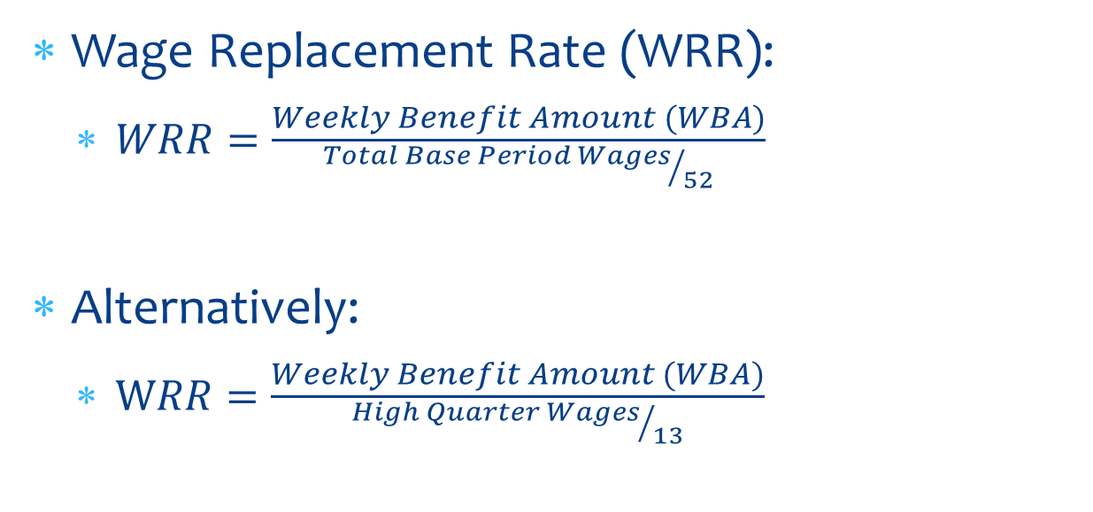
Key Calculated Variables cont.
Wage Replacement Rate (WRR):
  $WRR=\frac{Weekly Benefit Amount (WBA)}{{Total Base Period Wages}/{52}}$
Alternatively:
  $WRR=\frac{Weekly Benefit Amount (WBA)}{{High Quarter Wages}/{13}}$

Slide 20
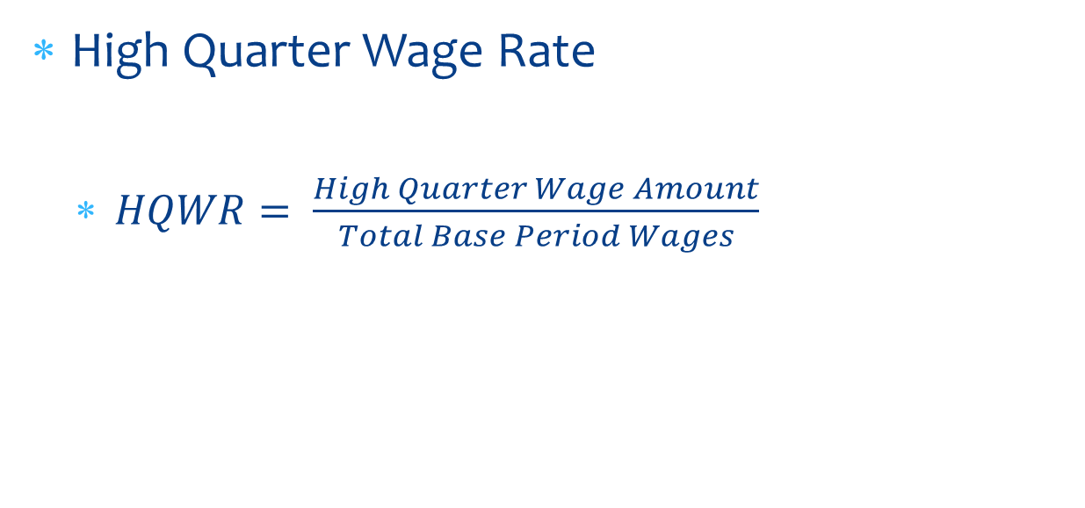
Key Calculated Variables Cont.
High Quarter Wage Rate
  $HQWR= \frac{High Quarter Wage Amount}{Total Base Period Wages}$

Slide 21
Further calculations to keep in mind
Tenure = last day worked – first day worked
Delay in filing = file date – last day worked
Computed 2 digit Industry (NAICS) or Occupation (ONET-SOC) – often need to be parsed out from the full 6 digit values
Notes:
Dates need to be handled according to the stats software being used.
SPSS will give a number in seconds → to get to days divide by 60 for minutes, by 60 again for hours and by 24 for days.
7 for weeks
52 for years, etc…

Slide 22
Additional Calculated Variables
Exhaustion Rates in place of categorical variables
  Useful for variables with lots of categories such as NAICS codes and OCC codes
  Produce a crosstab of variable by exh
  Use the % of claimants in each category that exhausted
  Code that exhaustion rate as a new variable
    (i.e. if NAICS = 21 then compute NAICS_exh = 0.341 for 34.1%)
  Rates can be updated as new data becomes available
    Recommend using a lookup table for this

Slide 23
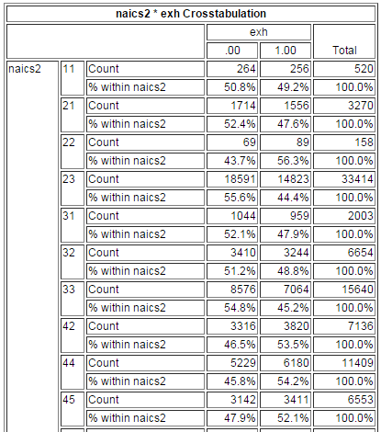
Example of a Crosstabulation of 2 Digit NAICS Codes versus Benefit Exhaustion
The Percentage values in the highlighted column represent the exhaustion rates of each NAICS code group from this dataset. These can be recoded as a continuous exhaustion rate variable and used in the model.

Slide 24
Note:
These exhaustion rates must be updated with each model update
Additional updates of the exhaustion rates between broader model updates are also possible

Slide 25
Additional Calculated Variables
Can also look at a continuously updated UI program exhaustion rate using ongoing claims data
Number of Claimants that Exhausted Benefits in Month (t)
Number of First Payments in Month (t-6)
Or
Number of Claimants that Exhaust in Months t thru t-5
Number of First Payments in Months t-6 thru t-11
(second formulation is a rolling, 6 month moving average, and smooths the exhaustion rate)
Notes:
If easy to code into model

Slide 26
The Dependent Variable:
UI Benefit Exhaustion
Notes:
Does anyone know what their state’s existing model uses as the definition of an exhaustee?
In the context of a model used to identify UI beneficiaries likely to exhaust, how would you define exhaustion?
What about claimant using 95% of benefits?

Slide 27
Defining an Exhaustee
Standard Definition:
  A claimant that draws 100% of all available benefits
  Total $ Collected (Paid) = Total $ Entitled
Notes:
$0 remaining balance?...
Within $1 of a $0 balance…

Slide 28
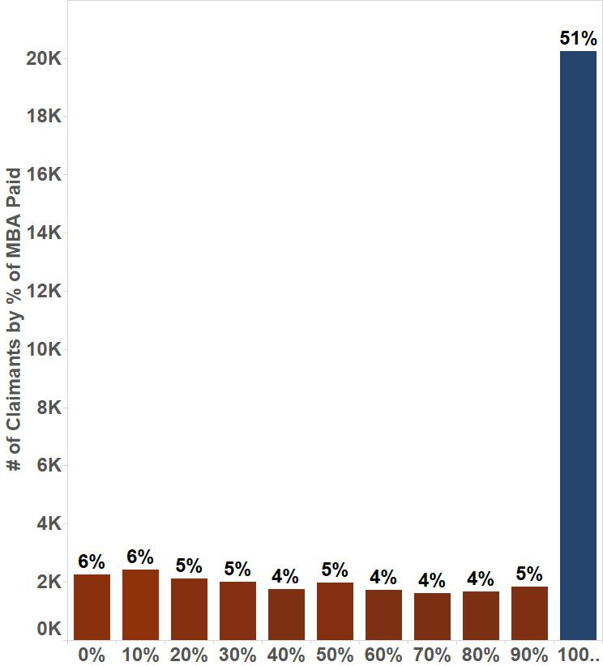
Claimants by % of MBA Paid
(AMT_PAID / MBA)
Notes:
If we look at a bar chart of the number of claimants in each percentile of exhaustion using UTAH’s data we see this.
51% of all claimants in dataset exhaust their benefits while the rest are spread fairly evenly using between 0% and 90% of their entitlement

Slide 29
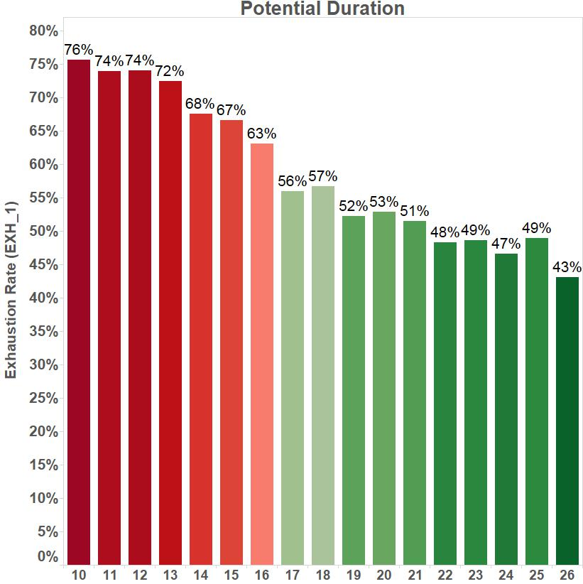
Exhaustion Rates (100% of Potential Benefits Paid) by Weeks of Potential Duration
Notes:
Now we see the exhaustion rates based on claimants potential duration.

Slide 30
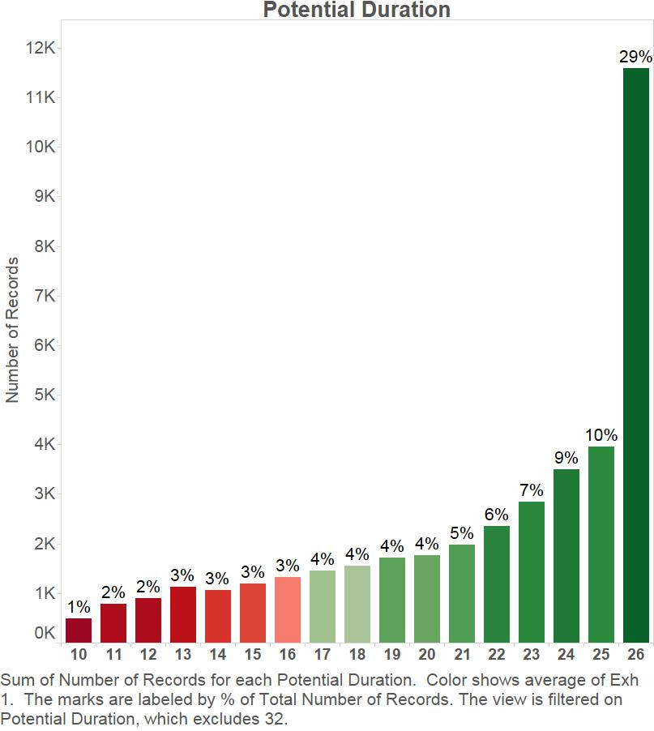
Number of Claimants by Potential Duration
Notes:
Shows the numbers of claimants based on the potential duration

Slide 31
Variables in Utah’s Model
Education | High Quarter Wage Rate
Job Tenure | Delay in Filing
Industry | Month of Year
Wage Replacement Rate | Severance

Slide 32
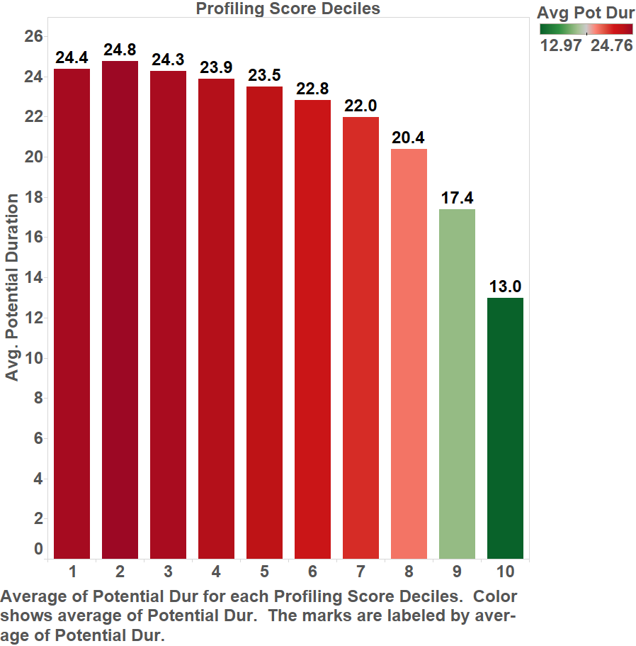
Model Scores Broken into 10 Equal Sized Groups Compared to the Average Potential Duration
Based on the Utah Model Specs with 100% Benefit Exhaustion
Notes:
Despite low volume of claimants at shorter durations, the model will still heavily target claimants with short durations
10 equal sized groups of roughly 3,961 cases each sorted by the profiling score produced using the Utah model built on the current data set.
(not the actual model state was using but built off current partial dataset using model specs shown earlier)
This model spec used 100% exhaustion of available benefits and this chart demonstrates wat we can expect to see using this definition in a variable duration state.

Slide 33
Alternative Approaches to Modeling Long Term Unemployment
Break out claimants into two separate models
    1 → w/ potential durations greater than or equal to 20 weeks
    2 → w/ potential durations of less than 20 weeks
  Determine an appropriate referral process from the two pools of claimants
Use an alternative dependent variable (duration of actual unemployment spell would be the ideal variable)
Notes:
Discuss
What about reduced duration states---
Reduced duration states with changing MAX potential duration based on TUR?

Slide 34
Alternative Dependent Variables
Define the dependent variable as claimants receiving >= X weeks of benefits
Define dependent variable as claimants receiving X% or more of the states Maximum Total Benefit Amount
Some alternate identifier of long term unemployment
Notes:
None of these are ideal as they are akin to limiting the dependent variable to claimants with potential durations of at least X number of weeks which creates issues with the modeling process

Slide 35
Considerations When Modifying the Targeted Population
  Continuous Wage Replacement Rate
    Exh_1 = 100% of Potential Benefits Paid
      WRR Coefficient = 1.727
    Exh_2 = 100% of Potential Benefits Paid AND Potential Duration >= 18 weeks
      WRR Coefficient = -3.244
Notes:
Changing your target populations means that the relationship between variables and the dependent variable will also change

Slide 36
Issues relating to use of an Alternate Dependent
Problems related to identifying benefit exhaustees with potential durations below a certain threshold as non-exhaustees
Effectively blocks shorter potential duration claimants from referral
Inclusion of these claimants then creates misleading dynamics within model
Weakens overall model performance
  Claimants exhausting short potential durations with other characteristics of desired target population skew model coefficients

Slide 37
Other Variations of the Dependent Variable
Expand target to include claimants receiving at least some percentage of their total entitlement (i.e. claiming 90% of total entitlement instead of 100%)
Broadens the profiling target population to include long duration claimants that might not necessarily be exhausting that could still benefit from RESEA and be able to return to work sooner OR find better employment with assistance
Notes:
Would be just over 23 weeks of a potential 26 week claim

Slide 38
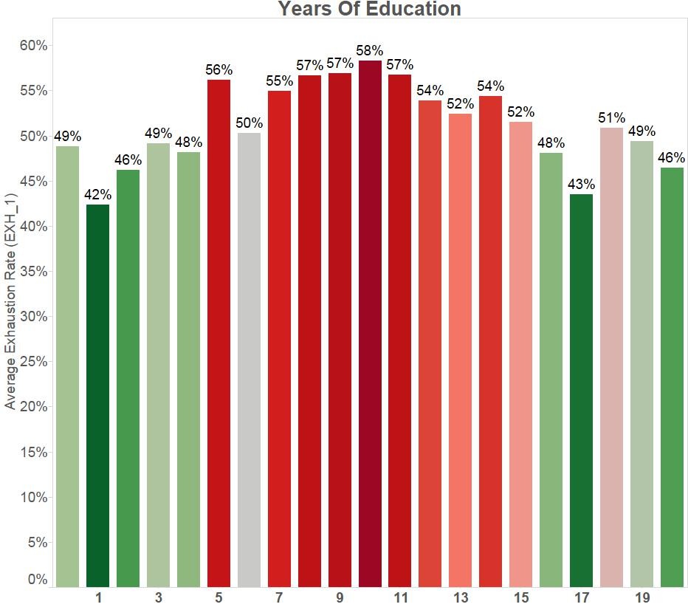
100% Benefit Exhaustion by Number of Years of Education
Notes:
Relationships of the dependent variable to claimant characteristics will change, often significantly.

Slide 39
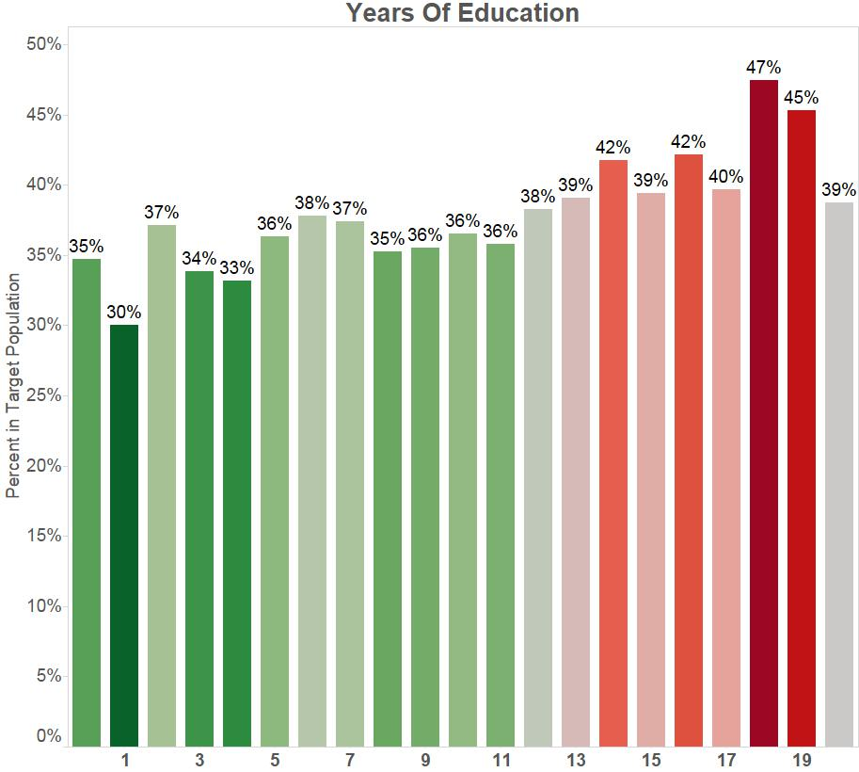
Alternate Dependent Variable by Number of Years of Education
Notes:
Dependent variable specified as those receiving at least 20 weeks of benefits (actual duration >= 20

Slide 40
Defining the Dependent/Target Population
How you define your target population is up to you and your state
  Be aware of the issues with some alternative dependent variable definitions with relation to the logistical modeling process
  Legally must be based on expectations of identifying potential long-term unemployed claimants that will likely benefit from employment services
Players in the decision can include
  RESEA Coordinator
  WPRS Coordinator
  Employment Services Representatives
  Others
Decision should be made based on who the state feels would best be served by the employment services while fitting remaining within legal parameters of Section 303, SSA.

