Slide 1
USING SPSS

Slide 2
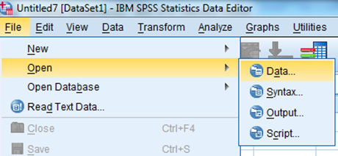
BASICS
What is SPSS?
SPSS is a windows based statistical software package that works with other programs including spreadsheets, data bases, and word processors.
1. File
2. Open
3. Data

Slide 3
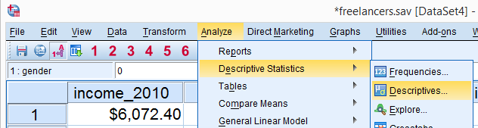
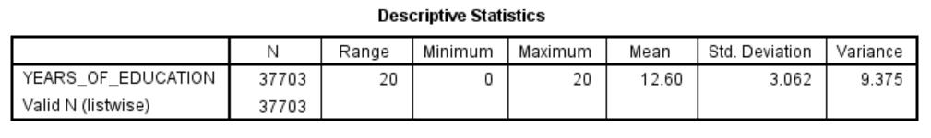
RUNNING DESCRIPTIVE STATISTICS
Analyze
Descriptive Statistics
Descriptives...
Choose YEARS_OF_EDUCATION
Options
OUTPUT WINDOW:
TO PRINT: File → Export → PDF

Slide 4
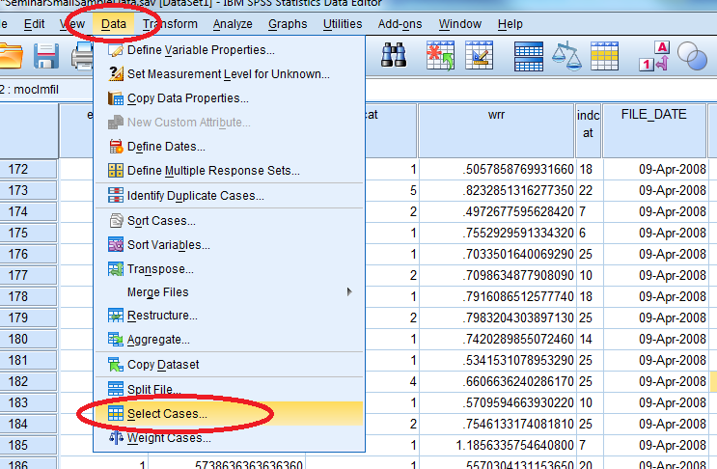
MODIFYING A DATABASE
Apply Filters:
Data
Select Cases…

Slide 5
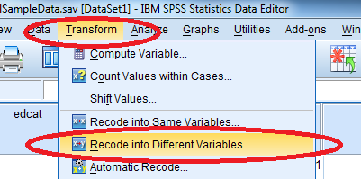
TRANSFORMING VARIABLES
Education Variable
0 – Less than 12 years
1 – HS Diploma
2 – 12 < education years<16
3 – College Degree
4 – Greater than 16 years
Transform
Recode into Different Variables

Slide 6
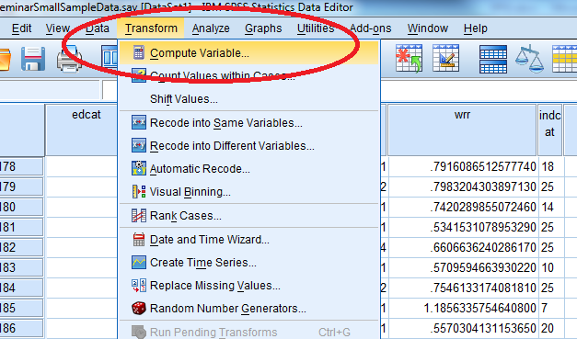
COMPUTING VARIABLES
Transform
Compute Variable…
EX: CAT_ED = 0

Slide 7
MEASURES OF CENTRALITY FOR QUANTITATIVE VARIABLES

Slide 8
NOTATION
POPULATION (N): All the elements from a set of data.
U₁, U₂, ..., U_{N}
SAMPLE (n): Consists of one or more observations from the population.
y₁, y₂, ..., y_{n}

Slide 9



MEAN (AVERAGE)
Definition: It is the sum of individual scores divided by the number of individuals.
A parameter is a measurable characteristic of a population.
The mean of a population is defined as:
Note: The population total is defined as τ = Nμ =
A statistic is a measurable characteristic of a sample.
The mean of a sample is defined as:

Slide 10
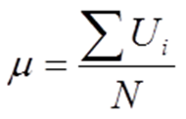
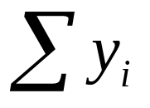
EXAMPLE (MEAN)
POPULATION (N = 6)
U₁ = 3
U₂ = 1
U₃ = 4
U₄ = 2
U₅ = 2
U₆ = 0
Formula for mean:
= (3 + 1 + 4 + 2 + 2 + 0) = 12
= 12 / 6 = 2
SAMPLE (N = 3)
y₁ = 4
y₂ = 3
y₃ = 0
Formula for mean:
= (4 + 3 + 0) = 7
= 7 / 3 = 2.333…

Slide 11
Years of Education in the Seminar Small Sample Data Set
MEAN: 12.60

Slide 12
MEASURES OF DISPERSION (VARIATION) FOR QUANTITATIVE VARIABLES

Slide 13
RANGE
In arithmetic, the range of a set of data is the difference between the largest and smallest values.
Maximum = 20
Minimum = 0
Range = 20 – 0 = 20

Slide 14
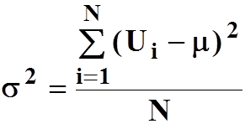
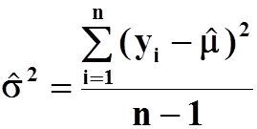
VARIANCE
Variance measures how far a set of numbers are spread out.
Small variance → data points tend to be very close to the mean (expected value) and hence to each other
High variance → data points are very spread out around the mean and from each other
POPULATION: SAMPLE:

Slide 15


STANDARD DEVIATION
Standard deviation (SD) is a measure that is used to quantify the amount of variation or dispersion of a set of data values.
POPULATION: SAMPLE:

Slide 16
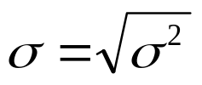


EXAMPLE (VARIANCE AND STANDARD DEVIATION)
POPULATION (N = 6)
U₁ = 3
U₂ = 1
U₃ = 4
U₄ = 2
U₅ = 2
U₆ = 0
Mean = = 12 / 6 = 2
Variance =
= [(3-2)² + (1-2)² + … + (0-2)²] / 6
= 1.67
SD = = = 1.29
SAMPLE (N = 3)
y₁ = 4
y₂ = 3
y₃ = 0
Mean = = 7 / 3 = 2.33
Variance =
= [(4 – 2.33) ² + (3 – 2.33) ² + (0 – 2.33) ²]/(3 – 1) = 4.33
SD = = = 2.08

Slide 17
Years of Education in the Seminar Small Sample Data Set
STANDARD DEVIATION: 3.062

Slide 18
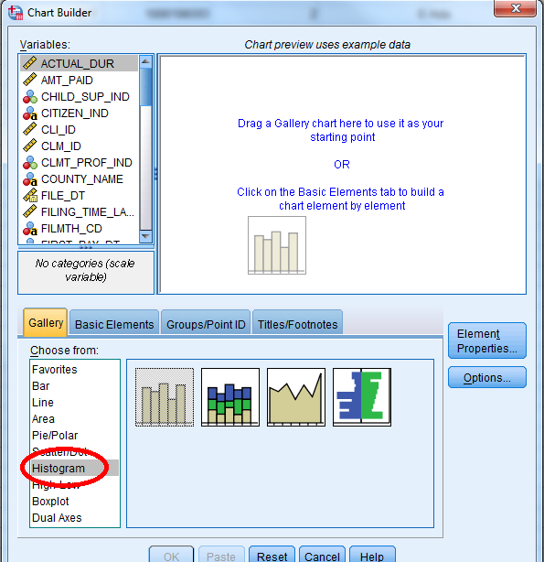
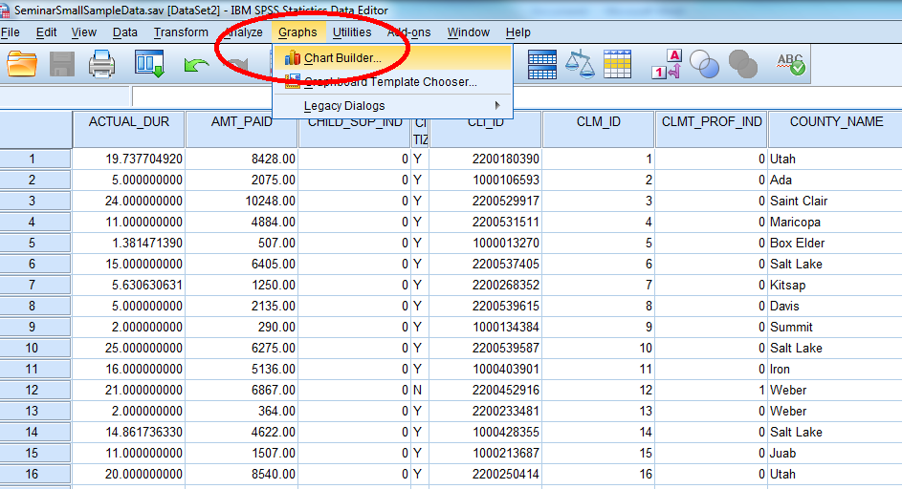
HISTOGRAM
Graphs
Chart Builder
Histogram

Slide 19
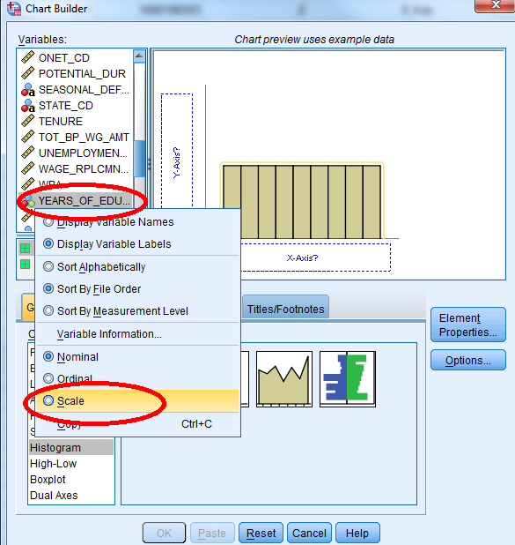
HISTOGRAM
NOT ACTUAL RESULTS
Drag Histogram chart to Chart Preview
Right click Years_of_Education to change to Scale
Drag Years_of_Education to X-Axis

Slide 20
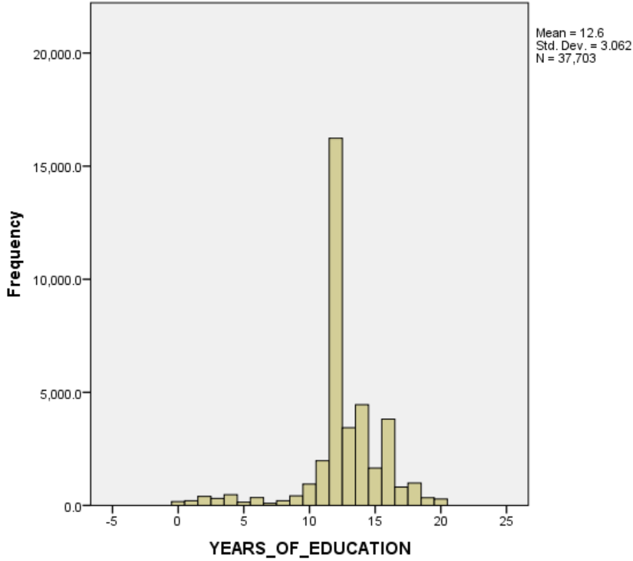
HISTOGRAM

Slide 21
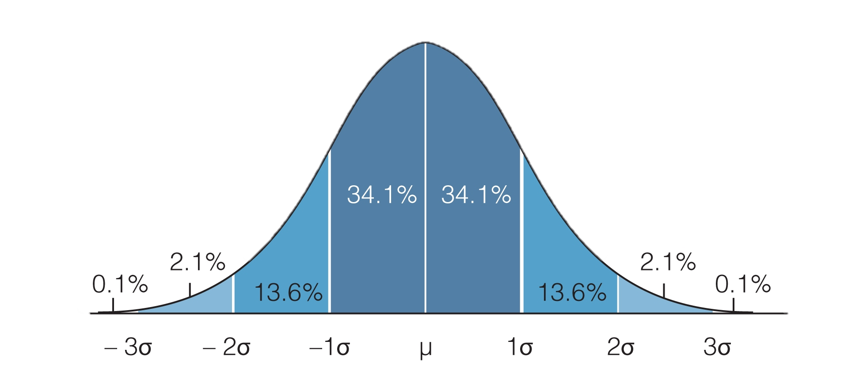
INTERPRETATION OF STANDARD DEVIATION
Empirical Rule: If histogram of a population of data is bell-shaped:
µ + 1σ contains about 68% of the data.
µ + 2σ contains about 95% of the data.
µ + 3σ contains about 99.7% of the data.

Slide 22
Years of Education in the Seminar Small Sample Data Set
We would expect to find 95% of the observations between
µ + 2σ
= 12.60 + 2(3.062)
= (6.476; 18.724)

Slide 23
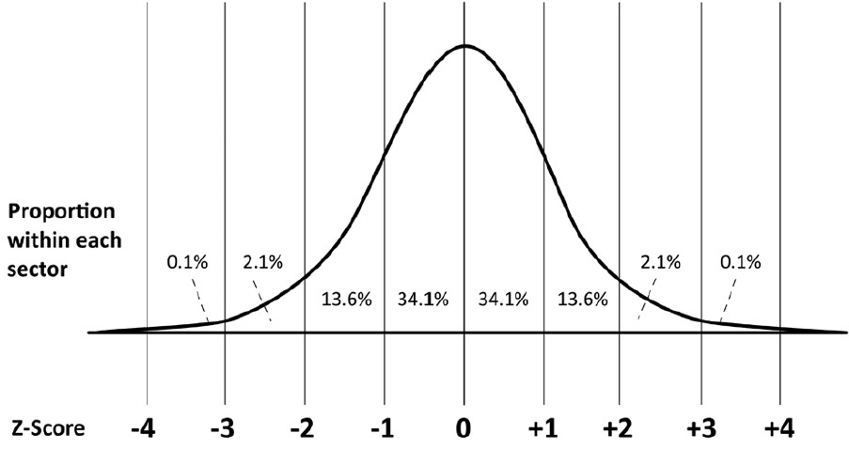
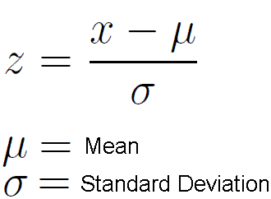
Z-SCORES
A Z-Score is the distance between an observation and the mean expressed in units of the standard deviation.

Slide 24
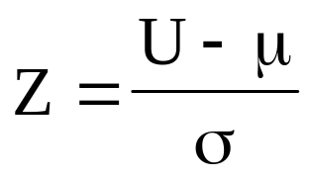
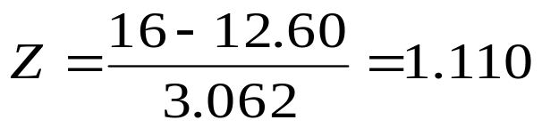
Years of Education in the Seminar Small Sample Data Set
If the value of Years_of Education is 16, it’s Z-Score is:

Slide 25
DESCRIBING A QUALITATIVE VARIABLE

Slide 26
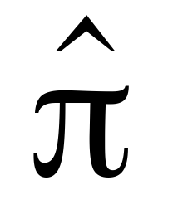
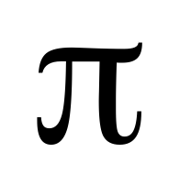
DEFINITION AND NOTATION
Qualitative variables have values that represent categories.
The parameter that is generally of interest is the proportion of items in the population that have a particular characteristic of interest (i.e., are in a particular category).
Example: The proportion of claimants with at least a high school education.
POPULATION: SAMPLE:

Slide 27
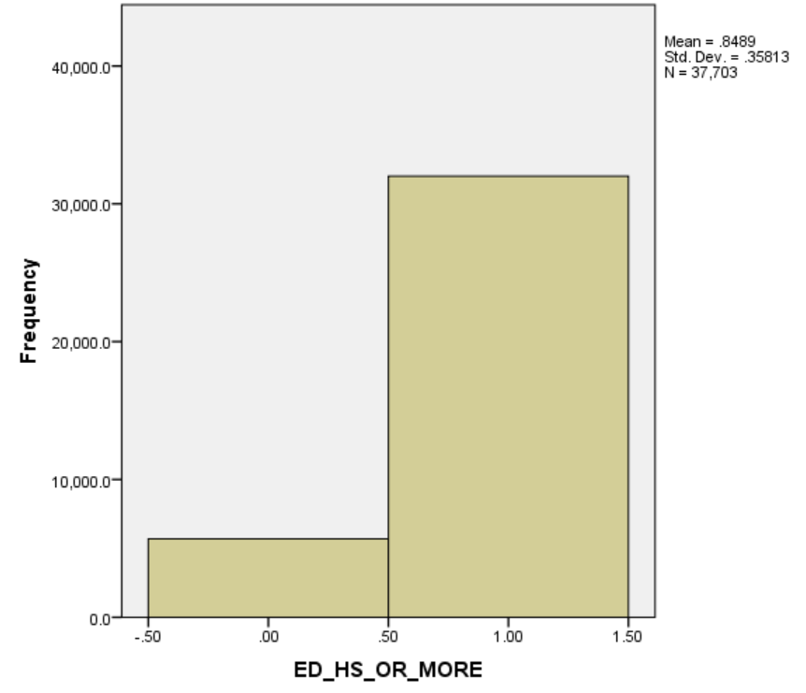
HISTOGRAM

