Slide 1
DATA PREPARATION

Slide 2
PARSIMONIOUS MODEL
Definition: A model that accomplishes a desired level of explanation or prediction with as few predictor variables as possible.
Parsimonious models have always been the default go-to in model selection because they are desirable not just for computing requirements, but also for generalization performance.
Notes:
The traditional approach to statistical model building involves seeking the most parsimonious model that still explains the data. The rational for minimizing the number of variables in the model is that the resulting model is more likely to be numerically stable, and is more easily generalized. The more variables included in the model, the more dependent the model becomes on the observed data.

Slide 3
VARIABLE SELECTION ANALYSIS
Independent Variables: Education, Job Tenure, Unemployment Rate, and Occupation
Question To Ask: Is the relationship between these variables and the Probability of Exhaustion (Outcome) linear?
Nominal, Ordinal, and Continuous Variables with only a few integer values →
Plot Mean Outcome vs. k levels of the independent variable
Continuous Variables → Group Variables → Plot Mean Outcome vs. k levels of the independent variable
Continuous Variables → Check for linearity → Reject variable if the true relationship is symmetric or U-Shaped Function
Notes:
The selection process should begin with a careful univariate analysis of each variable. Let’s look at education, job tenure, the unemployment rate, and occupation. Is the relationship between these variables and the probability of exhaustion linear? How can we tell?
For nominal, ordinal, and continuous variables with only a few integer values, we suggest this be done with a plot of mean outcome versus the k levels of the independent variable.
For continuous variables, the variable must first be grouped, and then a plot of mean outcome versus the k levels of the independent variable can be constructed.
For continuous variables we should check the assumption of linearity. Note also that if the true relationship is a symmetric or U shaped function, the variable will never enter the model even if it is important.

Slide 4

FREQUENCIES
Analyze → Descriptive Statistics → Frequencies… →
YEARS_OF_EDUCATION, TENURE_YRS, UNEMPLOYMENT_RATE, ONET_2
Create Rounded Tenure (RND_TEN_YRS)
Create Cleaned Rounded Tenure (CLN_RND_TEN_YRS)

Slide 5
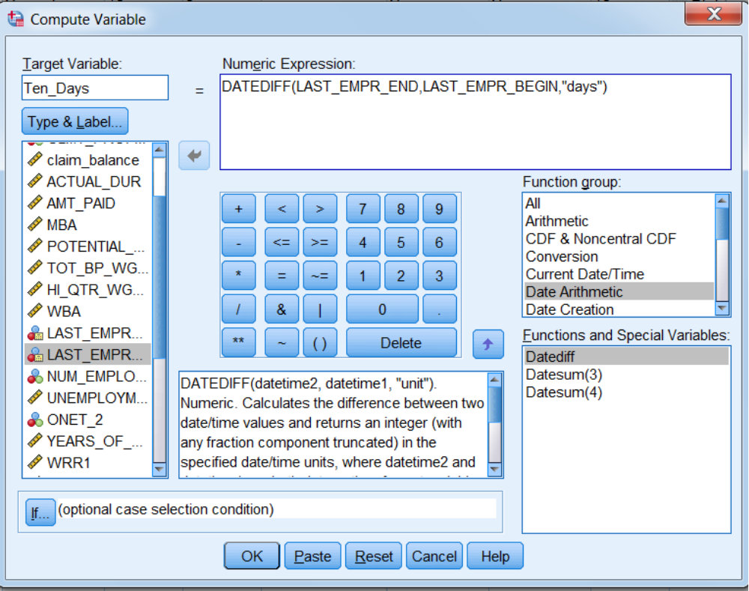
Calculate Job Tenure in Days

Slide 6
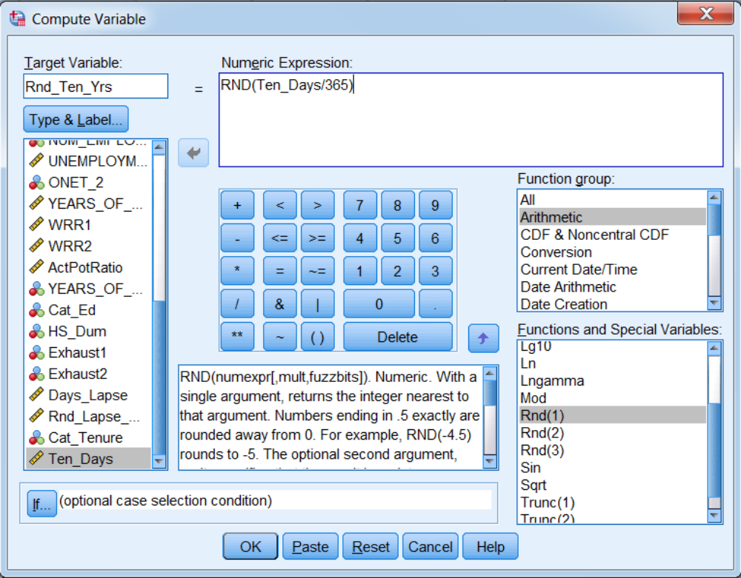
Convert to Years and Round

Slide 7
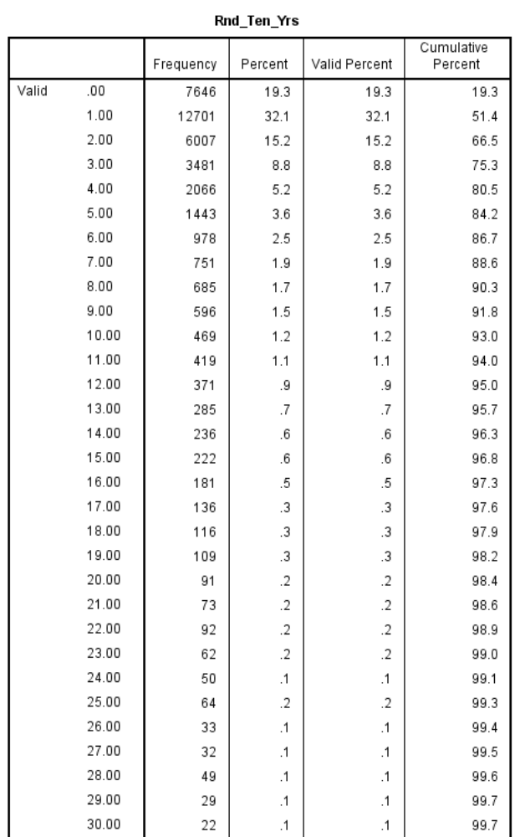
May want to truncate values greater than 25

Slide 8
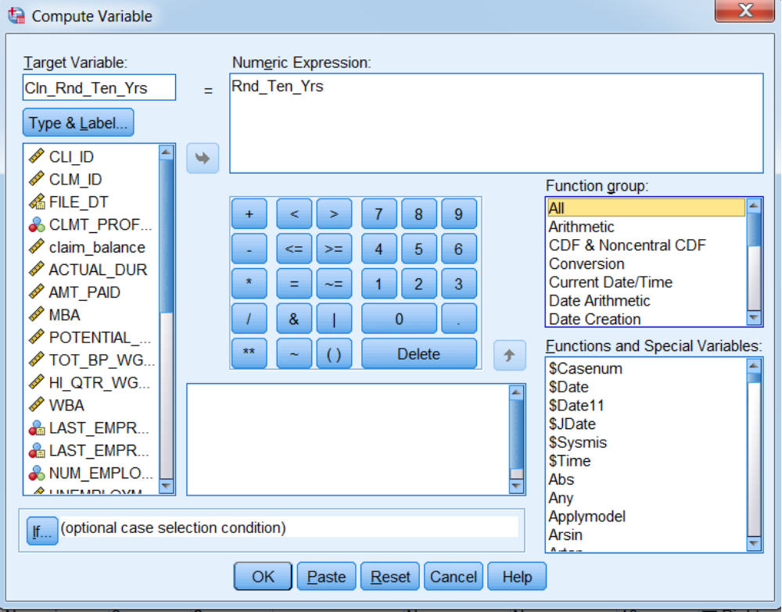
Create Copy of Rnd_Ten_Yrs

Slide 9
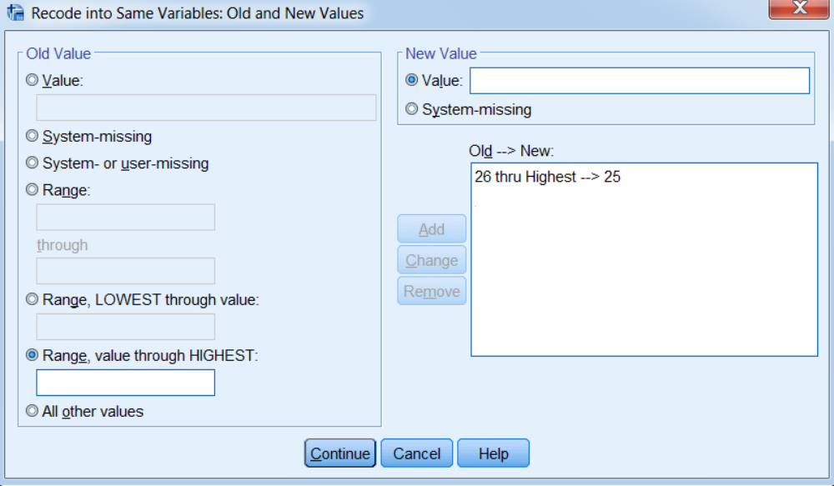
Truncate Values Greater Than 25

Slide 10
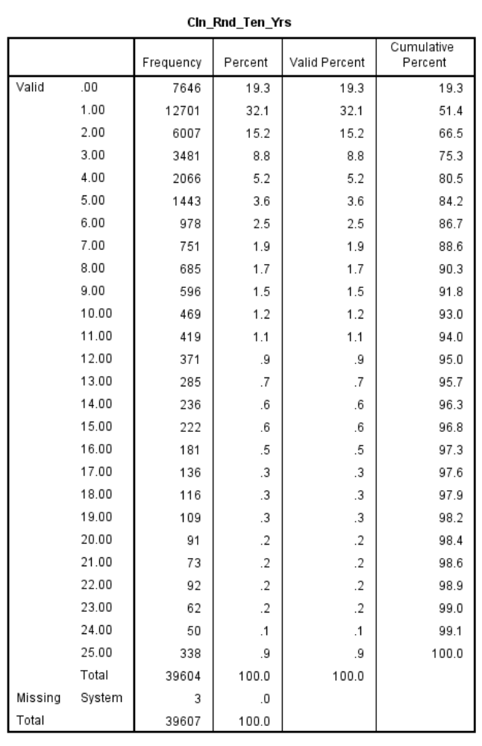

Slide 11
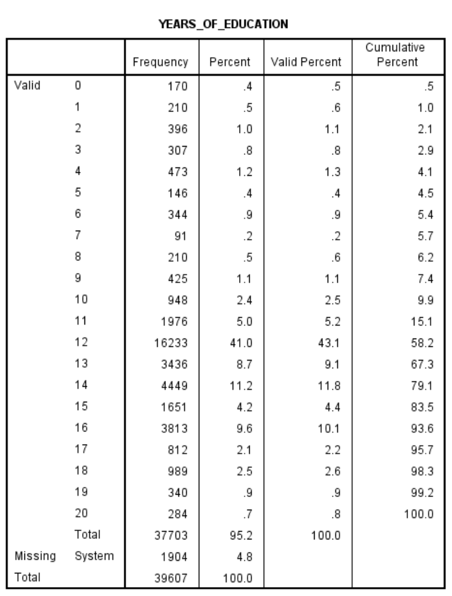

Slide 12
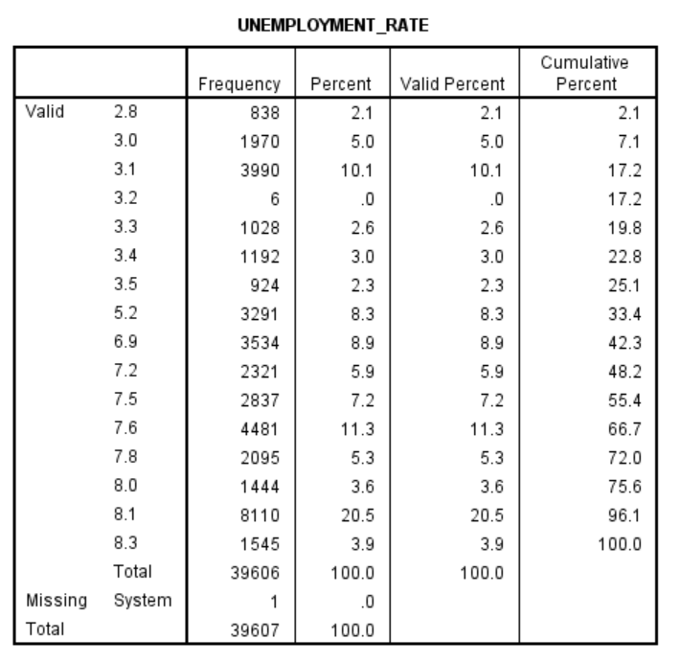

Slide 13
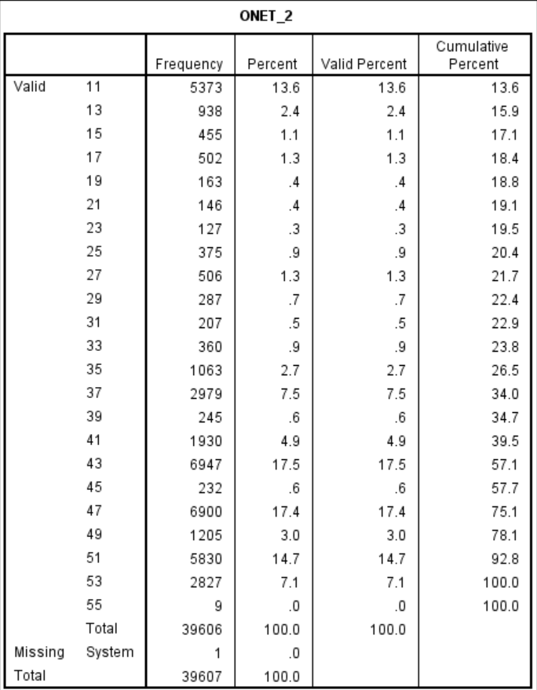

Slide 14
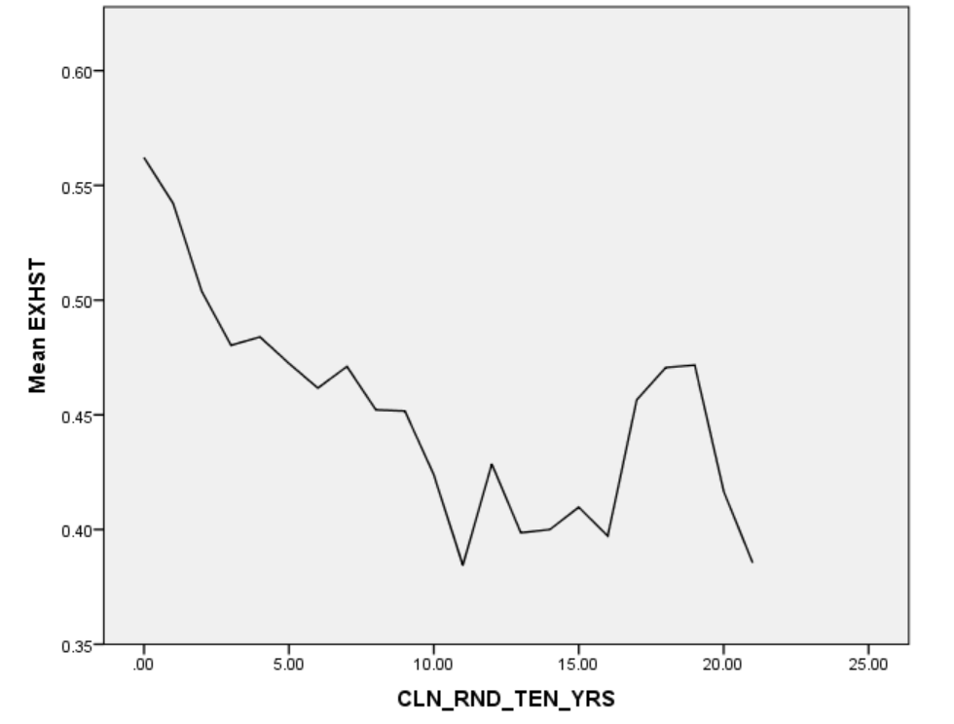
X-Axis: CLN_RND_TEN_YRS

Slide 15
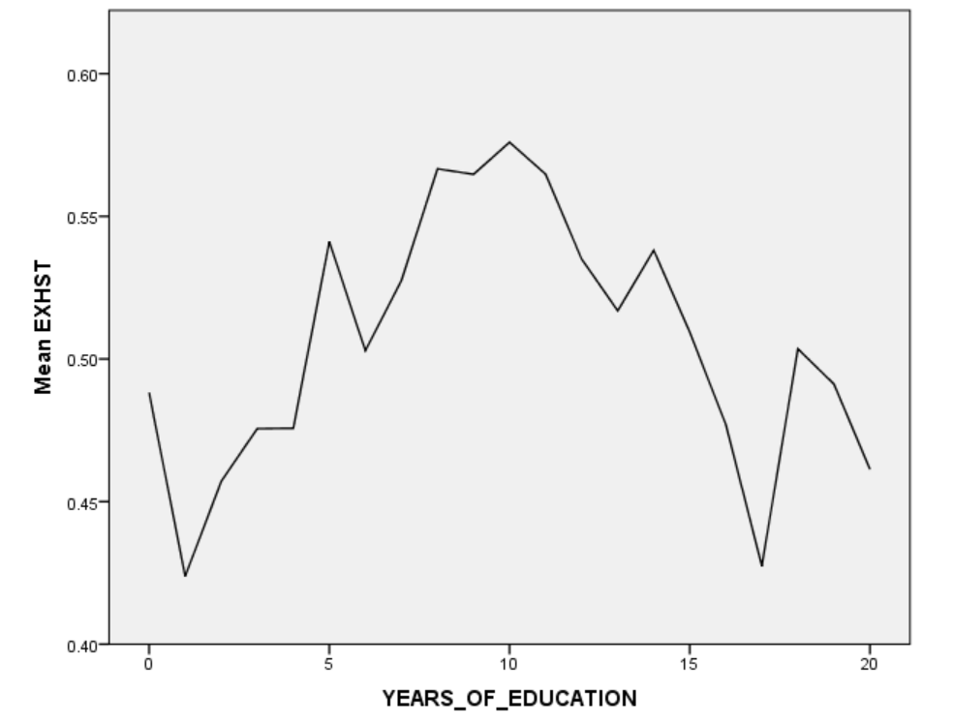
Graphs → Chart Builder… → Line
X-Axis: YEARS_OF_EDUCATION
Y-Axis: EXHST (Element Properties → Statistic: Mean)

Slide 16
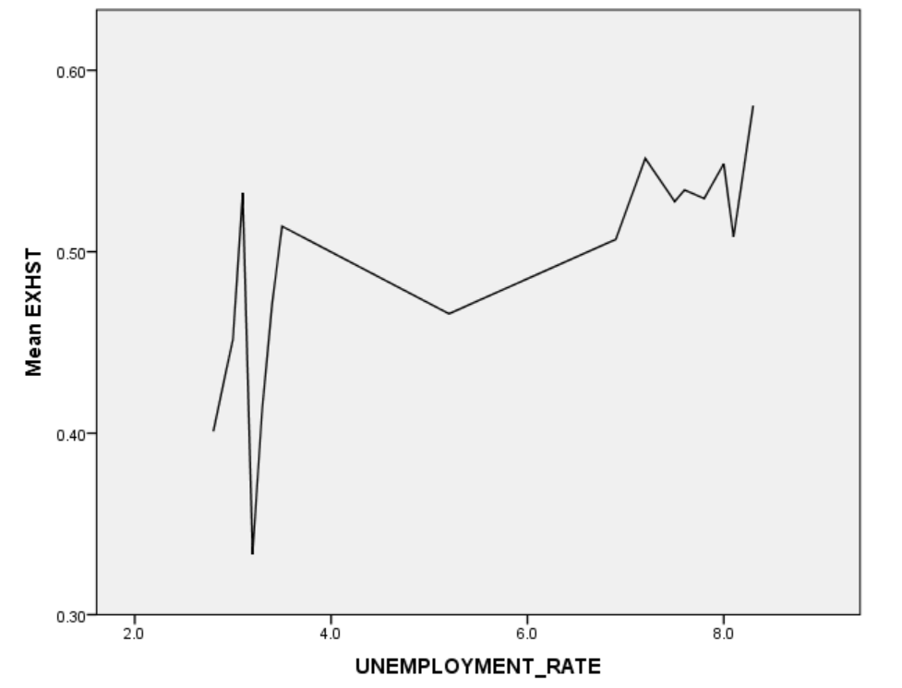
X-Axis: UNEMPLOYMENT_RATE

Slide 17
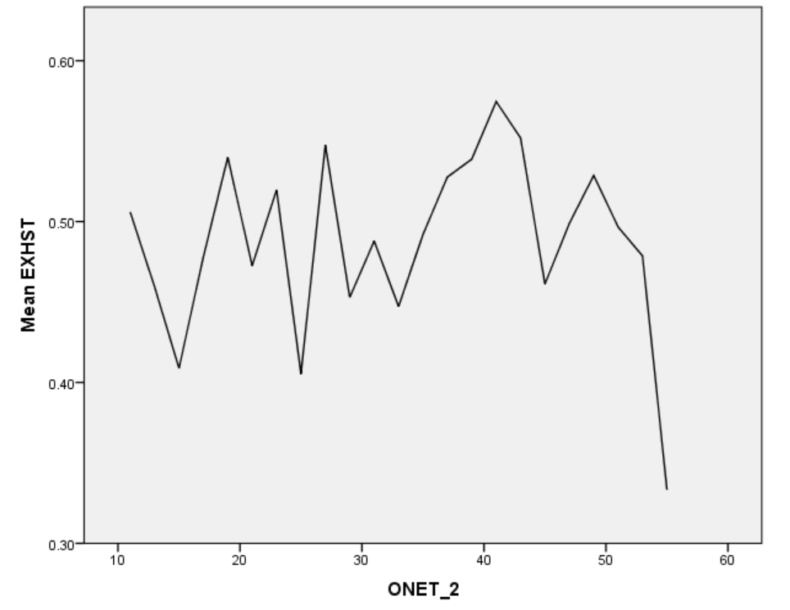
X-Axis: ONET_2

Slide 18
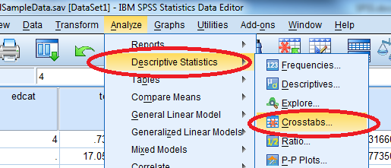
CROSS-TABULATIONS
Open File: Crosstabs Dataset.sav
  Analyze → Descriptive Statistics → Crosstabs

Slide 19
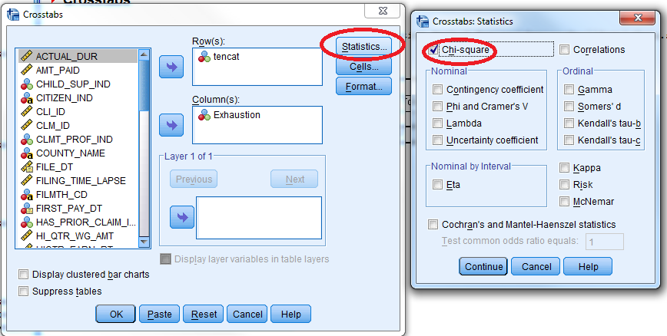
    Enter 1st Variable under Row
    Enter 2nd Variable under Column
    Click Statistics… → Select Chi-Square

Slide 20
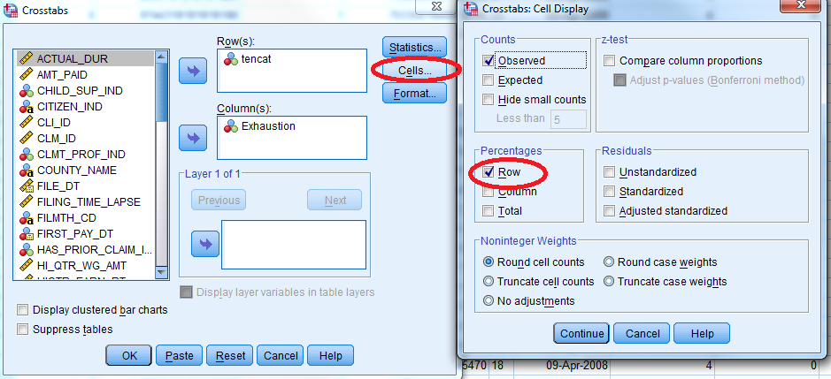
Click Cells… → Select Observed under Counts & Row under Percentages

Slide 21
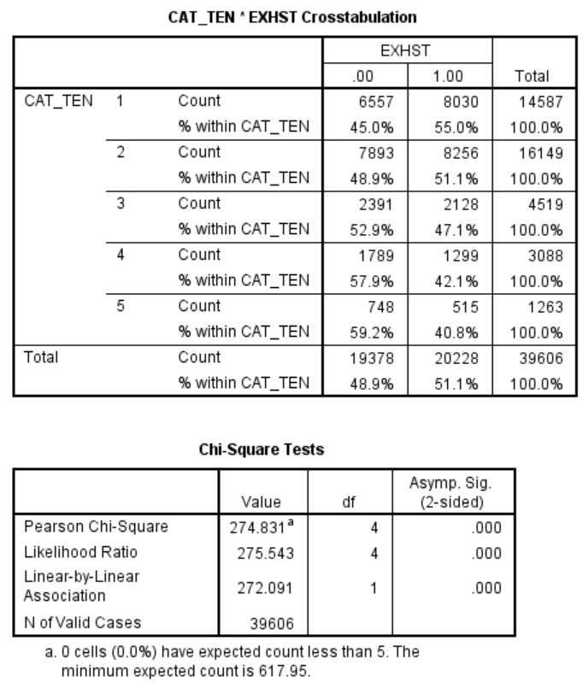
CROSS-TAB WITH CAT_TEN

Slide 22
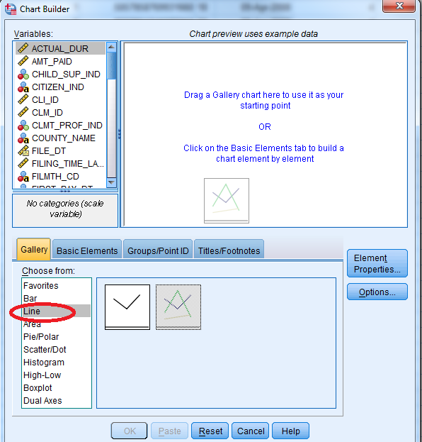
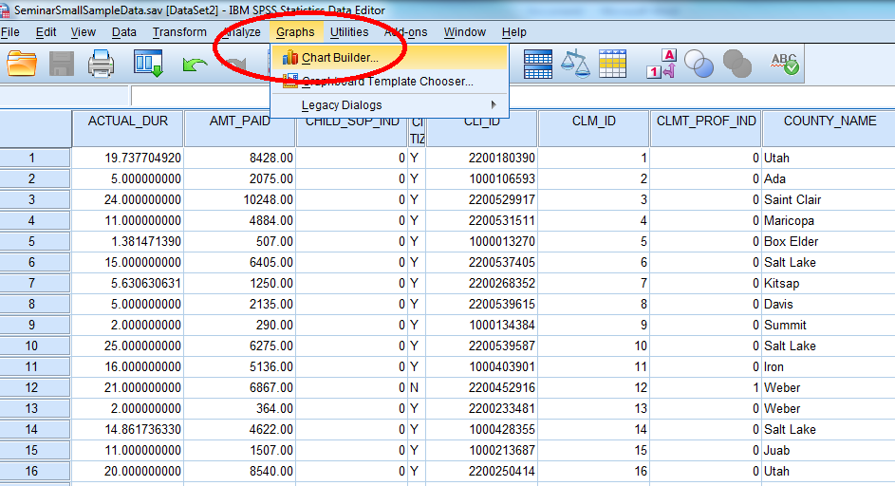
Graphs → Chart Builder…
Line Graph

Slide 23
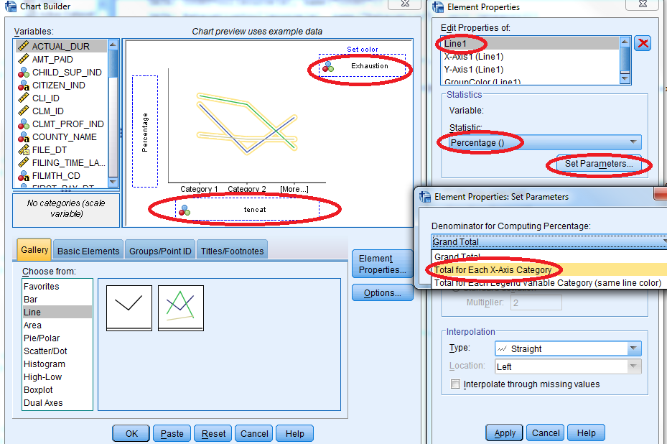
Define X-Axis → Set Color →
Set Line1 value as Percentage() → Click Set Parameters… →
Select Total for Each A-axis Category for Denominator for Computing Percentage

Slide 24
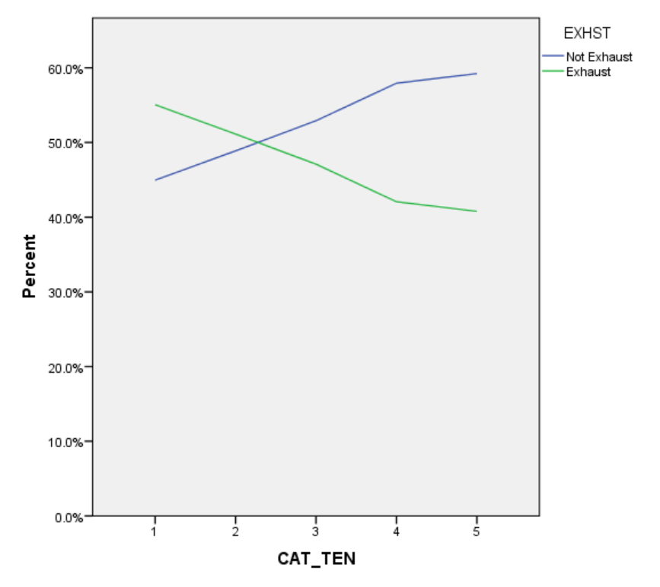

Slide 25
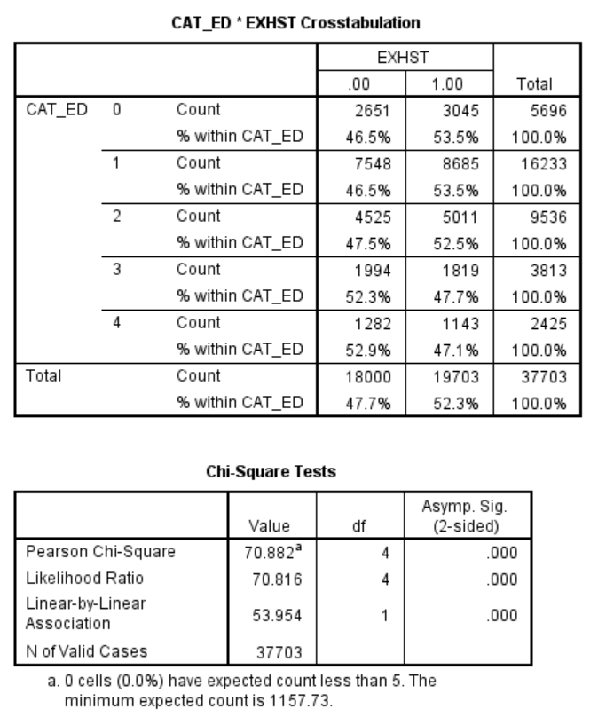
CROSS-TAB WITH CAT_ED

Slide 26
