Slide 1
ANALYZING DATA RELATIONSHIPS

Slide 2
Objective of UI Profiling Systems
To aid in the efficient identification of permanently laid off workers who are:
  Unlikely to return to previous industry or occupation
  Likely to exhaust regular UI benefits
  Need reemployment assistance to make a successful transition to new employment.
Notes:
The objective of any system of profiling UI claimants for referral to reemployment services is to aid in the efficient identification of those workers who have been permanently laid off, are unlikely to return to their previous industry or occupation, are likely to exhaust their regular UI benefits, and will need reemployment assistance in order to make a successful transition to new employment.

Slide 3
Profiling
A systematic procedure used to ID UI claimants who, because of certain characteristics, are thought to be permanently separated from their prior job and likely to exhaust regular UI benefits.
Notes:
Profiling -- A systematic procedure used to identify UI claimants who, because of certain characteristics, are thought to be permanently separated from their prior job and likely to exhaust regular benefits (logistic regression).

Slide 4
Characteristic Screen
A profiling methodology designed to use available data elements as the basis for including or excluding individual claimants from the target group based upon their particular profile.
Notes:
Characteristic Screen - A profiling methodology designed to use available data elements as the basis for including or excluding individual claimants from the target group based upon their particular profile (crosstabs).

Slide 5
Characteristic Screens
Discrete characteristics
An example characteristic screen model would screen on:
    Job Tenure Groupings
    Education Level Groupings
    Occupation Groupings
Notes:
Characteristic screens are based on discrete characteristics. An example would be a screen based on job tenure groupings, education groupings, and occupation groupings.

Slide 6
Example Characteristic Screen
Referred | Education Level | Industry Code | Job Tenure (years)
Yes | 12 | 21 | 5
Yes | 12 | 21 | 4
No | 12 | 22 | 2
No | 12 | 21 | 1
No | 16 | 13 | 3
Yes | 16 | 13 | 12
No | 16 | 13 | 5
If years of education = 12 and industry code =21 and job tenure >3
If years of education = 16 and industry code = 13 and job tenure >9
Notes:
Walk through how CS works and discuss ramifications

Slide 7
Advantages of Characteristic Screens
Easy to Explain and Conceptualize
* Not important in the process of ID’ing likely exhausters, but useful for effective communication within the organization and for explaining to external stake holders.
Easy to Implement
* Can be implemented via a simple computer sort of claimants over a particular time period.
Works fairly well when groupings are properly identified
Notes:
A. Advantages of Characteristic Screens
1. Easy to Explain and Conceptualize -- Characteristic screens have the advantage of being easy to explain and easy to conceptualize. This aspect, while not of importance within the actual process of identifying dislocated workers, does aid in effective communication of the plan within a large organization.
2. Fairly Easy to Implement -- States generally have established data processing procedures for translating initial claims into some electronic format which can then be used to perform a computer sort of new claimants for any given time period.
3. Work fairly well.

Slide 8
Disadvantages of Characteristic Screens
Inefficient method of identification.
  Does not allow for use of continuous variables.
Does not differentiate well between claimants with similar characteristics.
  Identical probabilities for large groups of claimants.
Notes:
B. Disadvantages of Characteristic Screens
1. Inefficient Method of Identification -- Do not allow for use of continuous variables.
2. Always give the same probability of exhausting to several claimants

Slide 9
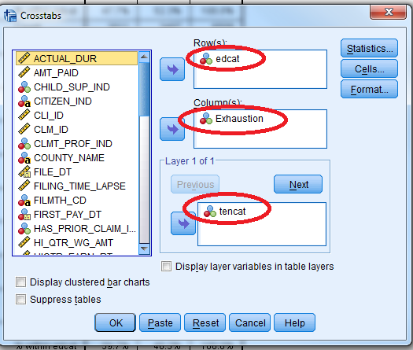
Two-Way Cross-Tabulations
1. Analyze →
2. Descriptive Statistics… →
3. Crosstabs…

Slide 10
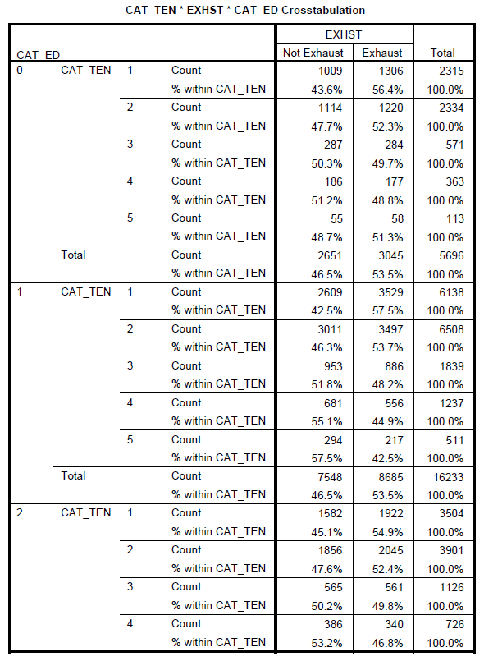
Education Variable
0 – Less than 12 years
1 – HS Diploma
2 – 12 < education years<16
3 – College Degree
4 – Greater than 16 years
Tenure Variable
1 – Less Than 1 Year
2 – At Least 1 Year but < 4 Years
3 – At Least 4 Years but < 8 Years
4 – At Least 8 Years but < 15 Years
5 – > 15 Years

Slide 11
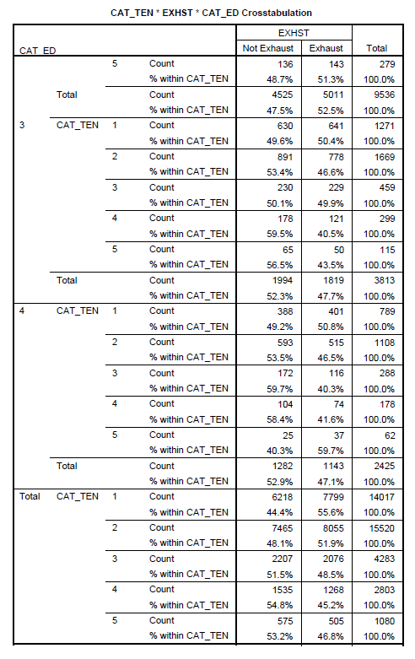
Education Variable
0 – Less than 12 years
1 – HS Diploma
2 – 12 < education years<16
3 – College Degree
4 – Greater than 16 years
Tenure Variable
1 – Less Than 1 Year
2 – At Least 1 Year but < 4 Years
3 – At Least 4 Years but < 8 Years
4 – At Least 8 Years but < 15 Years
5 – > 15 Years

Slide 12
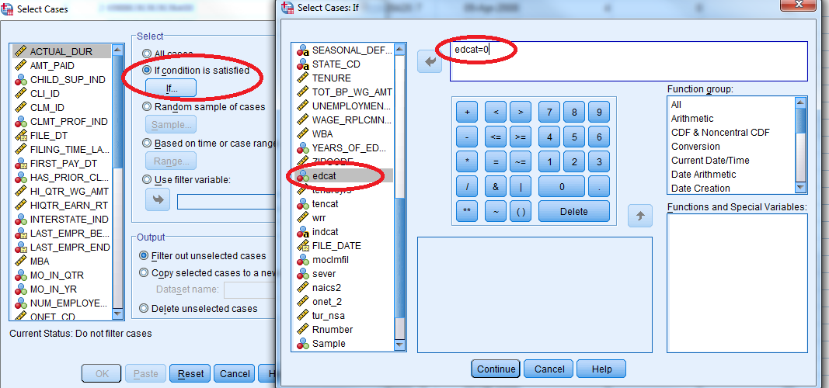
Apply Filters:
Data
Select Cases…

Slide 13
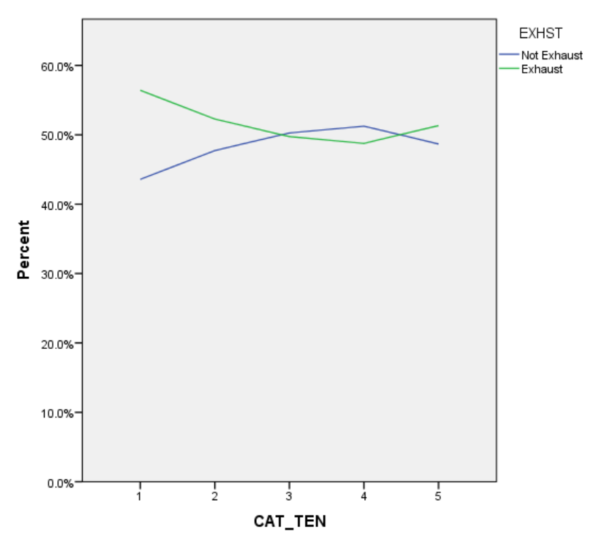
Education Less Than High School edcat = 0

Slide 14
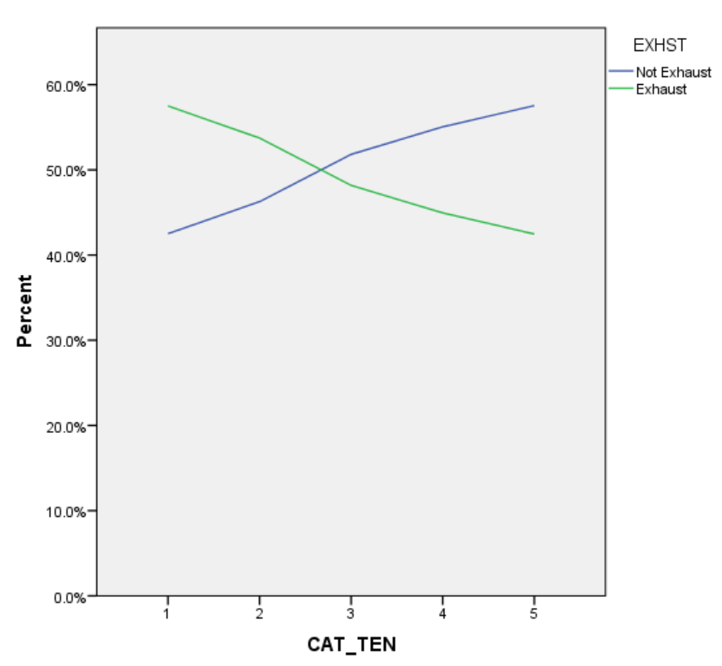
Education Equals High School edcat = 1

Slide 15
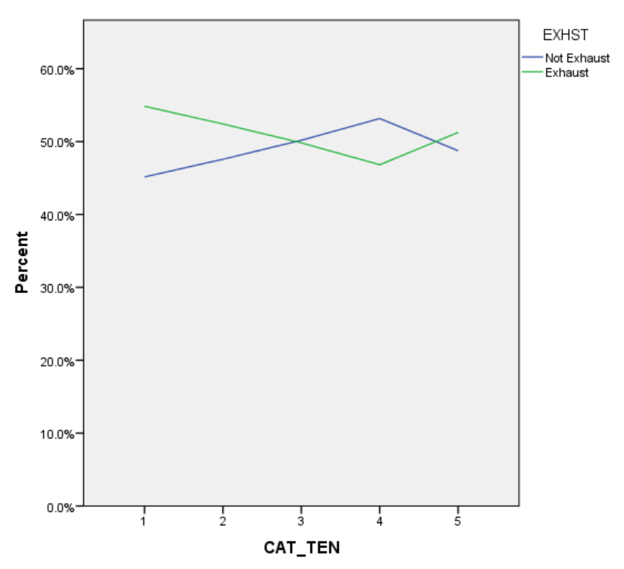
Education is Some College edcat = 2

Slide 16
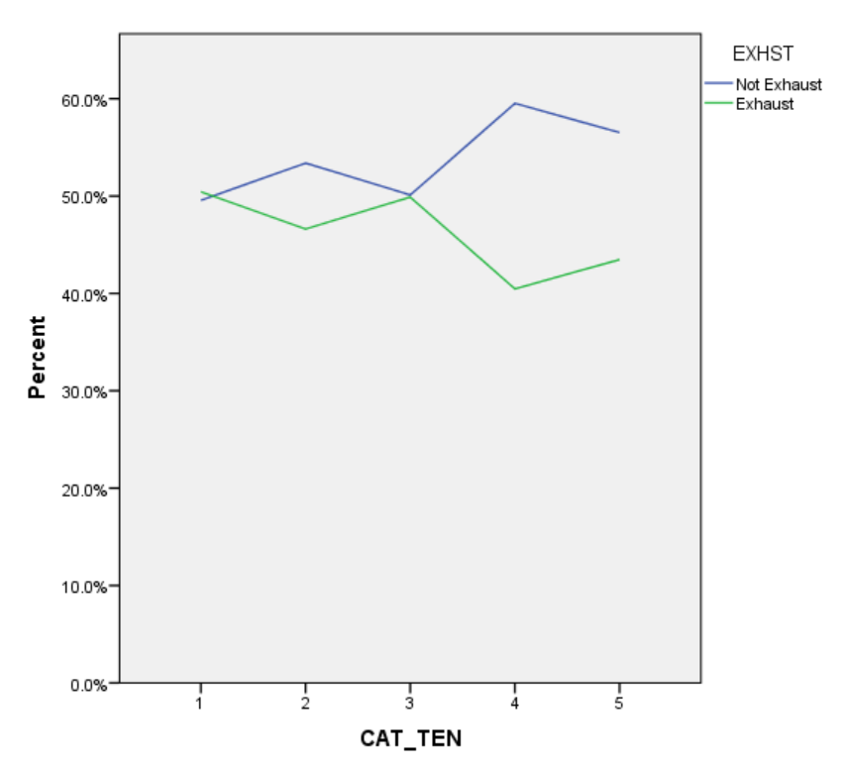
Education is College Degree edcat = 3

Slide 17
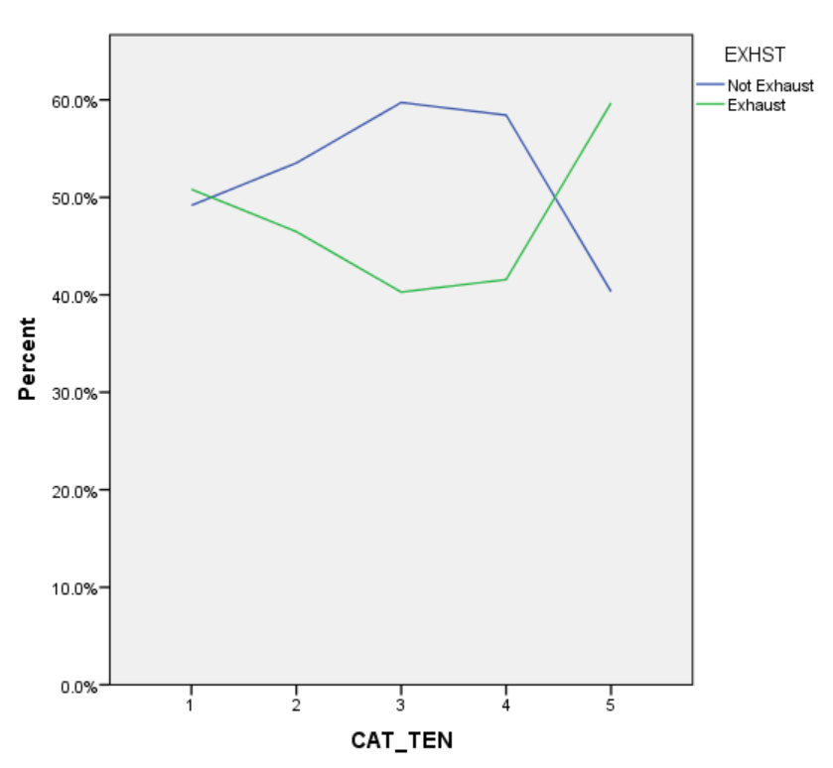
Education is More Than College Degree edcat = 4

Slide 18
Analysis of Graphs
Highest Probability of Exhaustion:
0.597 (59.70%)
for Education More Than College (edcat = 4)
and Job Tenure > 15 years (tencat = 5)
Lowest Probability of Exhaustion:
0.403 (40.3%)
for Education More Than College (edcat = 4)
and Job Tenure at least 4 years but < 8 years (tencat = 3)
Notes:
The highest probability of exhaustion for any group is .597 (education more than college and job tenure greater than or equal to 15 years)
The lowest probability of exhaustion for any group is .403 (education more than college and job tenure at least 4 years but less than 8 years)
Crosstab tables quickly become very large and very confusing.
It becomes difficult to tell what is statistically significant

Slide 19
Chi-Square Automatic Interaction Detection
CHAID
CHAID is…
a form of analysis that determines how variables best combine to explain the outcome in a given dependent variable.
a perfect tool to discover the relationship between variables.
a tool that can visualize the relationship between the target (dependent) variable and the related factors with a tree image.
Notes:
The CHAID Analysis (Chi Square Automatic Interaction Detection) is a form of analysis that determines how variables best combine to explain the outcome in a given dependent variable. The model can be used in cases of market penetration, predicting and interpreting responses or a multitude of other research problems. CHAID analysis is especially useful for data expressing categorized values instead of continuous values. For this kind of data some common statistical tools such as regression are not applicable and CHAID analysis is a perfect tool to discover the relationship between variables. One of the outstanding advantages of CHAID analysis is that it can visualize the relationship between the target (dependent) variable and the related factors with a tree image. (source: http://www.smres.com/chaidanalysis.pdf)
only accepts nominal or ordinal categorical predictors. When predictors are continuous, they are transformed into ordinal predictors before using the following algorithm.

Slide 20
Components of a CHAID Decision Tree
1. Root Node: Dependent (Target) Variable
2. Parent’s Node: The First Split of Target Variable into 2 or more categories.
3. Child Node: Independent Variable Categories below the Parents’ Categories
4. Terminal Node: The last categories of the CHAID analysis tree.
Notes:
Root node: Root node contains the dependent, or target, variable. For example, CHAID is appropriate if a bank wants to predict the credit card risk based upon information like age, income, number of credit cards, etc. In this example, credit card risk is the target variable and the remaining factors are the predictor variables.
Parent's node: The algorithm splits the target variable into two or more categories. These categories are called parent node or initial node. For the bank example, high, medium and low categories are the parent's nodes.
Child node: Independent variable categories which come below the parent's categories in the CHAID analysis tree are called the child node.
Terminal node: The last categories of the CHAID analysis tree are called the terminal node. In the CHAID analysis tree, the category that is a major influence on the dependent variable comes first and the less important category comes last. Thus, it is called the terminal node.

Slide 21
Step 1: Preparing Variables
CHAID only accepts nominal or ordinal categorical predictors. When predictors are continuous, they are transformed into ordinal predictors.
Creates categorical predictors out of any continuous predictors by dividing the respective continuous distributions into a number of categories with an approximately equal number of observations. For categorical predictors, the categories (classes) are already defined.
Notes:
The first step is to create categorical predictors out of any continuous predictors by dividing the respective continuous distributions into a number of categories with an approximately equal number of observations. For categorical predictors, the categories (classes) are already defined.

Slide 22
Step 2: Merging
Cycle through the predictors to determine for each predictor the pair of (predictor) categories that is least significantly different with respect to the dependent variable. It does this by computing a Chi-square test (Pearson Chi-square).
For each predictor variable , merge non-significant categories.
Significant predictor categories (less than the respective alpha-to-merge value) will have a Bonferroni adjusted p-value computed for the set of categories of the respective predictor.
Notes:
The second step is to cycle through the predictors to determine for each predictor the pair of (predictor) categories that is least significantly different with respect to the dependent variable. It does this by computing a Chi-square test (Pearson Chi-square). If the respective test for a given pair of predictor categories is not statistically significant, it will merge the respective predictor categories and repeat this step (i.e., find the next pair of categories, which now may include previously merged categories). If the statistical significance for the respective pair of predictor categories is significant (less than the respective alpha-to-merge value), then it will compute a Bonferroni adjusted p-value for the set of categories for the respective predictor.
------
Suppose that a predictor variable originally has I categories, and it is reduced to r categories after the merging step. The Bonferroni multiplier B is the number of possible ways that I categories can be merged into r categories.
ftp://ftp.software.ibm.com/software/analytics/spss/support/Stats/Docs/Statistics/Algorithms/13.0/TREE-CHAID.pdf

Slide 23
Step 3: Splitting
The splitting step selects which predictor to be used to best split the node. Selection is accomplished by comparing the adjusted p-value associated with each predictor.
Choose the predictor variable with the smallest adjusted p-value, i.e., the predictor variable that will yield the most significant split.
If this adjusted p-value is less than or equal to a user-specified alpha-level (alpha_split), split the node using this predictor. Else, do not split and the node is considered as a terminal node.
Notes:
The third step is to choose the predictor variable with the smallest adjusted p-value, i.e., the predictor variable that will yield the most significant split. If the smallest (Bonferroni) adjusted p-value for any predictor is greater than the alpha-to-split value, then the respective node is a terminal node.
ftp://ftp.software.ibm.com/software/analytics/spss/support/Stats/Docs/Statistics/Algorithms/13.0/TREE-CHAID.pdf

Slide 24
Step 4: Stopping
The stopping step checks if the tree growing process should be stopped.
The node will not be split if…
All cases in a node have identical values of the dependent variable
All cases in a node have identical values for each predictor
The current tree depth reaches the user specified maximum tree depth limit value
The size of a node is less than the user-specified minimum node size value
Resulting number of child nodes is 1
Continue this Steps 2-3 until no further splits can be performed (given the alpha-to-merge and alpha-to-split values).
Notes:
Continue this process until no further splits can be performed (given the alpha-to-merge and alpha-to-split values).
If all cases in a node have identical values of the dependent variable, the node will not be split.
If all cases in a node have identical values for each predictor, the node will not be split.
If the current tree depth reaches the user specified maximum tree depth limit value, the tree growing process will stop.
If the size of a node is less than the user-specified minimum node size value, the node will not be split.
If the split of a node results in a child node whose node size is less than the user-specified minimum child node size value, child nodes that have too few cases (as compared with this minimum) will merge with the most similar child node as measured by the largest of the p-values. However, if the resulting number of child nodes is 1, the node will not be split.

Slide 25
Classification & Regression Tree Analysis
CART
CART is the same as CHAID except only binary splits are allowed and uses pruning to adjust for tree size.
CHAID is most useful for analysis, whereas CART is more suitable for prediction.
Notes:
CART is the same as CHAID except only binary splits are allowed.
http://www.bzst.com/2006/10/classification-trees-cart-vs-chaid.html

Slide 26
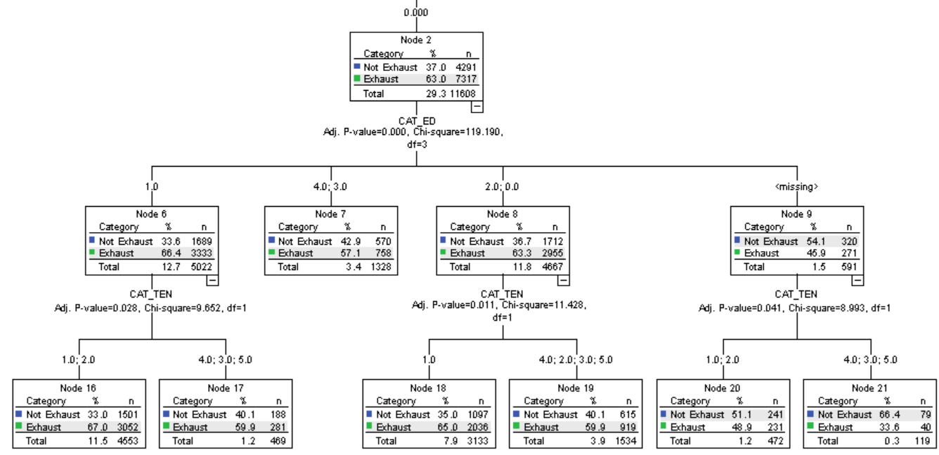
CHAID Example
Potential Duration as First Split

Slide 27
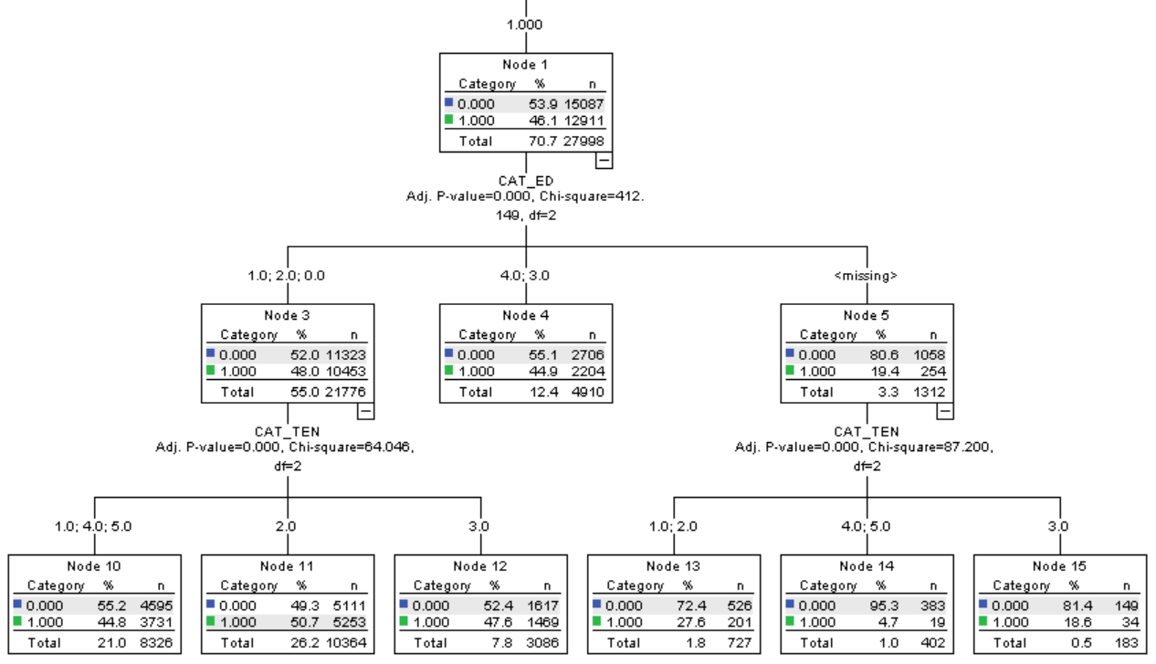
CHAID Example (Cont.)
Potential Duration as First Split

Slide 28
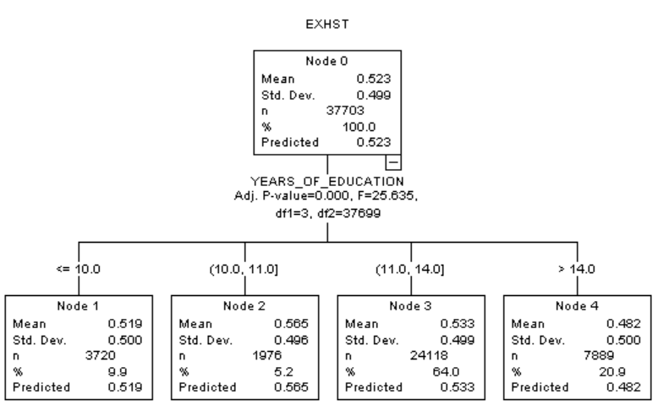
Root Node: Exhaustion
Parent Node: YEARS_OF_EDUCATION
How does this compare to what we did?
Which seems more appropriate?

Slide 29
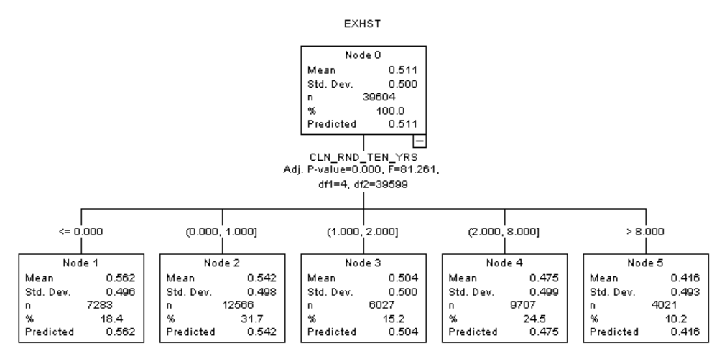
Root Node: Exhaustion
Parent Node: CLN_RND_TEN_YRS
How does this compare to what we did?
Which seems more appropriate?

Slide 30
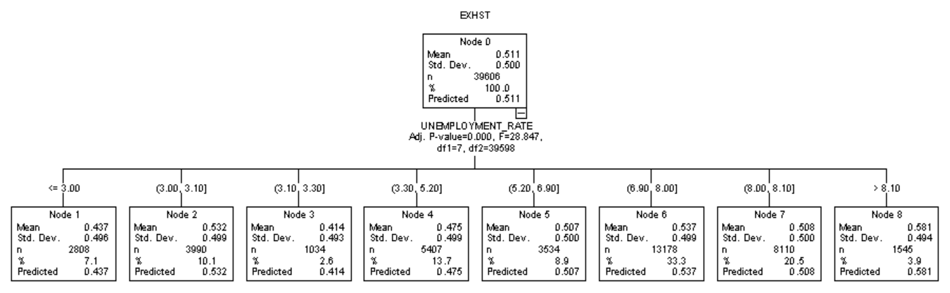
Root Node: Exhaustion
Parent Node: UNEMPLOYMENT RATE
Does this make sense?

Slide 31
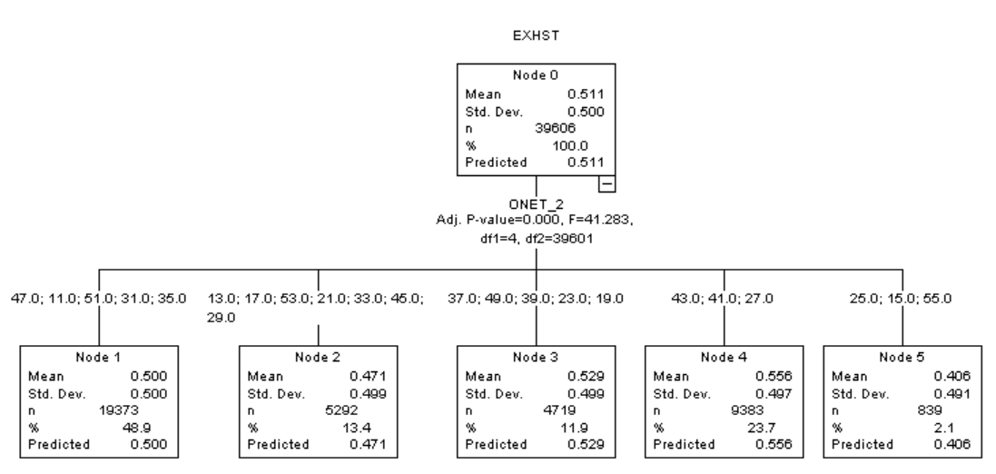
Root Node: Exhaustion
Parent Node: ONET_2
Does this make sense?

