Slide 1
REGRESSION ANALYSIS
AND
ORDINARY LEAST SQUARES (OLS)

Slide 2
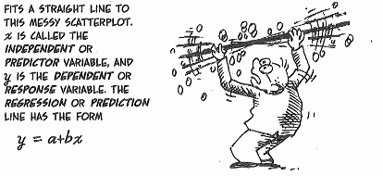
REGRESSION ANALYSIS
A statistical process for estimating the relationships among variables.
Notes:
Picture Source: https://madhureshkumar.files.wordpress.com/2015/07/cartoon_guide_regression.png?w=705

Slide 3
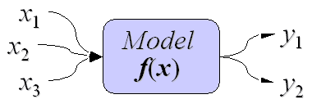
FUNCTIONAL vs. STATISTICAL INFERENCE
Functional Relationship (Deterministic)
An exact relationship between the predictor X and the response Y.
Y = f(X₁,X₂,...,X_{p})
Y = 3X₁+4X₂
Statistical Relationship
(Stochastic : “Random”)
It is not an exact relationship. It is instead a relationship in which “trend” exists between the predictor X and the response Y, but there is also some “scatter.”
Y = f(X₁,X₂,...,X_{p}) + ε
where ε = stochastic error term or “noise”
Notes:
https://onlinecourses.science.psu.edu/stat414/node/276

Slide 4
STATISTICAL (STOCHASTIC) RELATIONSHIP
Y = f(X₁,X₂,...,X_{p}) + ε
Relationship is not perfect
Y is the response (dependent) variable
X₁,X₂,...,X_{p} are the predictor (independent) variables

Slide 5
QUALITATIVE RESPONSE VARIABLES
Qualitative variables capture the presence or absence of some non-numeric quantity.
Binary variable with values of 0 and 1

Slide 6
EXAMPLES OF A BINARY RESPONSE VARIABLE
Over-Paid vs. Not Over-Paid
Eligible vs. Ineligible
Searched for Work vs. Did Not Search for Work
Exhausted Benefits vs. Did Not Exhaust Benefits

Slide 7
OBJECTIVE OF THE ANALYSIS
Consider the simple model:
Y_{i} = α + βX_{i}+ ε_{i}
where X = EDUCATION (Continuous)
Y_{i} = 1 if EXHAUSTED BENEFITS
Y_{i} = 0 if DID NOT EXHAUST BENEFITS
The dichotomous Y_{i} is represented as a linear function of X.

Slide 8
OBJECTIVE OF THE ANALYSIS (CONT.)
Y_{i} = α + βX_{i}+ ε_{i}
is called a linear probability model since the conditional expectation E(Y|X) can be interpreted as the conditional probability that the event will occur given X = X_{i}; that is,
E(Y|X) = Probability(Y = 1 | X) = f(X) = α + βX
Notes:
To determine the likelihood that an event has occurred, or revised probability that an event will occur, given a set of known information. The conditional mean, E(Y|X), now represents a probability.

Slide 9
USES OF THE ANALYSIS
Which claimants should be put on mail claims?
Which claimants should receive job placement assistance?
Which claimants should receive seated periodic interviews?
Which employers should be investigated for tax evasion?

Slide 10
Possible Techniques if a Dependent Variable is a Binary Outcome:
ORDINARY LEAST SQUARES (OLS)
model binary variables using linear probability models. There is constant variance in the errors (which is called homoscedasticity).
WEIGHTED LEAST SQUARES
can be used when the ordinary least squares assumption of constant variance in the errors is violated (which is called heteroscedasticity).
DISCRIMINANT ANALYSIS
predicts membership in a group or category based on observed values of several continuous variables.
LOGISTIC REGRESSION (LOGIT)
estimates the probability of an outcome.
Notes:
OLS vs. Discriminant Analysis vs. Logistic Regression: http://www.sagepub.com/sites/default/files/upm-binaries/5081_Spicer_Chapter_5.pdf

Slide 11
ORDINARY LEAST SQUARES
The goal of OLS is to closely "fit" a function with the data.
It does so by minimizing the sum of squared errors from the data.
Notes:
In statistics, ordinary least squares (OLS) or linear least squares is a method for estimating the unknown parameters in a linear regression model, with the goal of minimizing the differences between the observed responses in some arbitrary dataset and the responses predicted by the linear approximation of the data (visually this is seen as the sum of the vertical distances between each data point in the set and the corresponding point on the regression line - the smaller the differences, the better the model fits the data).

Slide 12
STATISTICAL MODEL
Y_{i} = β₀ + β₁X_{i}+ ε_{i}
Y_{i} = value of response variable on trial i
β₀, β₁ = parameters of the population
X_{i} = known value
ε_{i} = random error

Slide 13
CLASSICAL ASSUMPTIONS
The model is linear in the coefficients of the predictor
Error Terms:
  Are from normal distribution
  Have constant variance σ²
  Are independent

Slide 14
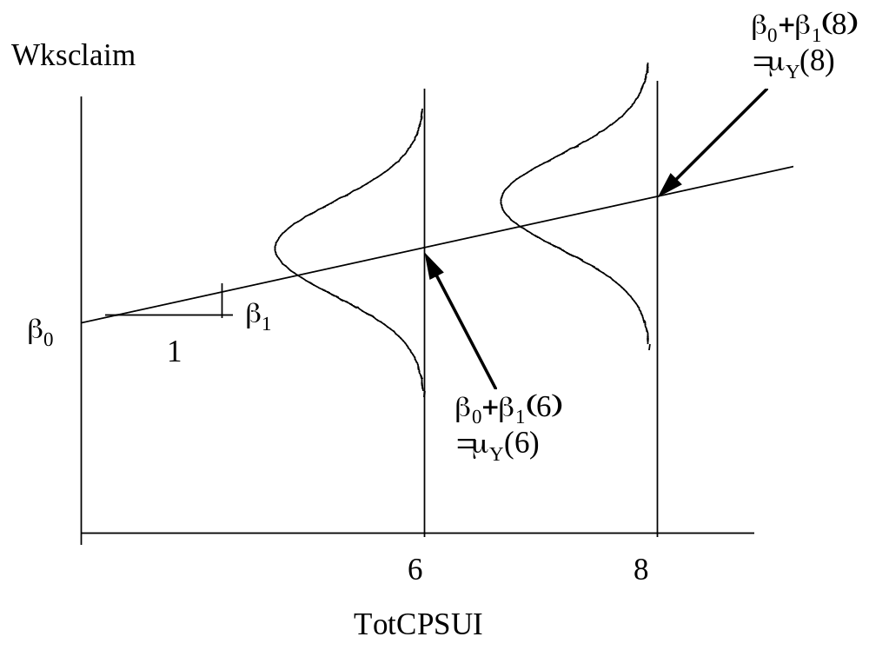
GRAPHICAL REPRESENTATION
Y = Weeks Claimed (Wksclaim)
X = Total CPS Unemployment Rate (TotCPSUI)
Definition of β₀, β₁
We are interested in the means of many subpopulations
Model can be used for prediction of new observations or estimation of subpopulation means.

Slide 15
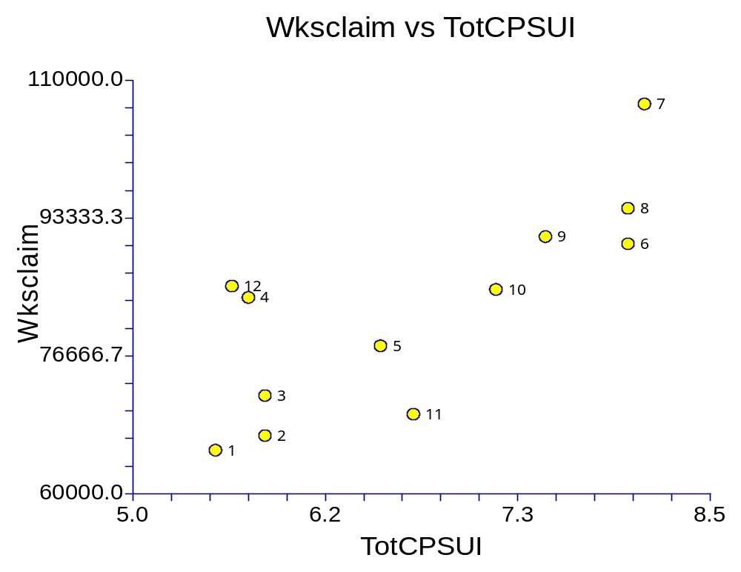
ESTIMATION OF REGRESSION FUNCTION
Scatter Diagram
Year | Month | Wksclaim | TotCPSUI
1980 | 1 | 65,263 | 5.50
1980 | 2 | 67,035 | 5.80
1980 | 3 | 71,876 | 5.80
1980 | 4 | 83,748 | 5.70
1980 | 5 | 77,892 | 6.50
1980 | 6 | 90,244 | 8.00
1980 | 7 | 107,163 | 8.10
1980 | 8 | 94,534 | 8.00
1980 | 9 | 91,106 | 7.50
1980 | 10 | 84,715 | 7.20
1980 | 11 | 69,626 | 6.70
1980 | 12 | 85,122 | 5.60
Notes:
Weeks claimed - intrastate (Y=Wksclaim) and Total CPS unemployment rate (X=TotCPSUI) for 1980

Slide 16
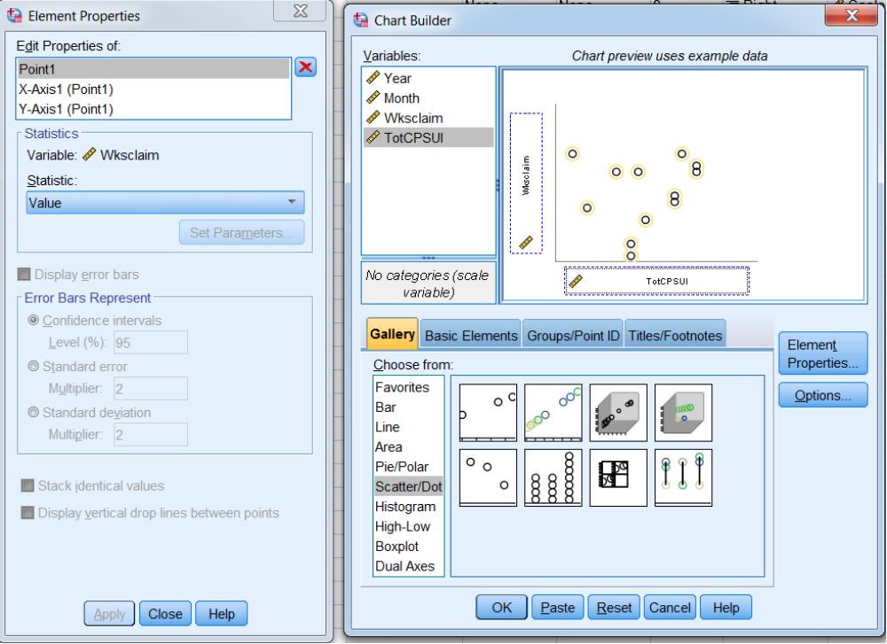
SCATTERPLOT OF VALUES

Slide 17

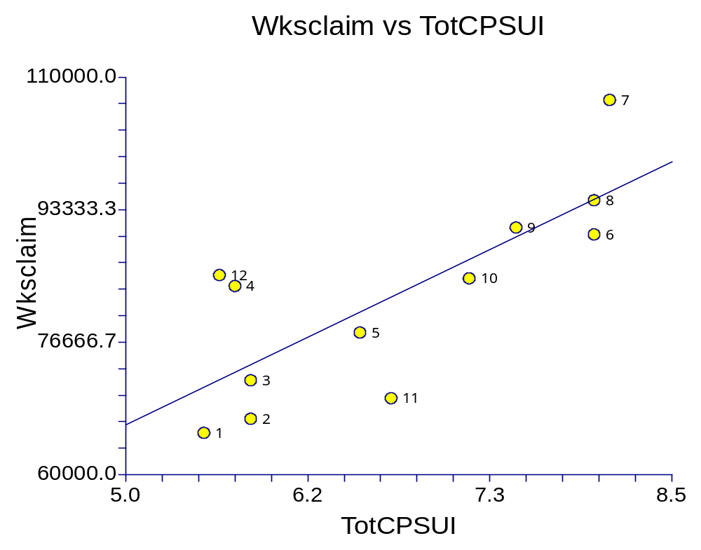
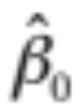
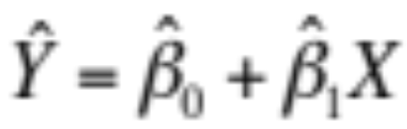
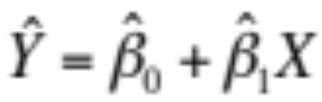
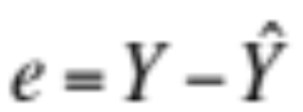
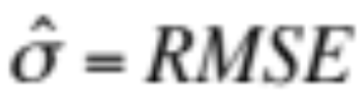
2. Method of Least Squares
Estimates β₀ and β₁ in order to minimize squared prediction errors.
= slope of the best fitting line
= y-intercept
Equation for estimating a subpopulation mean is
The same equation is used for predicting a new observation
A prediction error (residual) is
The estimate for σ is Root Mean Square Error (RMSE), i.e.,

Slide 18
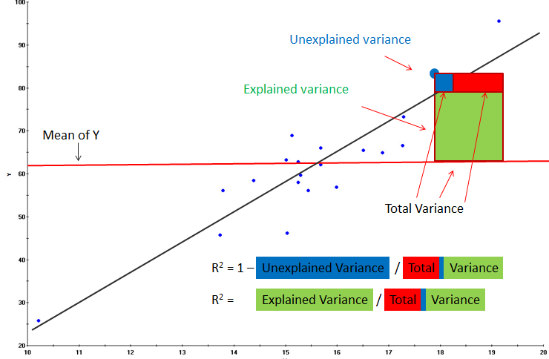
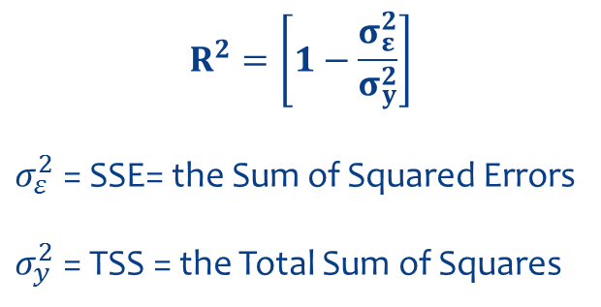
$$R^{2}=\left[1−\frac{σ_{ε}^{2}}{σ_{y}^{2}}\right]$$
$σ_{ε}^{2}$ = SSE= the Sum of Squared Errors
$σ_{y}^{2}$ = TSS = the Total Sum of Squares
R-squared can be written as one minus the unexplained variance divided by the total variance, as shown above.
Notes:
http://www.rapidinsightinc.com/brushing-r-squared/

Slide 19
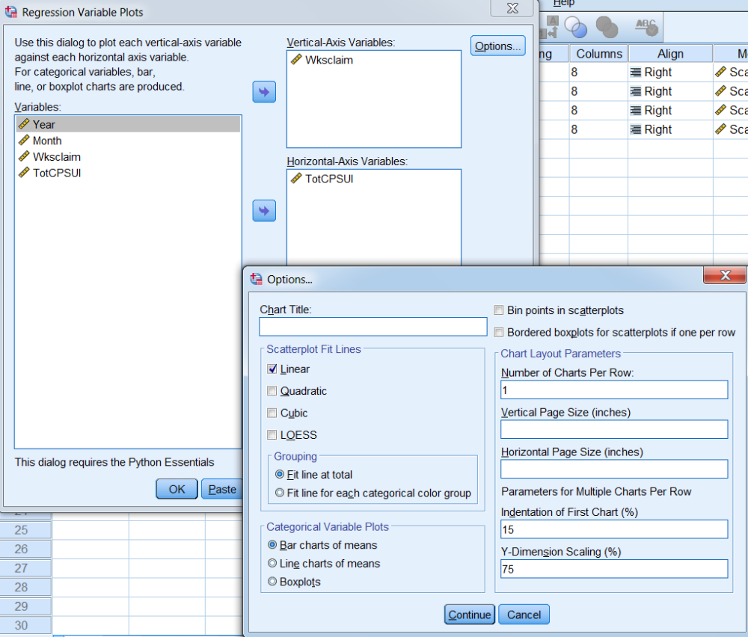
Scatter Plot with Regression Line

Slide 20
STATISTICAL INFERENCES
Are X and Y statistically related?
X and Y are statistically related if β₁ (the slope) is not zero.
How do we test whether X and Y are statistically related?
A) Confidence Interval for β₁ (the slope) [sample statistic + margin of error]
Lower = (Reg. coeff.) – [(T-critical) * (Standard error)]
Upper = (Reg. coeff.) + [(T-critical) * (Standard error)]
B) P-Value associated with Null Hypothesis (H₀) that there is no relationship (slope is zero). We want to reject this hypothesis.
Notes:
There are four steps to constructing a confidence interval.
1. Identify a sample statistic. Choose the statistic (e.g, sample mean, sample proportion) that you will use to estimate a population parameter.
2. Select a confidence level. As we noted in the previous section, the confidence level describes the uncertainty of a sampling method. Often, researchers choose 90%, 95%, or 99% confidence levels; but any percentage can be used.
3. Find the margin of error. If you are working on a homework problem or a test question, the margin of error may be given. Often, however, you will need to compute the margin of error, based on one of the following equations.
Margin of error = Critical value * Standard deviation of statistic Margin of error = Critical value * Standard error of statistic
4. Specify the confidence interval. The uncertainty is denoted by the confidence level. And the range of the confidence interval is defined by the following equation. Confidence interval = sample statistic + Margin of error
---------------------------
The P-value is the probability of observing a sample statistic as extreme as the test statistic. The test statistic is a t-score (t) defined by the following equation. (t = b₁ / SE) where b₁ is the slope of the sample regression line, and SE is the standard error of the slope.

Slide 21
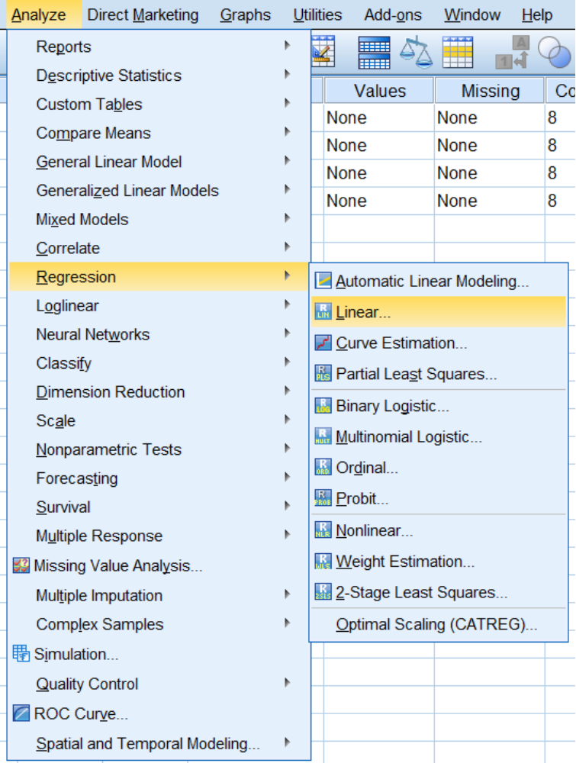
Estimate Regression Parameters and Test for Significance
Analyze
Regression
Linear…

Slide 22
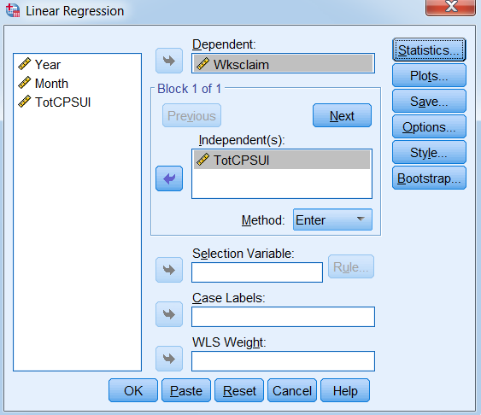
Estimate Regression Parameters and Test for Significance (cont.)

Slide 23
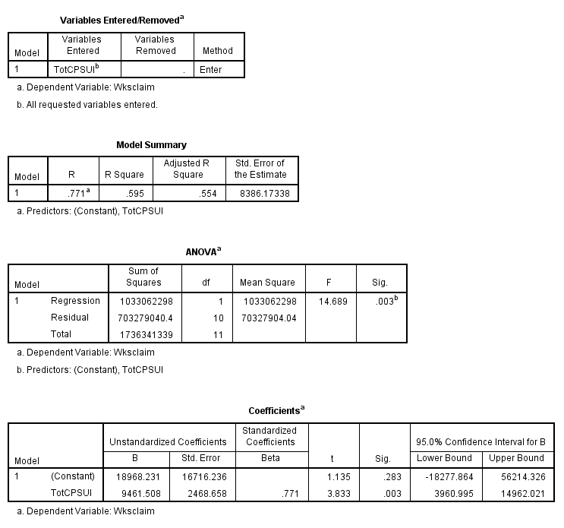
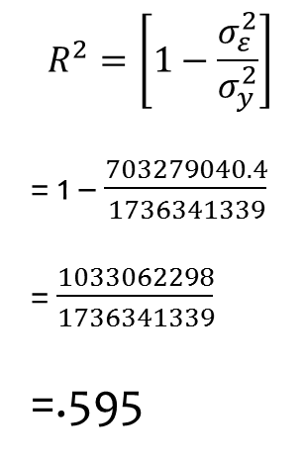
SPSS Output
$$R^{2}=\left[1−\frac{σ_{ε}^{2}}{σ_{y}^{2}}\right]$$
= 1 – $\frac{703279040.4}{1736341339}$
= $\frac{1033062298}{1736341339}$
=.595

Slide 24
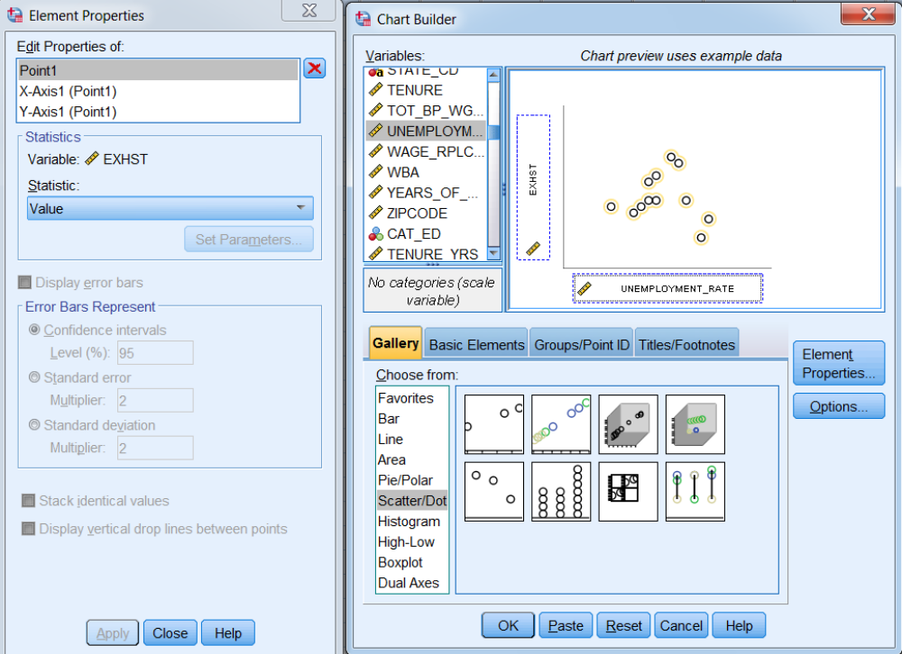
SPSS SCATTERPLOT OF VALUES

Slide 25
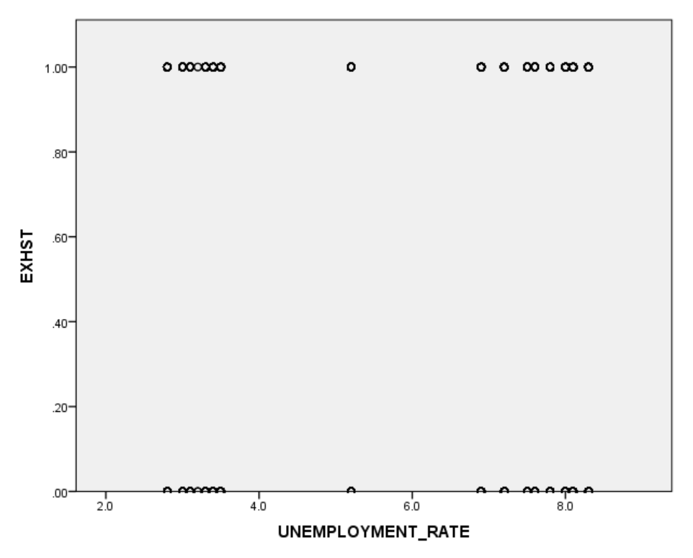
Scatter Plot of Values is Not Very Useful for a Binary Dependent Variable

Slide 26
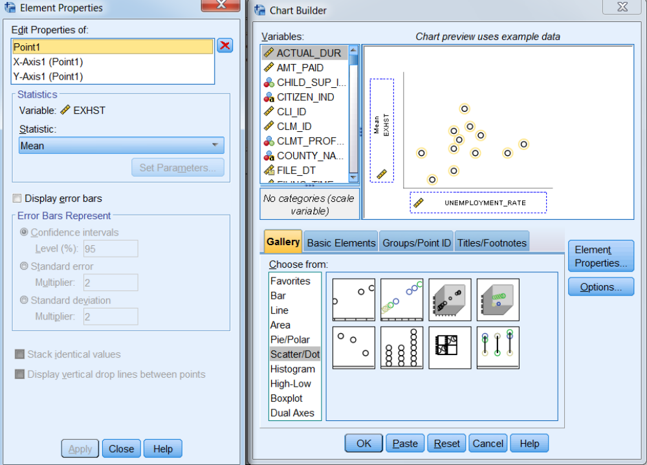
SPSS SCATTERPLOT OF MEANS

Slide 27
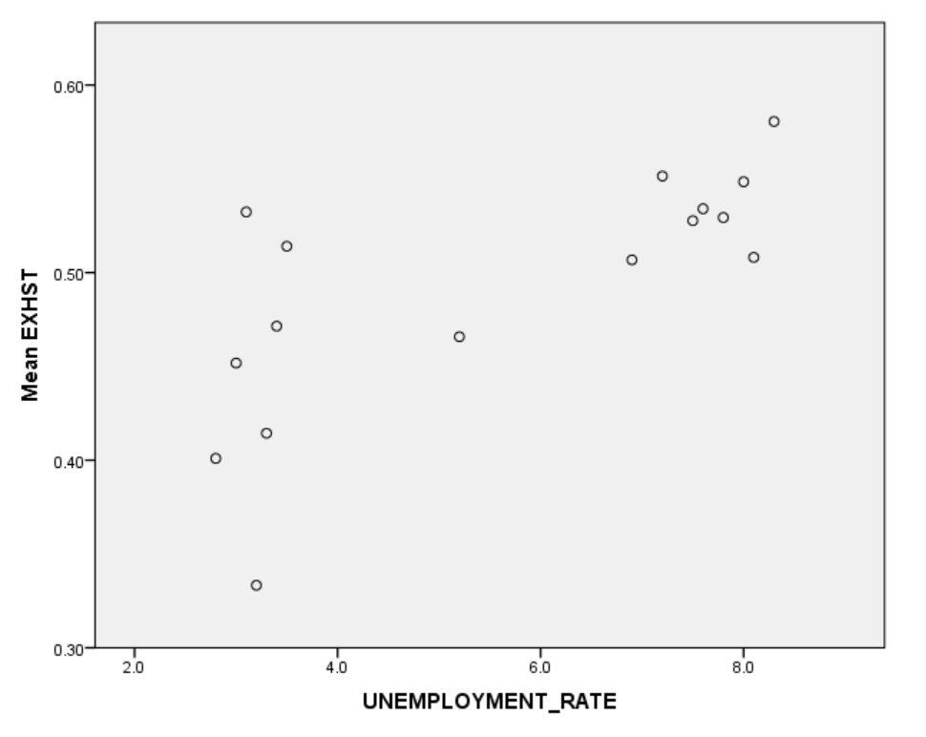
SCATTERPLOT OF MEANS IS MUCH MORE USEFUL

Slide 28
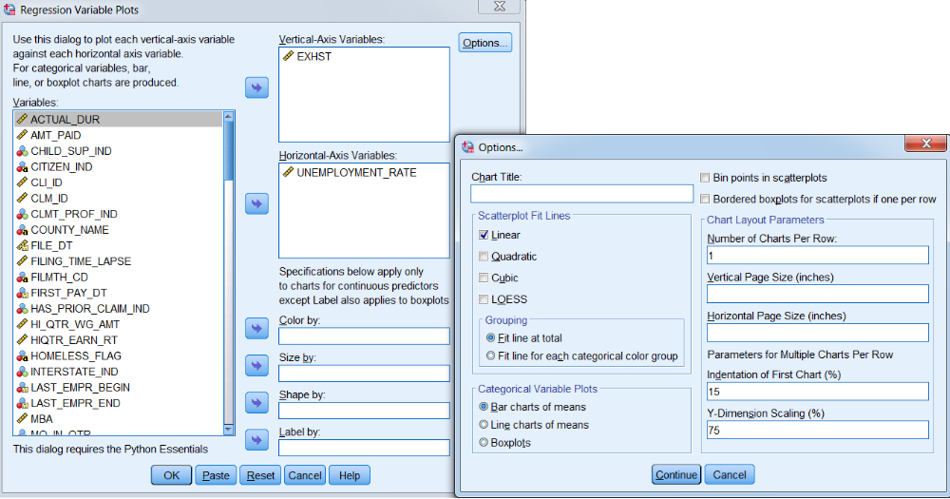
SPSS SCATTERPLOT WITH REGRESSION LINE

Slide 29
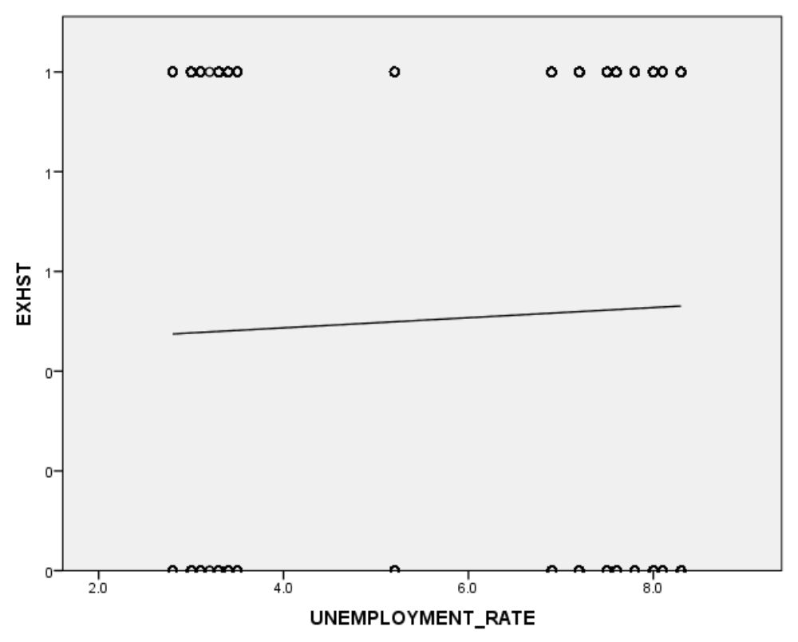
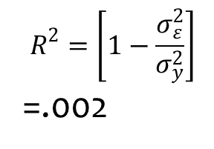
SCATTERPLOT WITH REGRESSION LINE
$$R^{2}=\left[1−\frac{σ_{ε}^{2}}{σ_{y}^{2}}\right]$$
=.002

Slide 30
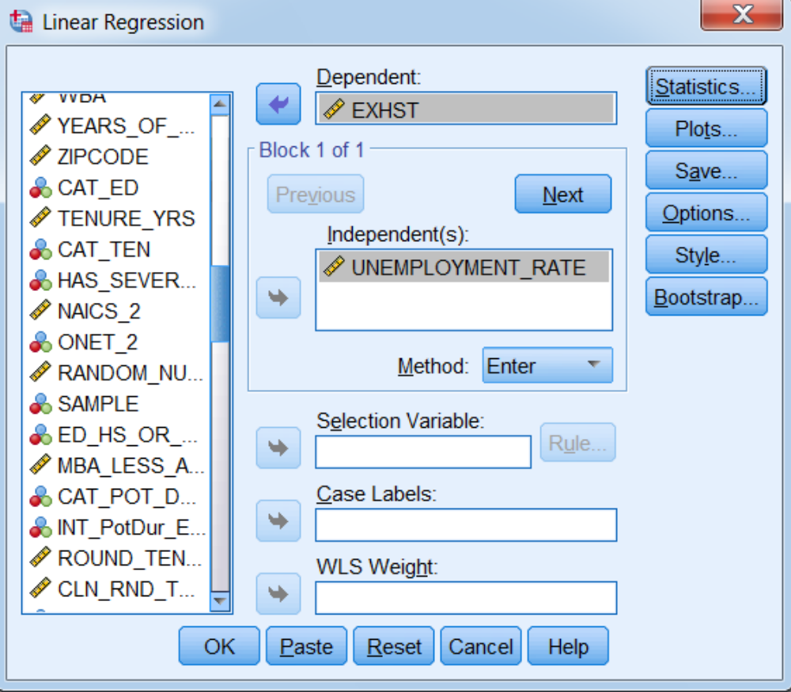
SPSS REGRESSION PROCEDURE

Slide 31
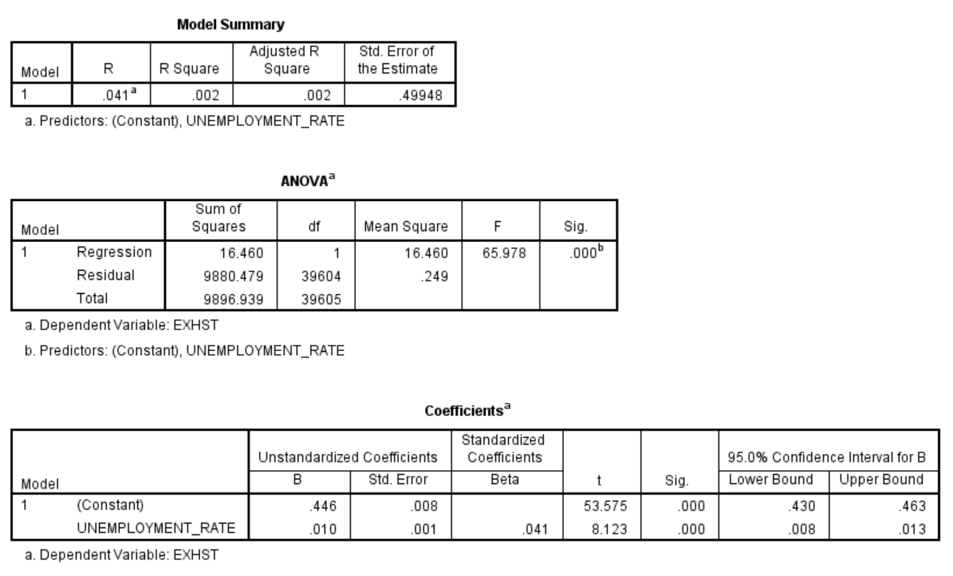
SPSS OUTPUT
Why do you think the unemployment rate does not work that well to predict exhaustions?

Slide 32
PROBLEMS
Meaning of response function (conditional means are probabilities).
For fixed X_{i}, Y_{i} is Bernoulli. Hence the error terms are not normal.
Error terms are heteroscedastic
Response surface is constrained to be between 0 and 1 since it is a probability
Response surface may be nonlinear
Notes:
1. Meaning of response function (conditional means are probabilities).
2. For fixed X_{i}, Y_{i} is Bernoulli. Hence the error terms are not normal.
Error terms are heteroscedastic
Response surface is constrained to be between 0 and 1 since it is a probability
Response surface may be nonlinear

Slide 33
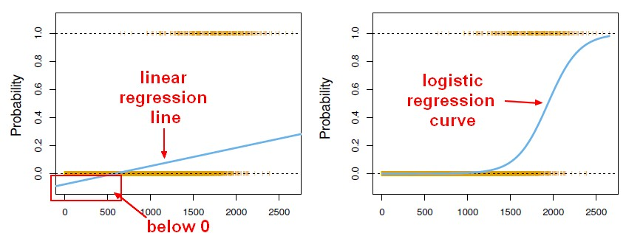
OLS vs. LOGIT
Notes:
http://gerardnico.com/wiki/_media/data_mining/logistic_regression_vs_linear.jpg

Slide 34
CONSEQUENCES OF PROBLEMS
Model may be inappropriate
Estimators are not efficient
Confidence intervals and hypothesis tests are not exact (If X_{i} and σ_{i} are positively associated, confidence intervals and acceptance regions are too narrow)
Problem is exacerbated by the fact that interest generally lies in the extremes of the response function, and the fit of the model is poorest in the extremes of the response function.
Having said all of this, many analysts nonetheless use ordinary least squares to build their preliminary models.

