Slide 1
LOGISTIC REGRESSION MODELING

Slide 2
WEIGHTED LEAST SQUARES (WLS)
In WLS, you are simply treating each observation as more or less informative about the underlying relationship between X and Y. Those points that are more informative are given more 'weight', and those that are less informative are given less weight.
Corrects for Unequal Error Variances (Solution to Heteroskedasticity)
Weights come from:
    1. Stage 1 regression
    2. Sample proportions
Today, no one would use weighted least squares to analyze a binary dependent variable.
Notes:
http://stats.stackexchange.com/questions/97832/how-do-you-find-weights-for-weighted-least-squares-regression
**reciprocal of the variance

Slide 3
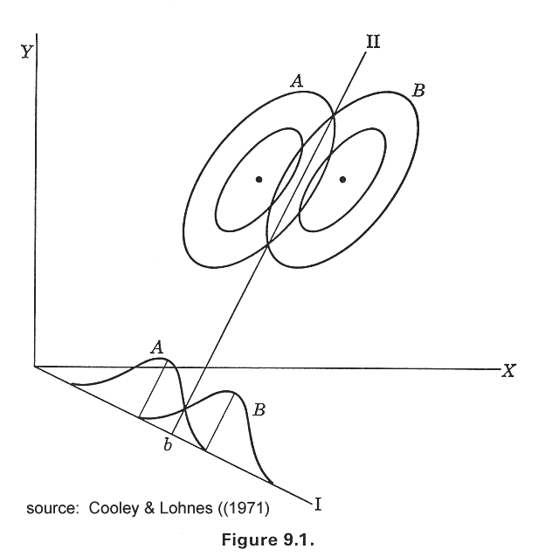
DISCRIMINANT ANALYSIS
Discriminant analysis predicts membership in a group or category based on observed values of several continuous variables.
Specifically, discriminant analysis predicts a classification (X) variable (nominal or ordinal) based on known continuous responses (Y).
The basic strategy is to form a linear combination of the independent variables and then to assign an observation to group A or B based on the predicted value resulting from the equation.
Notes:
http://www.jmp.com/support/help/Disciminant_Analysis.shtml

Slide 4
DISCRIMINANT ANALYSIS (cont.)
Assumptions
1. Independent variables are multivariate normal
2. Two populations have equal covariance matrices
Problems
1. Dummy variables violate normality assumption and equal covariance assumption.
2. When assumptions are violated, confidence intervals and hypothesis tests are not exact, parameter estimates are biased, and conditional probabilities may be poorly estimated.
3. Procedure is adversely affected by data sets with large proportions of cases with conditional probabilities very close to zero or one.
4. Rarely used anymore

Slide 5
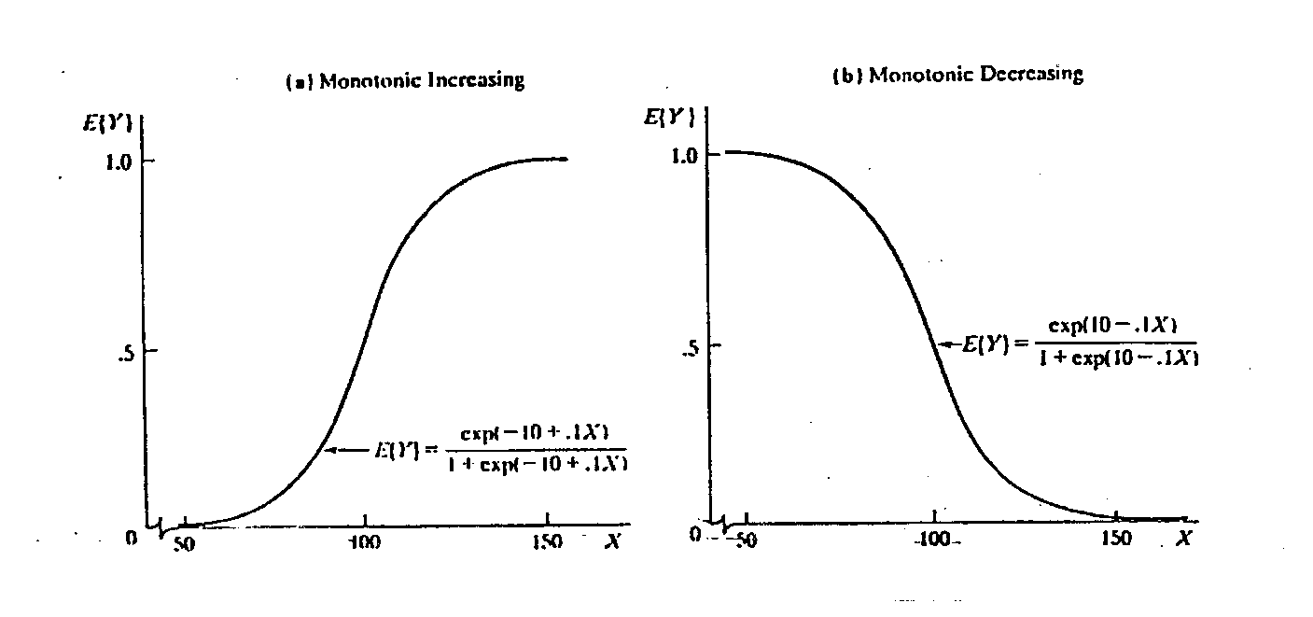
LOGISTIC REGRESSION
used to make inferences about the relationship of a categorical, binary dependent variable and one or more independent variables using a logistic function
the predicted values are probabilities and are therefore restricted to the interval (0,1) through the logistic distribution function

Slide 6

ASSUMPTIONS OF LOGISTIC REGRESSION
1. Assumes logistic form for response function
where p is the probability of presence of the characteristic of interest.
The logit transformation is defined as the logged odds:
2. Assumes large sample size (greater than 50) for significance tests

Slide 7
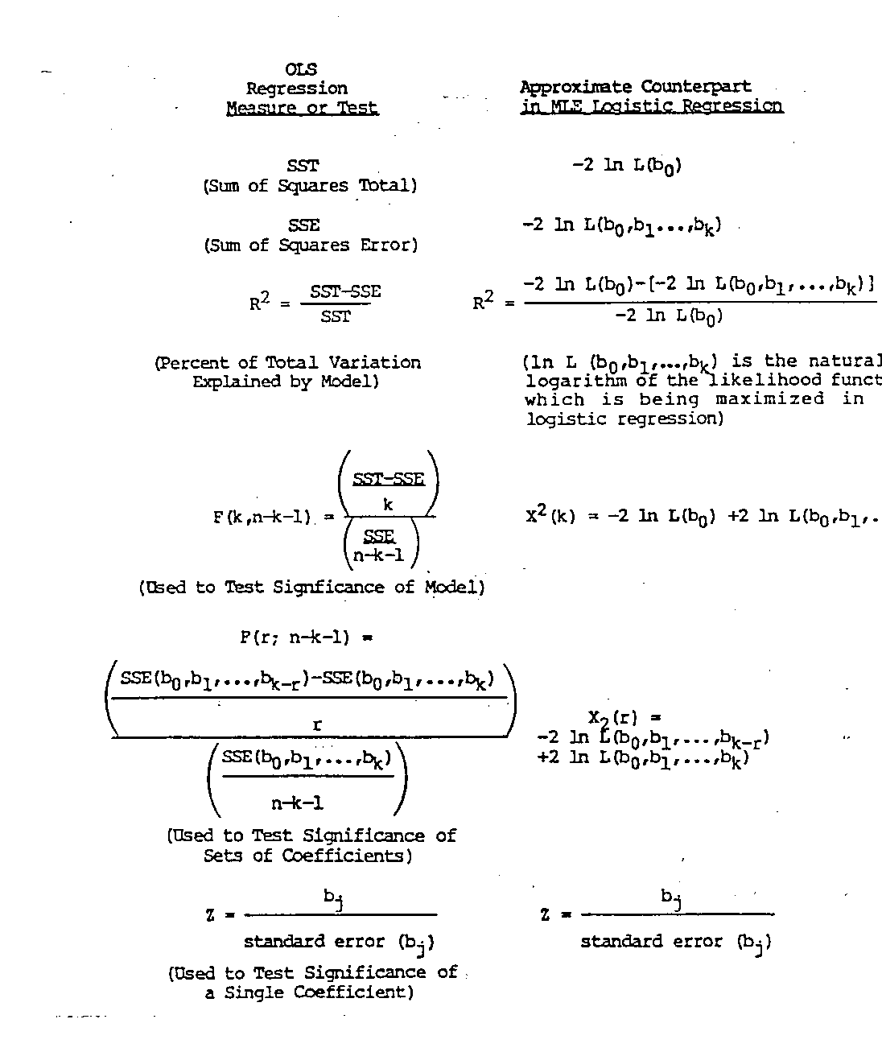
{
}
LOGISTIC REGRESSION COUNTERPART
OLS MEASURE OR TEST

Slide 8
COVERING YOUR POSTERIOR
Hosmer, page 46 of Hosmer, D. W., Lemeshow, S., Sturdivant, R. 2013. Applied Logistic Regression (Third Edition). John Wiley & Sons, Inc., Hoboken, New Jersey.
“
Because of the bias in the discriminant function estimators when normality does not hold, they should be used only when logistic regression software is not available, and then only in preliminary analyses. Any final analyses should be based on the maximum likelihood estimators of the coefficients.
”

Slide 9
COMPARISON OF CROSSTABS, DISCRETE VARIABLE LOGISTIC REGRESSIONS, AND CONTINUOUS VARIABLE LOGISTIC REGRESSIONS

Slide 10
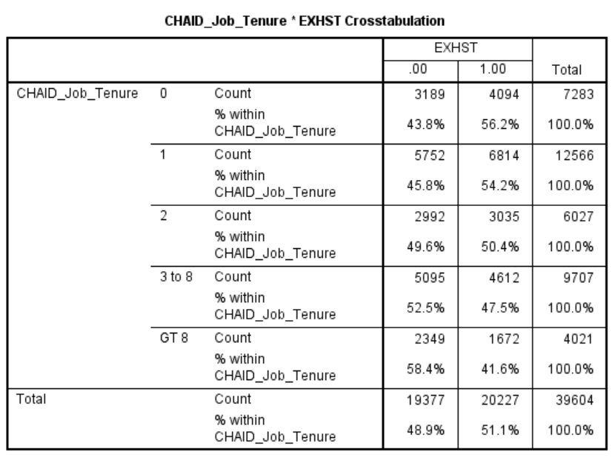
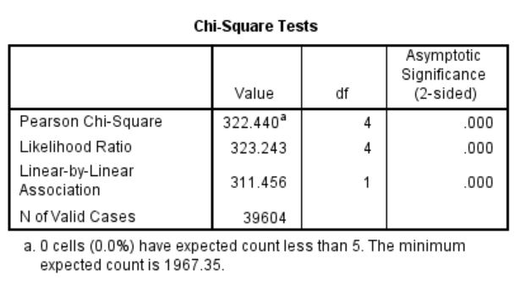

Slide 11
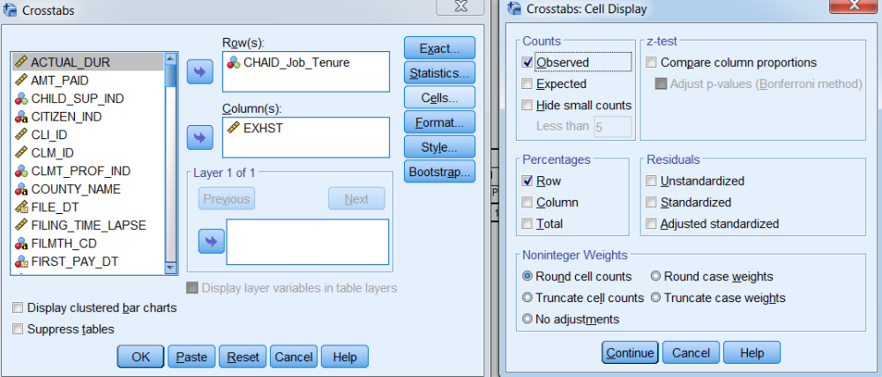
CROSS-TABS PROCEDURE

Slide 12
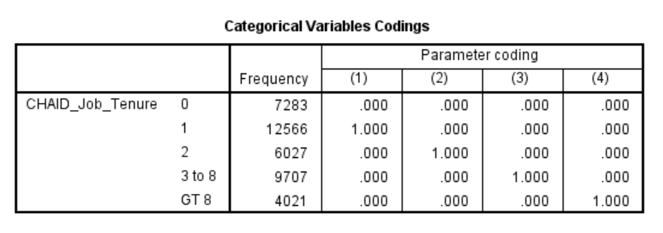
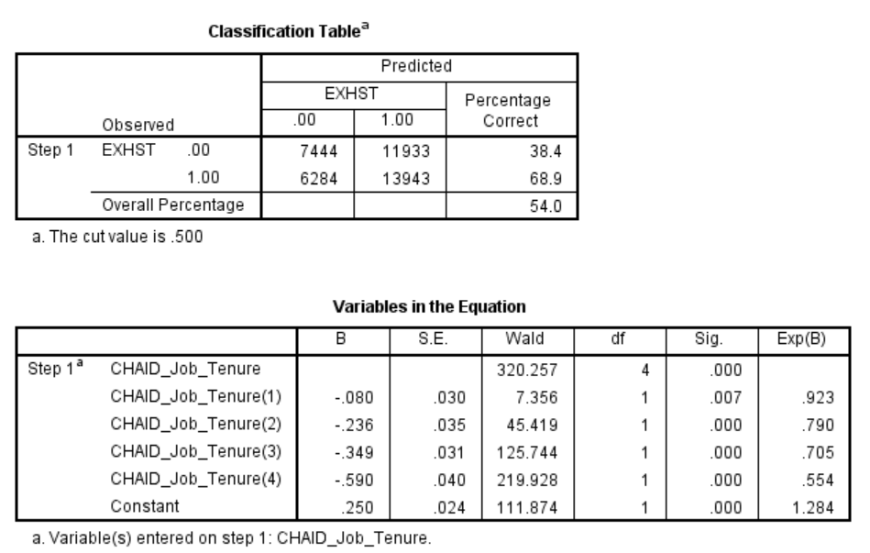
LOGISTIC REGRESSION REPORT

Slide 13
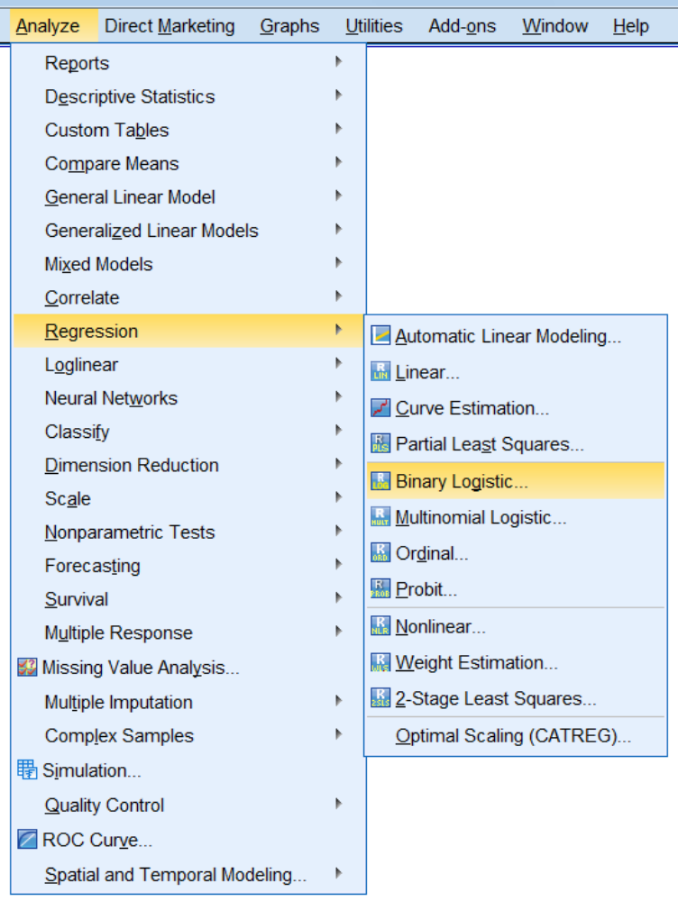
LOGISTIC REGRESSION PROCEDURE

Slide 14
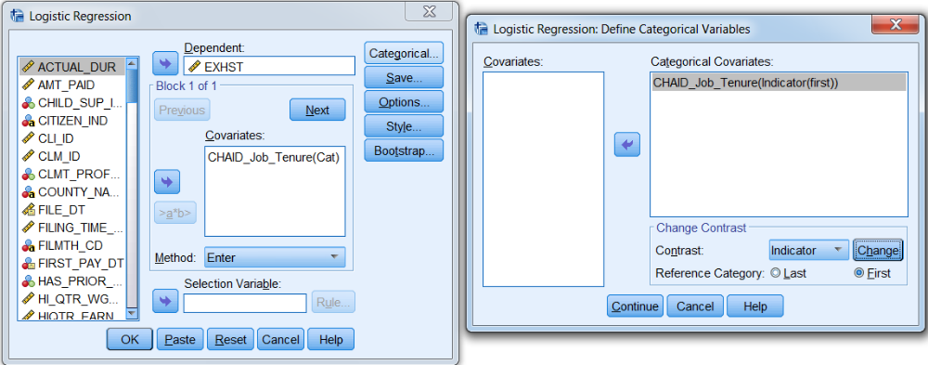
LOGISTIC REGRESSION PROCEDURE (CONT.)

Slide 15
QUESTIONS TO ASK ABOUT THE REPORT
1. How many unique values can the predicted values assume, and what will those values be? We can use Excel to answer this.

Slide 16
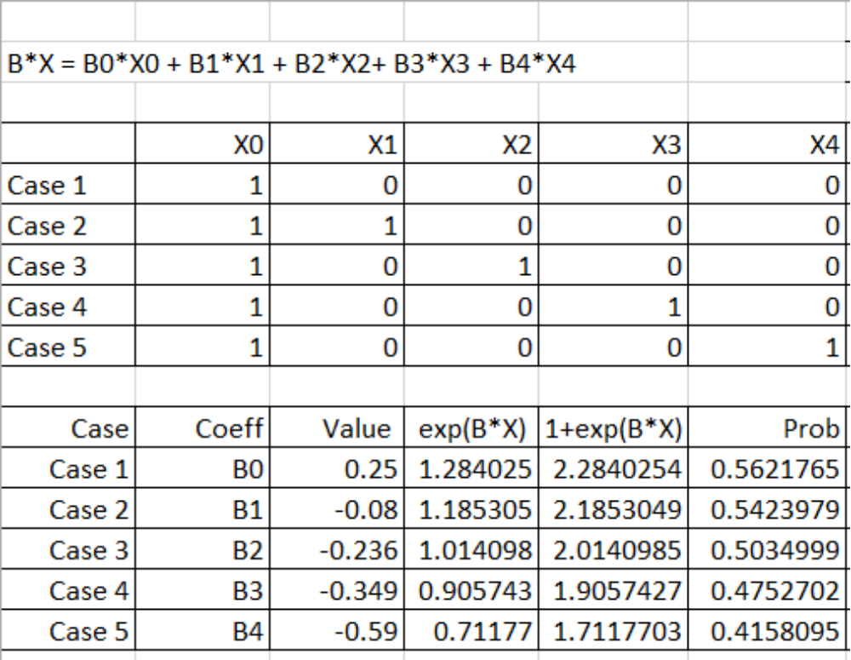
EXCEL CALCULATIONS

Slide 17
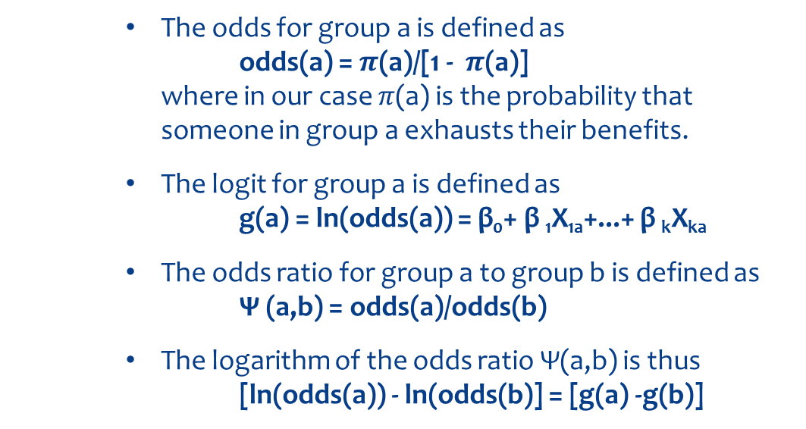
QUESTIONS TO ASK ABOUT THE REPORT
2. How are we to interpret the regression coefficients? What do they tell us about the probability of exhaustion?
Bottom Line: About all we can say is that a positive coefficient means the probability of exhaustion goes up, and a negative coefficient means the probability of exhaustion goes down. Also, the greater the magnitude of the coefficient, the greater the change in the probability.
The odds for group a is defined as
odds(a) = $π$(a)/[1 - $π$(a)]
where in our case $π$(a) is the probability that someone in group a exhausts their benefits.
The logit for group a is defined as
g(a) = ln(odds(a)) = β₀+ β ₁X_{1a}+...+ β _{k}X_{ka}
The odds ratio for group a to group b is defined as
Ψ (a,b) = odds(a)/odds(b)
The logarithm of the odds ratio Ψ(a,b) is thus
[ln(odds(a)) - ln(odds(b)] = [g(a) -g(b)]

Slide 18
QUESTIONS TO ASK ABOUT THE REPORT (cont.)
3. What does β₀ tell us in our example?
Can we confirm this from the Crosstabs output?
4. What do β₁ through β₄ tell us in our example?
Can we confirm this from our Crosstabs output?
How do odds ratios differ from probability ratios?
Assume P(A) = .9 and P(B) = .2 Then the odds ratio = 36, but the probability ratio = 4.5

Slide 19
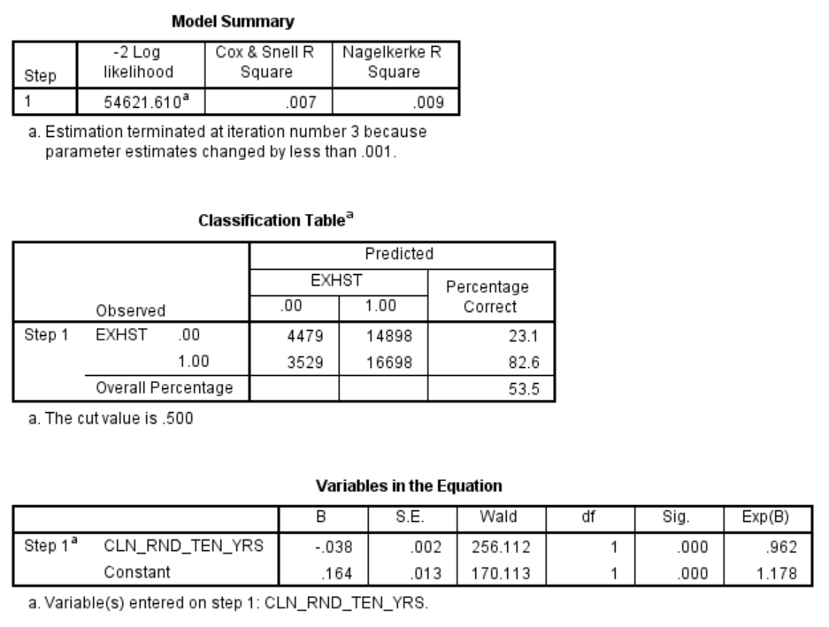
LOGISTIC REGRESSION REPORT
Job Tenure is Continuous

Slide 20
QUESTIONS TO ASK ABOUT THE REPORT
1. Is it a good idea to treat job tenure as a continuous variable in this data set?
2. How can we interpret β₀ and β ₁ in this example?
3. How would you check to see if the logistic regression results differ substantially from the ordinary least squares results?

Slide 21
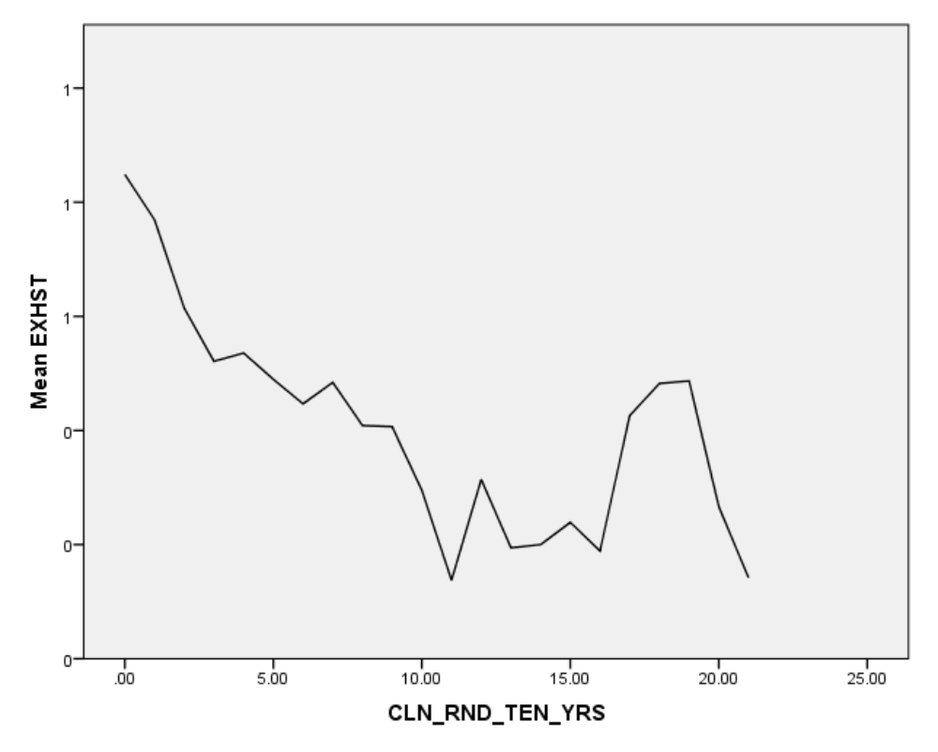
Not a Linear Relationship
Not an S Shaped Relationship

Slide 22
COEFFICIENTS
What do β₀ and β₁ tell us in this example
We know the highest probability of exhaustion occurs when Job Tenure equals zero
We know that the probability of exhaustion decreases as Job Tenure increases

Slide 23
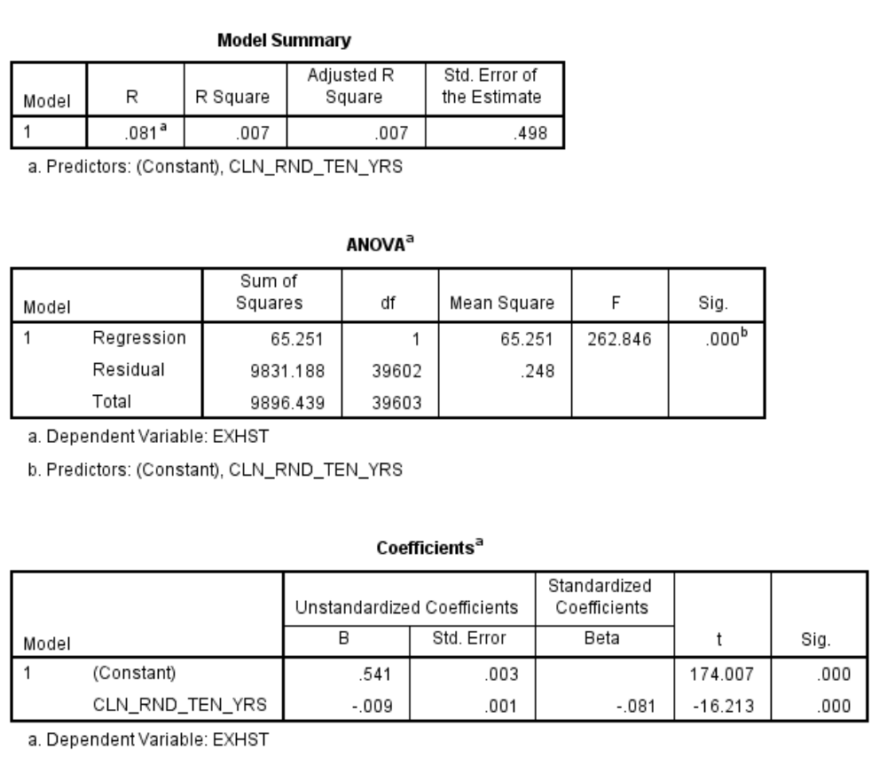
OLS Versus Logistic Regression
B0 is the probability that someone will exhaust their benefits if they have zero years of job tenure.
B1 is the expected change in the probability that someone will exhaust their benefits if job tenure increases by one year.

Slide 24
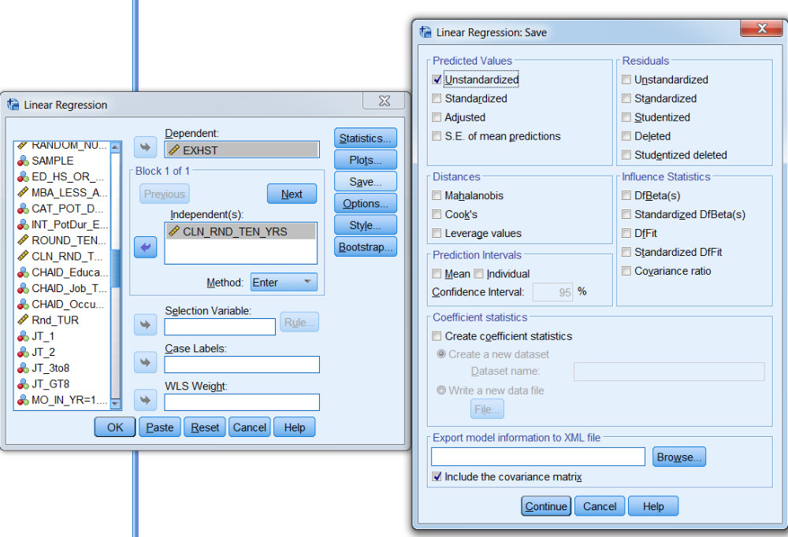
Save Probabilities from OLS

Slide 25
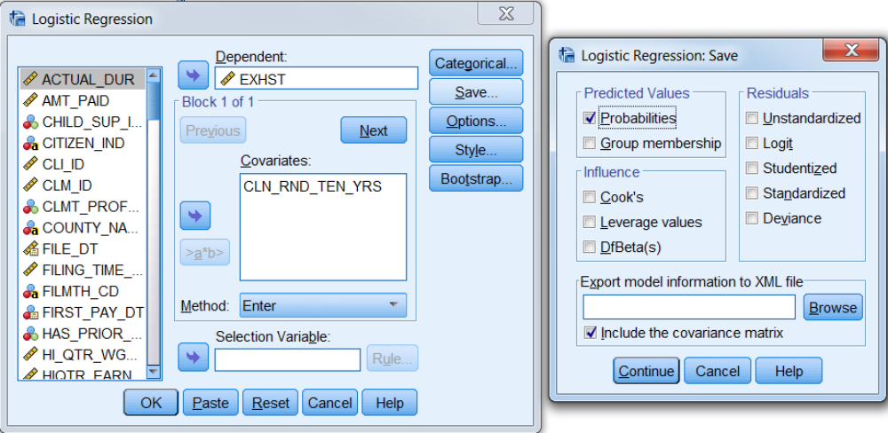
Save Probabilities from Logistic Regression

Slide 26
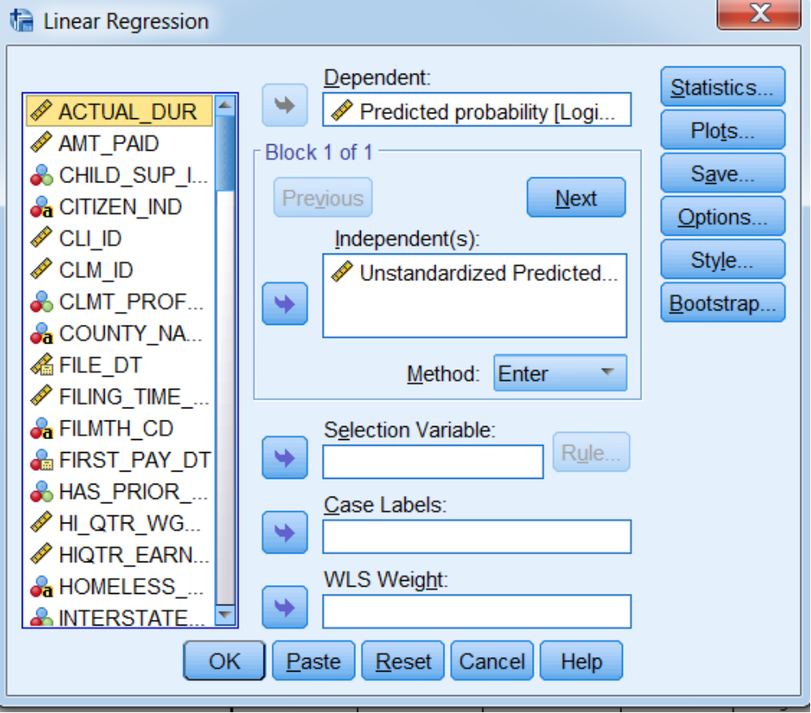
Regress OLS Probabilities on Logistic Probabilities

Slide 27
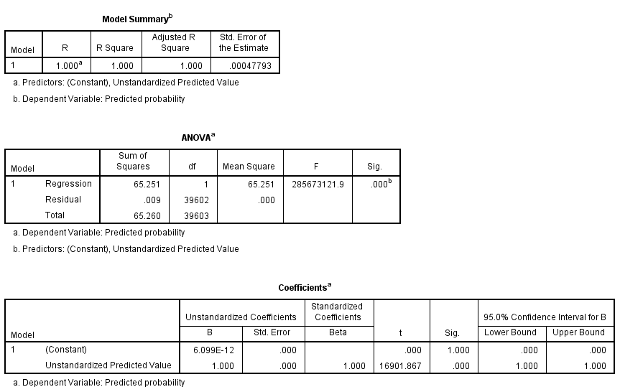
Results are Nearly Identical
R² = 1
B₁ = 1
B₀ = 0

