Slide 1
ADVANCED MODELING:
Multiple Independent Variables,
Binary Variables, and Collinearity

Slide 2
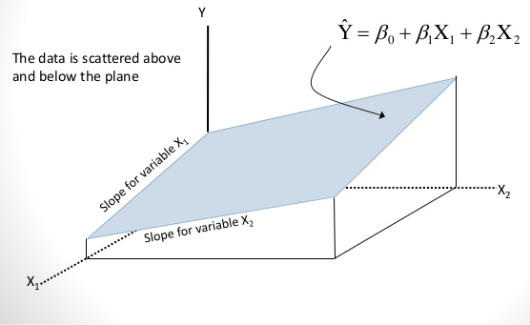
MULTIPLE REGRESSION ANALYSIS:
TWO PREDICTOR VARIABLES
Model:
Y_{i} = β₀+ β₁ X_{i1} + β₂ X_{i2} +ε_{i}
Response Surface:
E(Y_{i}) = β₀+ β₁ X_{i1} + β₂ X_{i2}
Notes:
http://image.slidesharecdn.com/multipleregression-130320062840-phpapp02/95/multiple-regression-7-638.jpg?cb=1363760985

Slide 3
MULTIPLE REGRESSION ANALYSIS:
DEFINITIONS
β₁ and β₂ are partial regression coefficients.
β₁ indicates the change in E(Y) given a one unit increase in X₁ when X₂ is held fixed. β₂ is similarly defined.
Contrast to simple regression coefficient in which other variables are ignored. This can be a major problem when X₁ and X₂ are correlated, or the effect of X₁ depends on the level of X₂

Slide 4
EXAMPLE REGRESSION (DATA FILE IS LAND)
Landval | Improval | Salepric (Y)
5,600 | 19,410 | 44,000
5,600 | 21,040 | 45,000
8,600 | 35,560 | 69,900
5,600 | 22,020 | 44,000
6,200 | 31,640 | 70,300
5,500 | 22,360 | 48,200
7,020 | 40,790 | 80,000
5,000 | 56,520 | 97,500
2,000 | 7,340 | 25,000
2,000 | 9,130 | 27,600
2,500 | 13,300 | 39,000
4,000 | 13,630 | 40,500
4,300 | 22,070 | 50,000
3,600 | 18,060 | 39,500
3,600 | 19,220 | 41,500
3,600 | 14,970 | 32,500
3,630 | 19,200 | 44,500
3,490 | 14,680 | 32,500
3,450 | 21,630 | 43,000
3,490 | 19,100 | 38,000
2,500 | 10,680 | 28,500
2,500 | 10,010 | 26,000
2,500 | 10,520 | 26,000
3,000 | 13,640 | 30,500

Slide 5
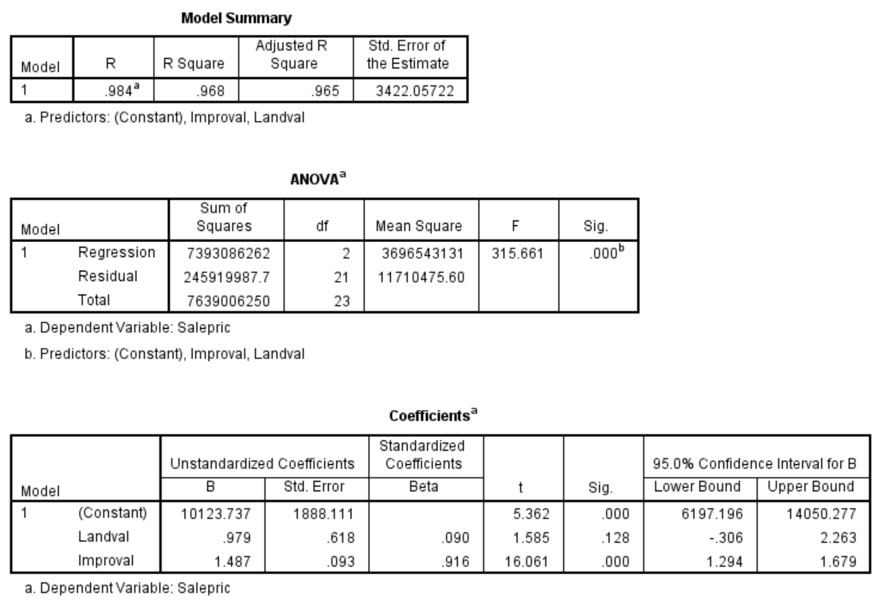
PARTIAL REGRESSION COEFFICIENTS (DATA FILE IS LAND)

Slide 6
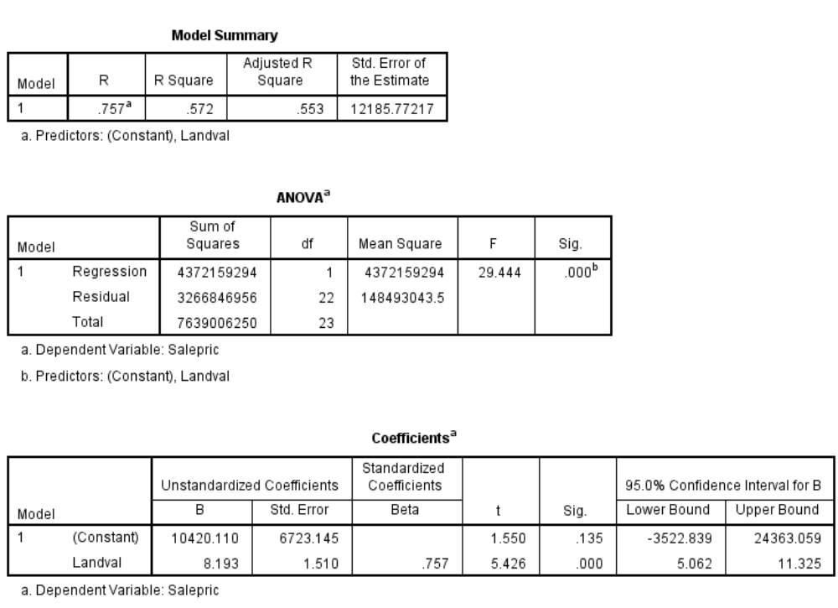
SIMPLE REGRESSION COEFFICIENTS: LANDVAL = X
The coefficient for Landval is 8 times larger than it should be. Moreover, you cannot get the correct value for the coefficient by increasing sample size. You would just get more and more confident about the wrong answer.

Slide 7
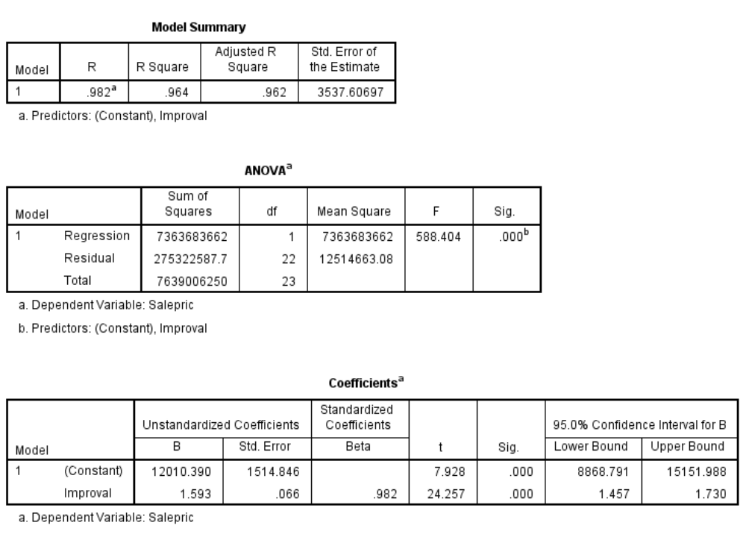
SIMPLE REGRESSION COEFFICIENTS: IMPROVAL = X
The coefficient for Improval is larger than it should be. It is picking up the effect of both land value and improvement value.

Slide 8


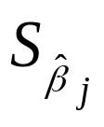
GENERAL MODEL
Model
Y_{i}=β₀+ β₁X_{i1}+ β₂X_{i2}+.....+ β_{k}X_{ik}+ε_{i}
Response Surface
E(Y_{i}) = β₀+ β₁X_{i1}+ β₂X_{i2}+.....+ β_{k}X_{ik}
Point Estimators
for j = 1, ..., k
* Referred to as “B” on SPSS output
Standard Errors
* Referred to as “Std Error” on SPSS output

Slide 9
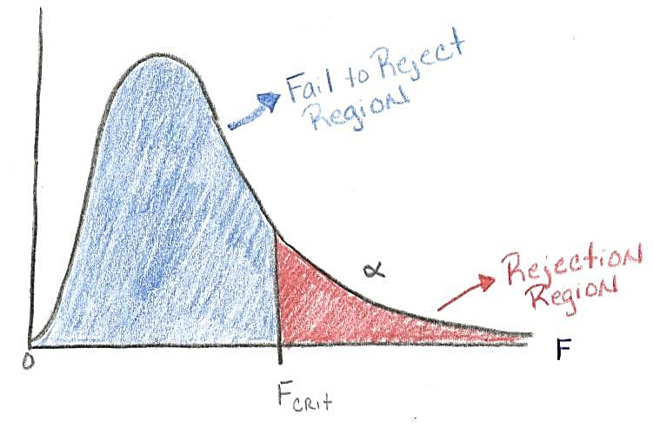

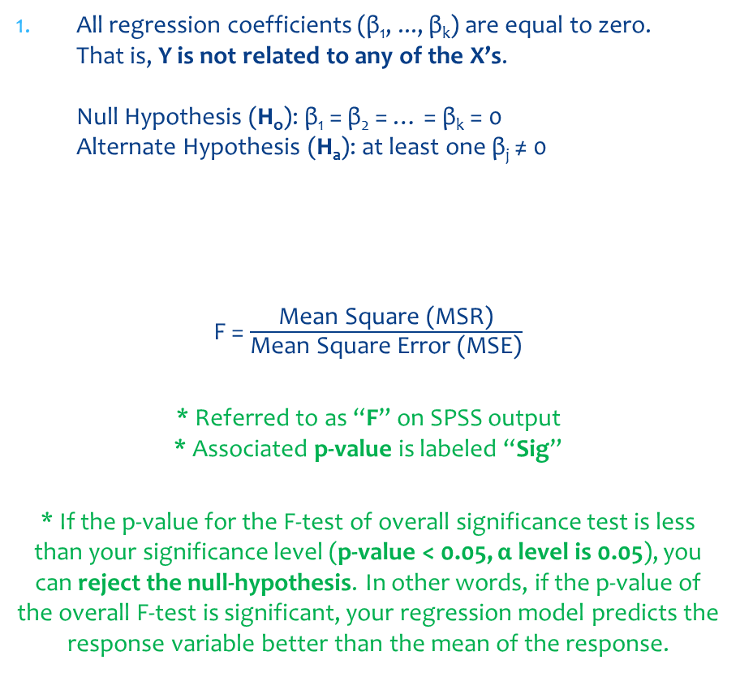
GENERAL MODEL: TESTS OF INTEREST
All regression coefficients (β₁, ..., β_{k}) are equal to zero.
That is, Y is not related to any of the X’s.
Null Hypothesis (H_{o}): β₁ = β₂ = … = β_{k} = 0
Alternate Hypothesis (H_{a}): at least one β_{j} ≠ 0
F = $\frac{\text{Mean} \text{Square}\text{ (}\text{MSR}\text{)}}{\text{Mean} \text{Square} \text{Error}\text{ (}\text{MSE}\text{)}}$
* Referred to as “F” on SPSS output
* Associated p-value is labeled “Sig”
* If the p-value for the F-test of overall significance test is less than your significance level (p-value < 0.05, α level is 0.05), you can reject the null-hypothesis. In other words, if the p-value of the overall F-test is significant, your regression model predicts the response variable better than the mean of the response.

Slide 10


GENERAL MODEL: TESTS OF INTEREST (cont.)
An individual β_{j} is equal to zero. That is, an individual X is not related to Y given the other X variables that are in the model.
H_{o}: β_{j} = 0 (no relationship / X is not related to Y at all)
H_{a}: β_{j} ≠ 0
t is the ratio of the coefficient (β_{j}) to the standard error of the coefficient ( )
* Referred to as “t” on SPSS output
* Alternatively, a 100(1-α)% confidence interval on β_{j} is
β_{j} + t_{n-(k+1),α/2}
* The larger the absolute value of the t-value, the smaller the p-value, and the greater the evidence against the null hypothesis.
Notes:
These columns in the Regression Output of SPSS provide the t-value and 1 or 2 tailed p-value used in testing the null hypothesis that the coefficient/parameter is 0. If you use a 2 tailed test, then you would compare each p-value to your preselected value of alpha. Coefficients having p-values less than alpha are statistically significant. For example, if you chose alpha to be 0.05, coefficients having a p-value of 0.05 or less would be statistically significant (i.e., you can reject the null hypothesis and say that the coefficient is significantly different from 0). If you use a 1 tailed test (i.e., you predict that the parameter will go in a particular direction), then you can divide the p-value by 2 before comparing it to your preselected alpha level. With a 2-tailed test and alpha of 0.05, you should not reject the null hypothesis that the coefficient for female is equal to 0, because p-value = 0.051 > 0.05. The coefficient of -2.009765 is not significantly different from 0.

Slide 11
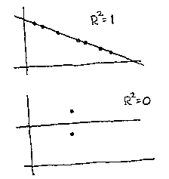
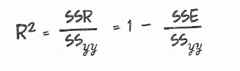
GENERAL MODEL: COEFFICIENT OF MULTIPLE DETERMINATION
Perfect Relationship
No Relationship
R² = SS(Model) / SS(Total) = 1 – (σ_{e}²/ σ_{y}²)
Measures the proportionate reduction in the total variance of Y that is associated with the use of all the predictor variables in the model

Slide 12
BINARY VARIABLES AND INTERACTIONS

Slide 13
INDICATOR VARIABLES
Indicator or dummy variables are used to code Qualitative or Categorical variables such as gender, ethnic group, industry classification, or season.
It is easiest to use the “Transform” tab on the SPSS menu. There is an option to Create Dummy Variables
Quarterly and monthly seasonal dummy variables already have been created in your database.

Slide 14
ADDITIVE SEASONAL REGRESSION MODELS
Example
Suppose we want to model EXHST as a function of the yearly quarter.
Allocated Code
X₁ = 1 if January-March
= 2 if April-June
= 3 if July-September
= 4 if October-December

Slide 15
ADDITIVE SEASONAL REGRESSION MODELS (CONT.)
Model: E(Y)=β₀+β₁X₁
This model implies:
E(Y)=β₀+ β₁ in Quarter 1 (January – March)
E(Y)=β₀+ 2β₁ in Quarter 2 (April – June)
E(Y)=β₀+ 3β₁ in Quarter 3 (July – September)
E(Y)=β₀+ 4β₁ in Quarter 4 (October – December)
Note that the model forces differences in EXHST between the quarters to be in increments of β₁. In addition, the allocated code forces an implicit ordering among the quarters with regard to EXHST. Does this make sense?

Slide 16
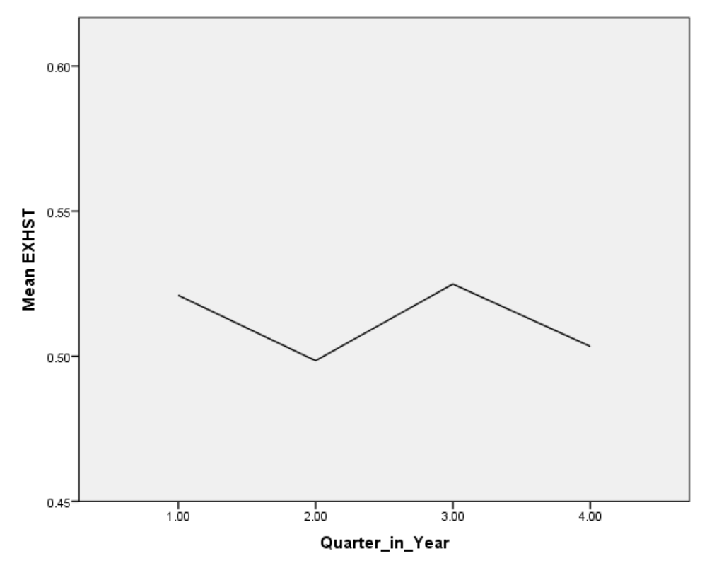
Plot of Mean Exhaust by Quarter
Not a linear relationship

Slide 17
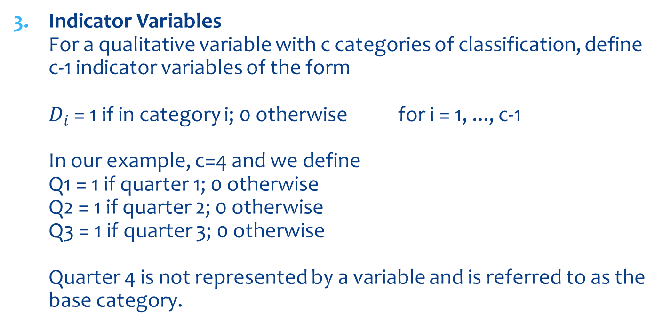
ADDITIVE SEASONAL REGRESSION MODELS (CONT.)
Indicator Variables
For a qualitative variable with c categories of classification, define c-1 indicator variables of the form
$D_{i}$ = 1 if in category i; 0 otherwise for i = 1, ..., c-1
In our example, c=4 and we define
Q1 = 1 if quarter 1; 0 otherwise
Q2 = 1 if quarter 2; 0 otherwise
Q3 = 1 if quarter 3; 0 otherwise
Quarter 4 is not represented by a variable and is referred to as the base category.

Slide 18
ADDITIVE SEASONAL REGRESSION MODELS (CONT.)
Model: E(Y)= β₀+ β₁Q₁+ β₂Q₂+ β₃Q₃
This model implies:
E(Y)=β₀+ β₁ in Quarter 1
E(Y)=β₀+ β₂ in Quarter 2
E(Y)=β₀+ β₃ in Quarter 3
E(Y)= β₀ in Quarter 4
β₁ represents the difference in average EXHST between quarter 1 and quarter 4.
β₂ represents the difference in average EXHST between quarter 2 and quarter 4.
β₃ represents the difference in average EXHST between quarter 3 and quarter 4.
β₁ = β₂ = β₃ = 0 implies the average for EXHST is equal for all quarters. That is, there is no quarterly effect.
What does β₁ - β₂ represent?

Slide 19
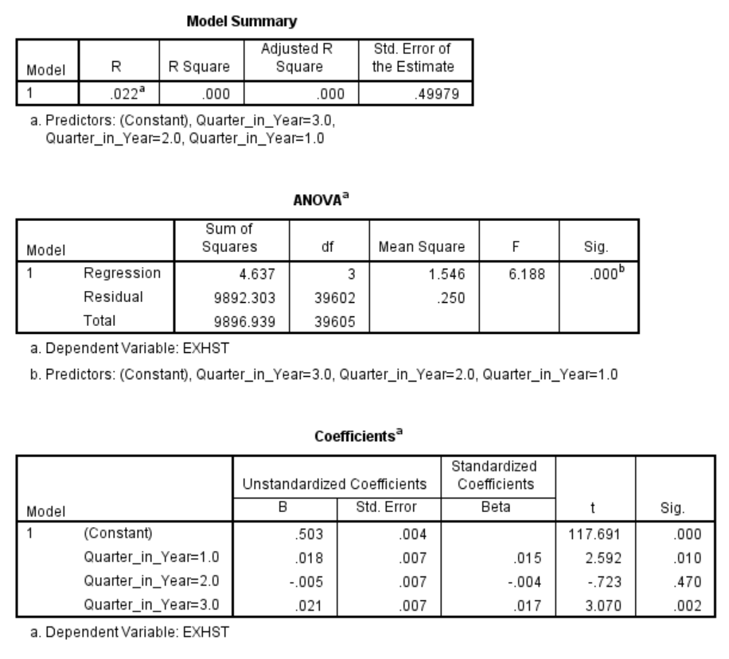
B1 – B2 is the difference in the exhaustion rates between quarter 1 and quarter 2

Slide 20
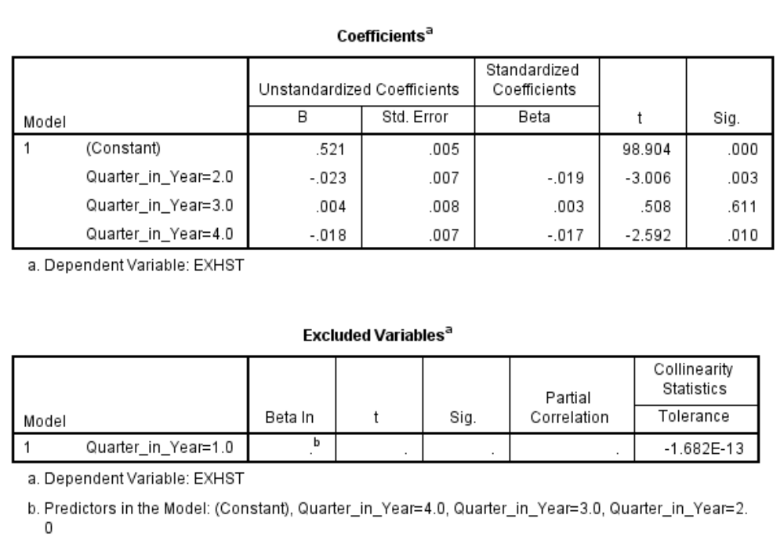
Attempt to Run with Four Quarterly Dummies

Slide 21
MODELS WITH BOTH QUANTITATIVE AND QUALITATIVE PREDICTORS
No interaction example
Y = EXHST
Q₁, Q₂, Q₃ = Dummy variables to represent quarter
X₄=UNEMPLOYMENT_RATE

Slide 22
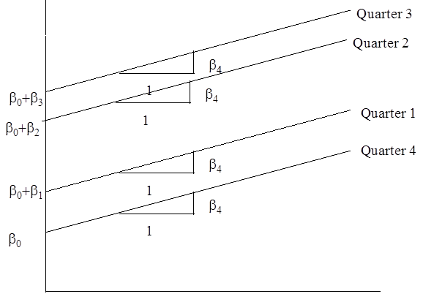
MODELS WITH BOTH QUANTITATIVE AND QUALITATIVE PREDICTORS
Model: E(Y)=β₀+ β₁Q₁+ β₂Q₂+ β₃Q₃+ β₄X₄
This model implies:
E(Y)=(β₀+ β₁)+ β₄X₄ in Quarter 1
E(Y)= (β₀+ β₂)+ β₄X₄ in Quarter 2
E(Y)= (β₀+ β₃)+ β₄X₄ in Quarter 3
E(Y)= (β₀)+ β₄X₄ in Quarter 4
EXHST
*Note that the slope is the same in each quarter in this model.
UNEMPLOYMENT RATE

Slide 23
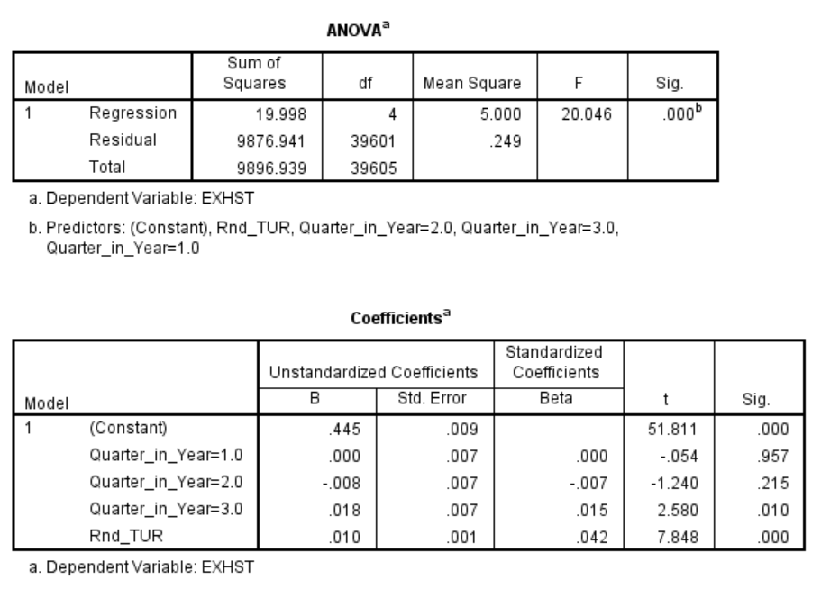
Regression Output
*Note that there is only one coefficient for the Unemployment Rate

