Slide 1
ADVANCED MODELING:
Interactions, Transformations, and Collinearity

Slide 2
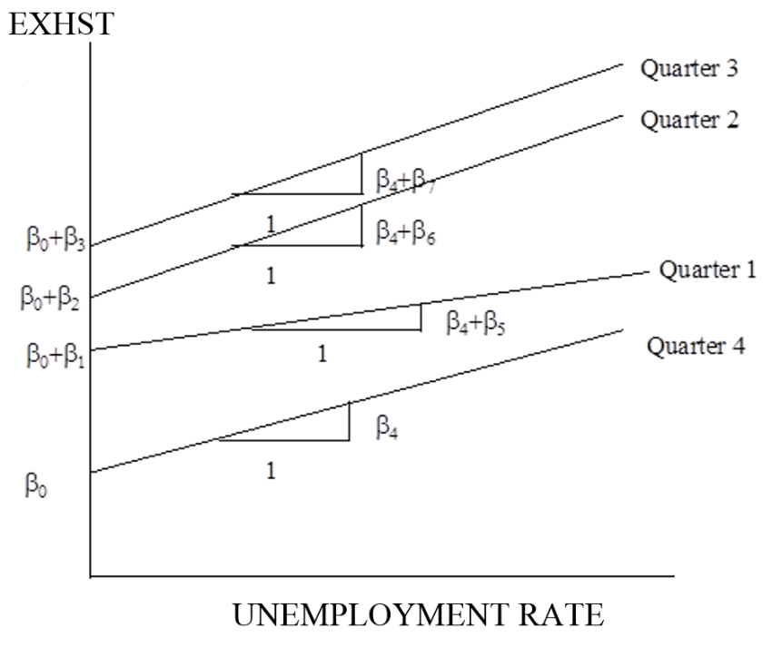
MODELS WITH BOTH QUANTITATIVE AND QUALITATIVE PREDICTORS
Interaction example
Model: E(Y)=β₀+ β₁Q₁+ β₂Q₂+ β₃Q₃+ β₄X₄+ β₅Q₁X₄+ β₆Q₂X₄+ β₇Q₃X₄
This model implies:
E(Y)=(β₀ +β₁)+(β₄+β₅)X₄ in Quarter 1
E(Y)= (β₀ +β₂)+(β₄+β₆)X₄ in Quarter 2
E(Y)= (β₀ +β₃)+(β₄+β₇)X₄ in Quarter 3
E(Y)= (β₀)+β₄X₄ in Quarter 4
*Note that both the slope and the intercept can be different for each quarter.

Slide 3
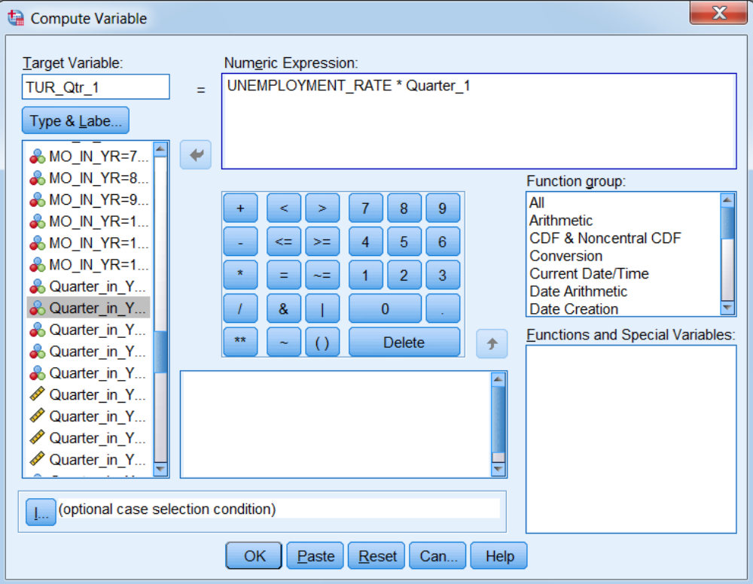
Create Product Variables

Slide 4
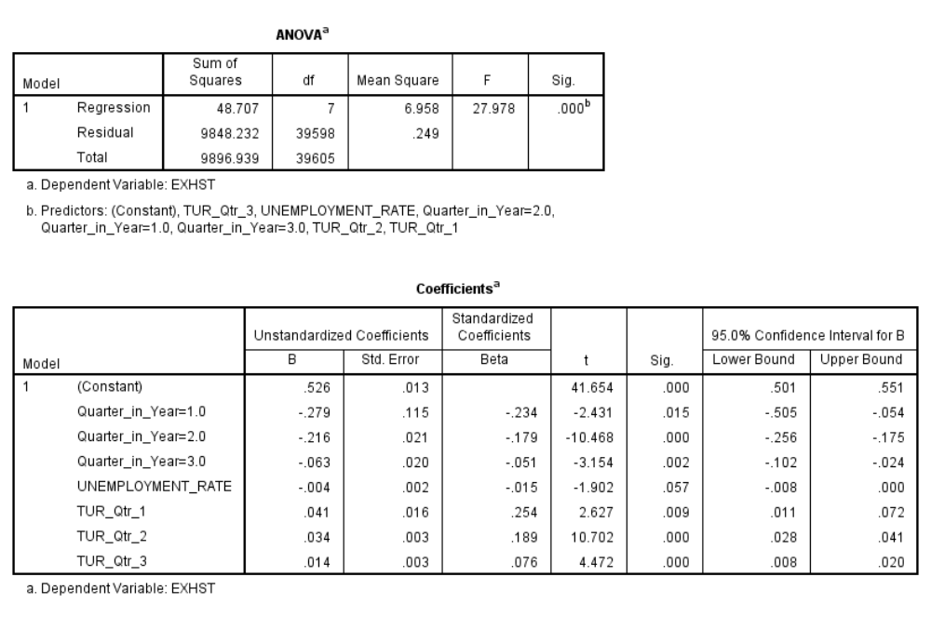
Regression Results
*Note that both intercepts and slopes are different.

Slide 5
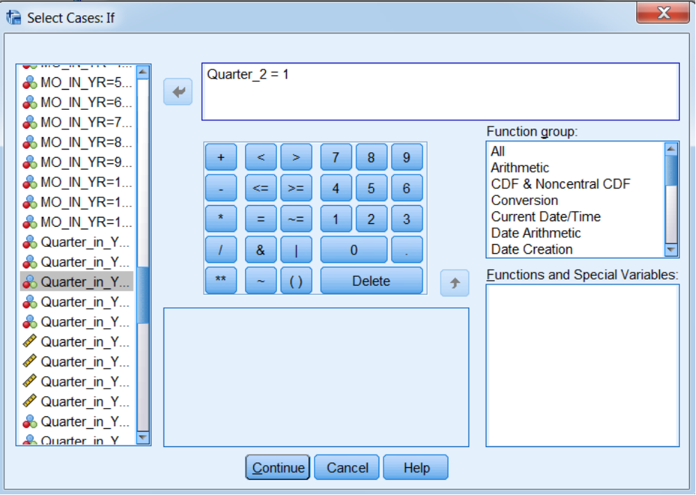
Does this differ from running four separate regressions?
(apply filter for quarter 2)

Slide 6
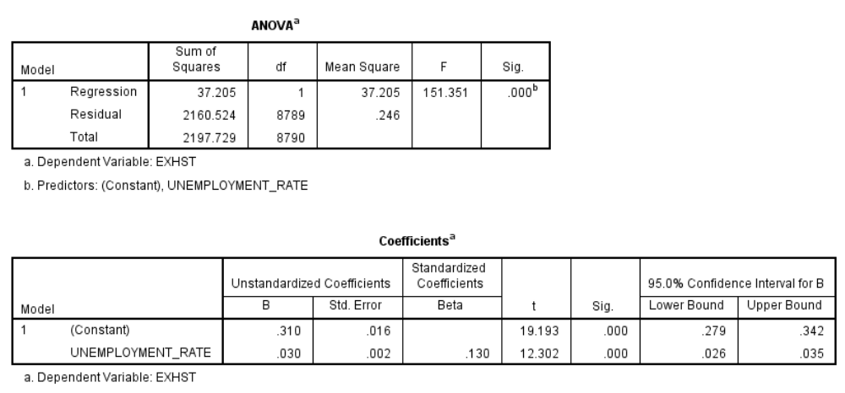
Run separate regression for quarter 2
*Note that B₀ + B₂ = .526 - .216 = .310 and B₄ +B₆ = -.004 + .034 = .030

Slide 7
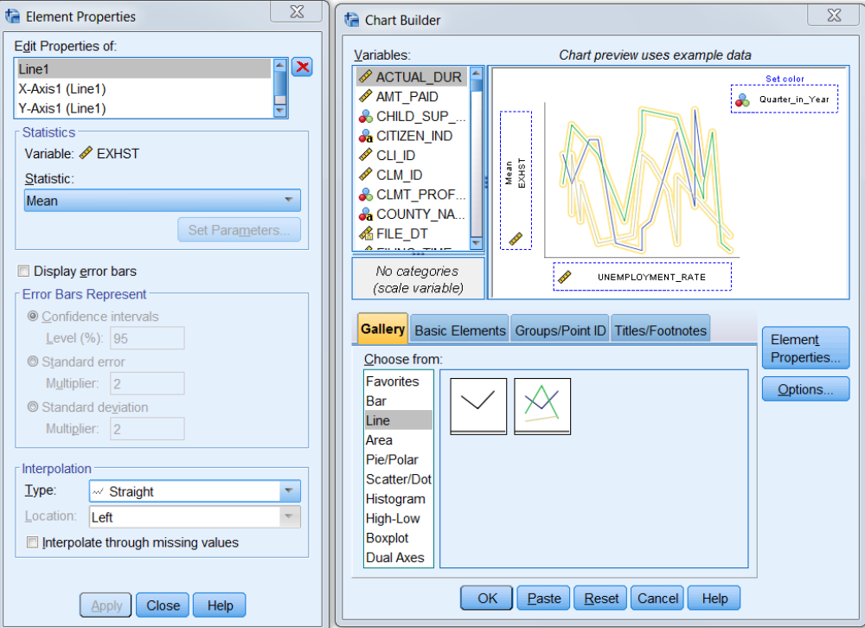
How to visually check to see if it may be necessary
to add an interaction term

Slide 8
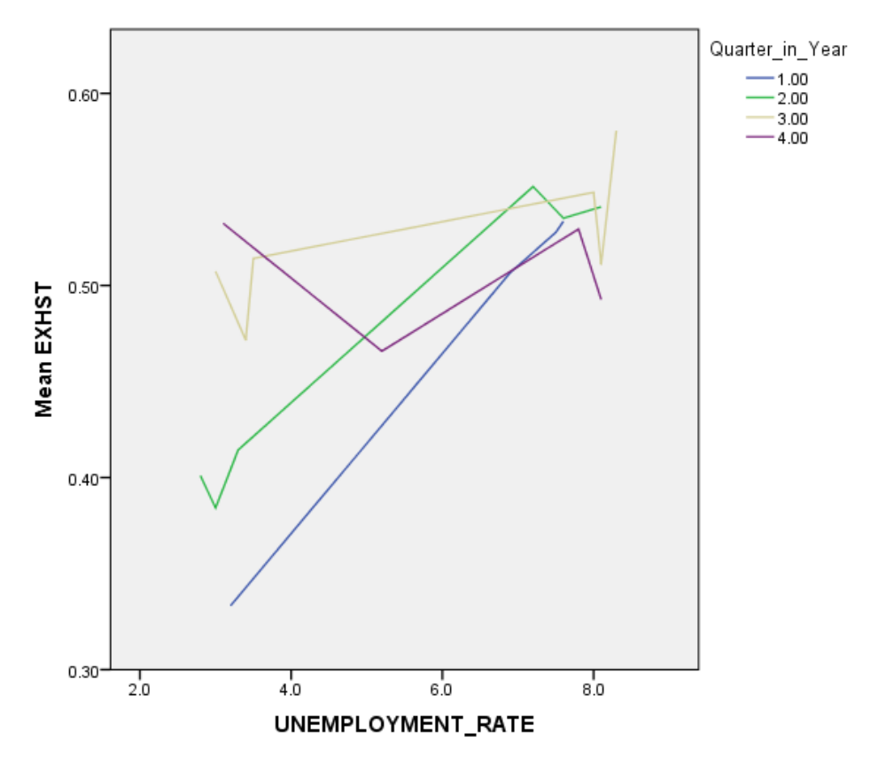
Do the lines for each quarter have the same slopes?

Slide 9
MODEL BUILDING EXAMPLE
income | age | educ
20 | 25 | <HS
25 | 35 | <HS
30 | 45 | <HS
25 | 25 | HS
35 | 35 | HS
45 | 45 | HS
30 | 25 | >HS
50 | 35 | >HS
70 | 45 | >HS
Is it possible to build a model which has an R² of 1.00 for this data? What is the model?
Hint: Plot income versus age for the three education levels. File name is PerfectModel.

Slide 10
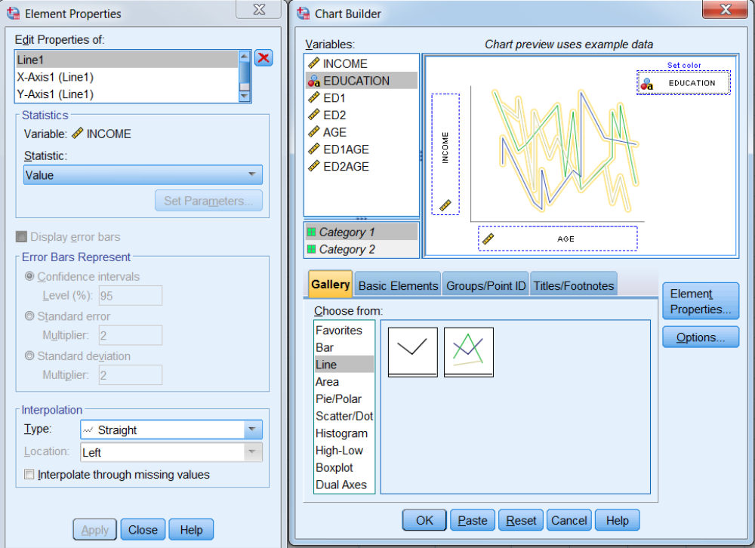
Chart Builder

Slide 11
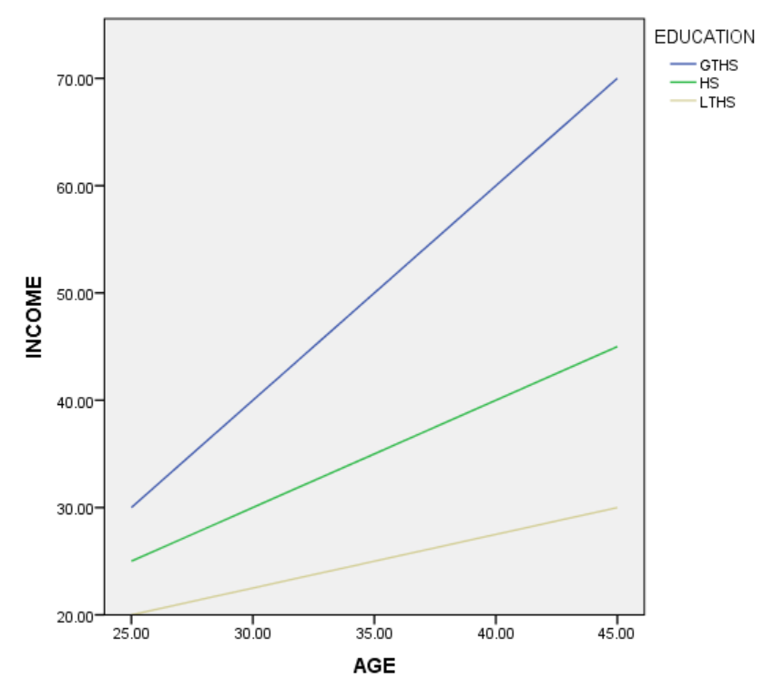
INCOME VS. AGE FOR THREE EDUCATION LEVELS

Slide 12
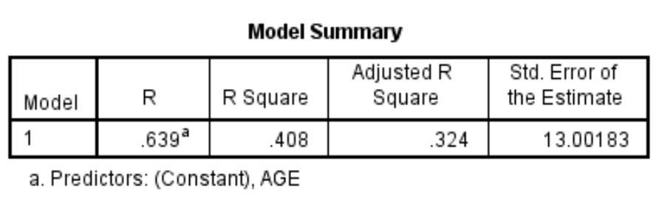
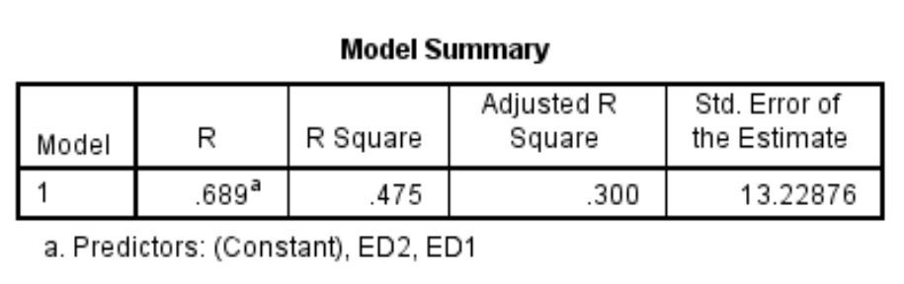
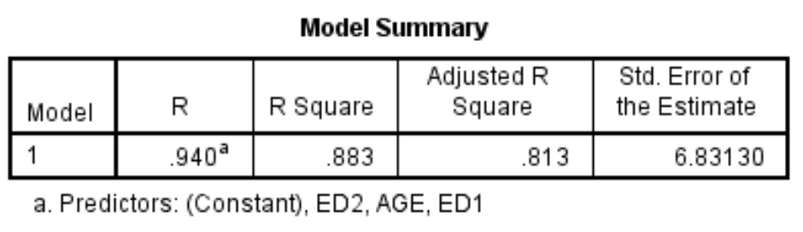
Just Age
Just Education
Age and Education, but no Interactions

Slide 13
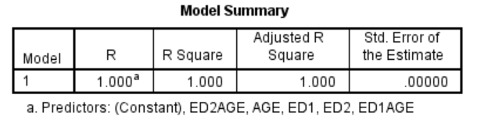
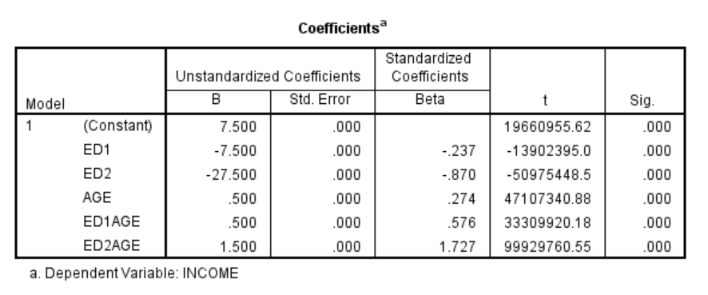
Age, Education, and Interactions

Slide 14
The True Model
Model:
Income = 7.5 - 7.5*ed1 - 27.5*ed2 + .5*age + .5*ed1age + 1.5*ed2age
income | ed1 | ed2 | age | ed1age | ed2age
20 | 0 | 0 | 25 | 0 | 0
25 | 0 | 0 | 35 | 0 | 0
30 | 0 | 0 | 45 | 0 | 0
25 | 1 | 0 | 25 | 25 | 0
35 | 1 | 0 | 35 | 35 | 0
45 | 1 | 0 | 45 | 45 | 0
30 | 0 | 1 | 25 | 0 | 25
50 | 0 | 1 | 35 | 0 | 35
70 | 0 | 1 | 45 | 0 | 45

Slide 15
LOGISTIC REGRESSION and INTERACTIONS

Slide 16
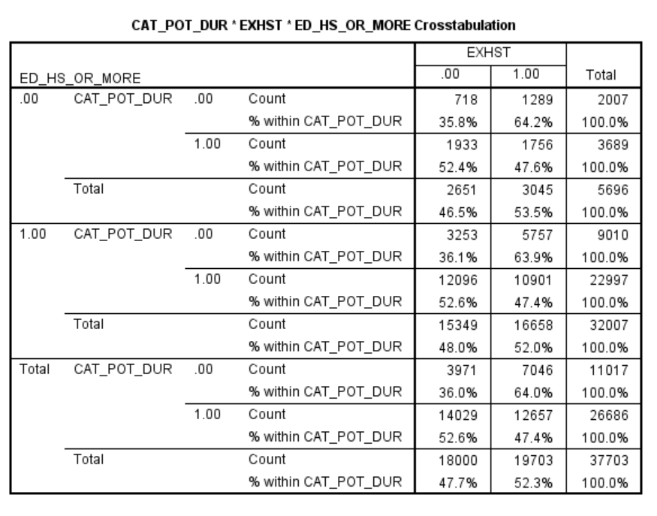
CROSSTABS
Crosstabs automatically handle interactions

Slide 17
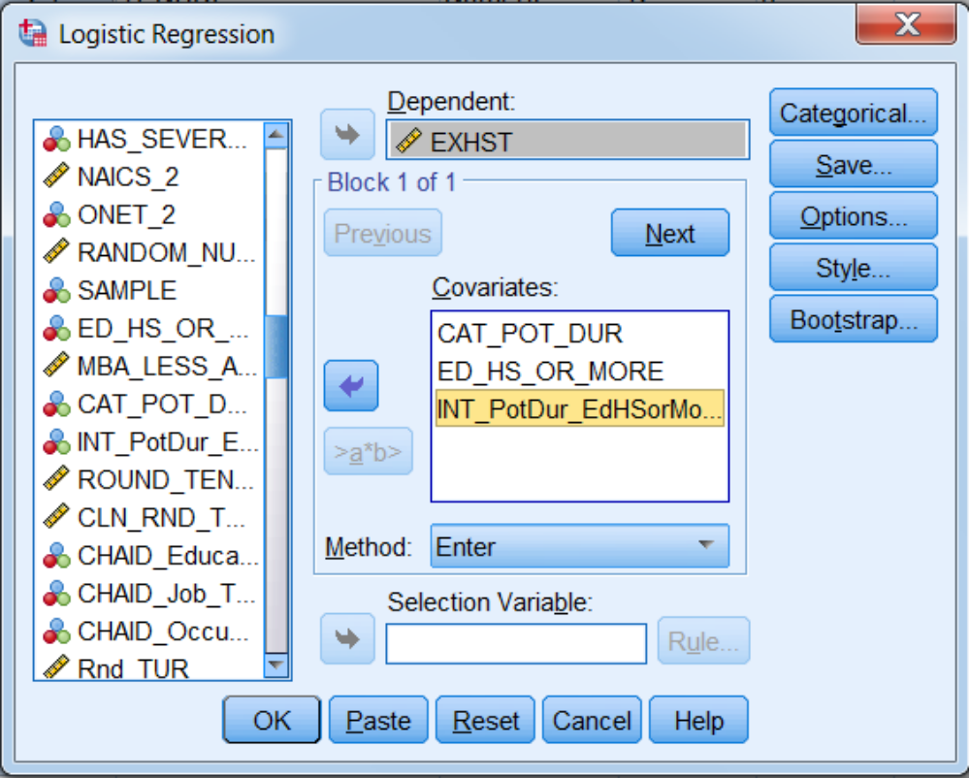
In logistic regression, interactions must be modeled
(same as in OLS)

Slide 18
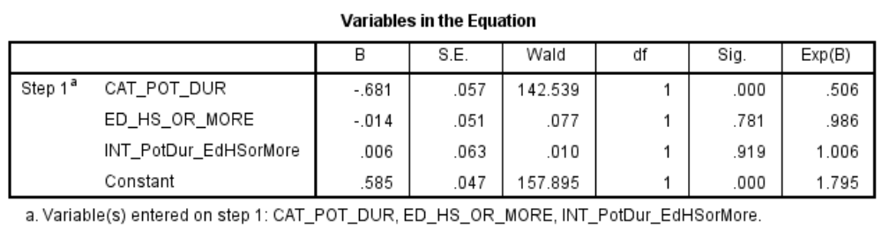
What does using logistic regression do for you that crosstabs do not? (Hint: Think about statistical significance).
Logit = .585 -.681*(CAT_POT_DUR) -.014*(ED_HS_OR_MORE)
+.006*(INT_PotDur_EdHSorMore)
Note that the regression tells us the education variable is not helpful as currently specified.

Slide 19
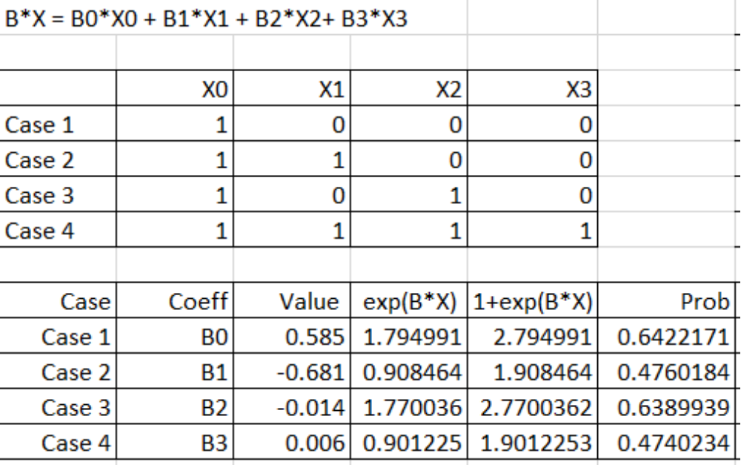
Estimated Probabilities are the Same as in Crosstabs
Note that this confirms that the education variable is not helpful as currently specified.

Slide 20
FITTING NON-LINEAR RELATIONSHIPS

Slide 21
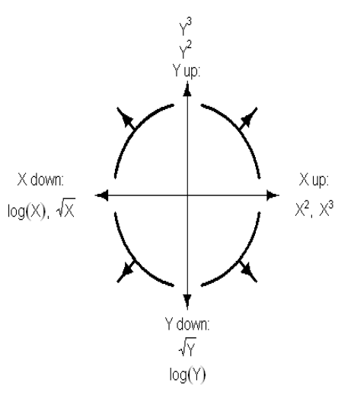
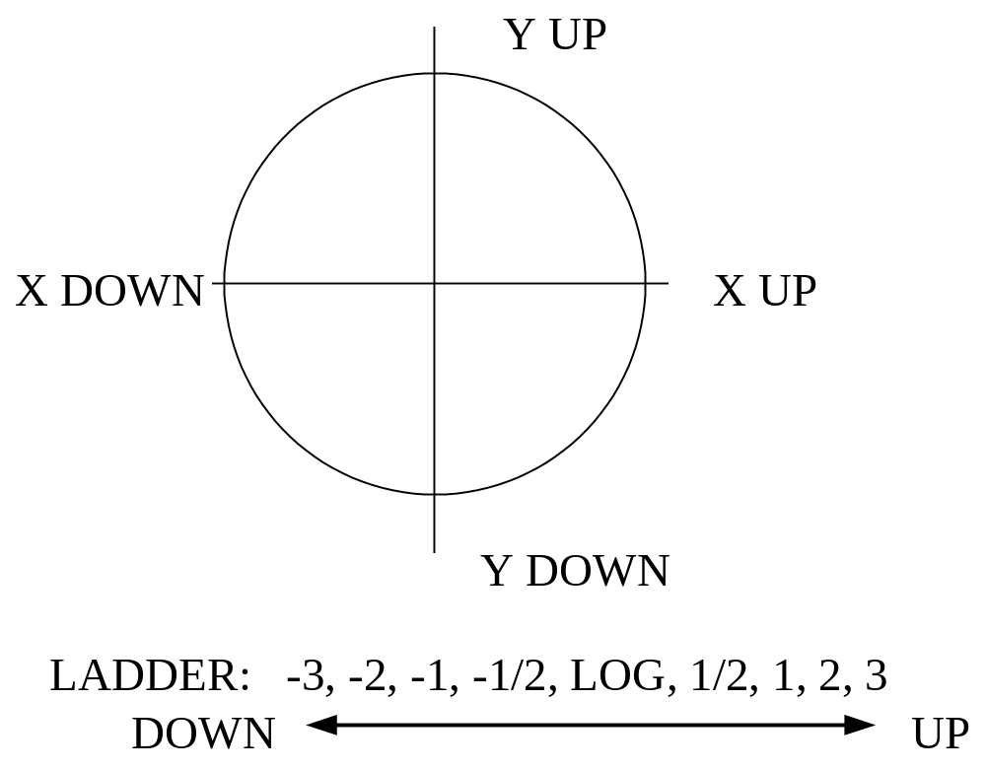
TRANSFORMATIONS
Ladder of re-expression (Mosteller and Tukey)

Slide 22
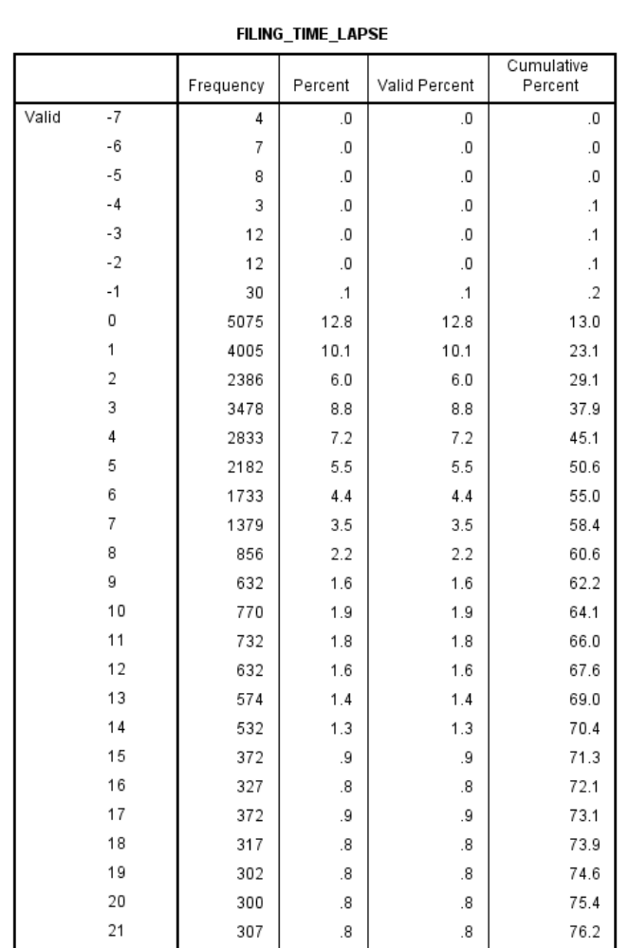
Let’s Look at Filing Time Lapse
There are a number of outliers for this variable. We can use a filter to screen them out. We also may want to group the values in order to get a more meaningful plot.

Slide 23
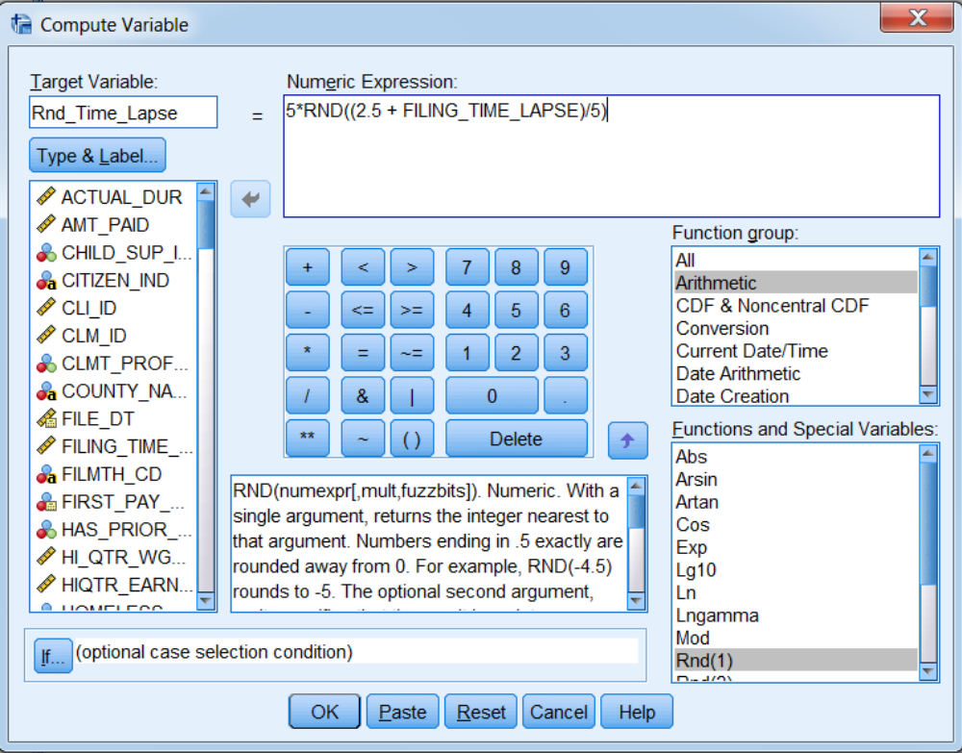
Let’s Use 5 Day Groups

Slide 24
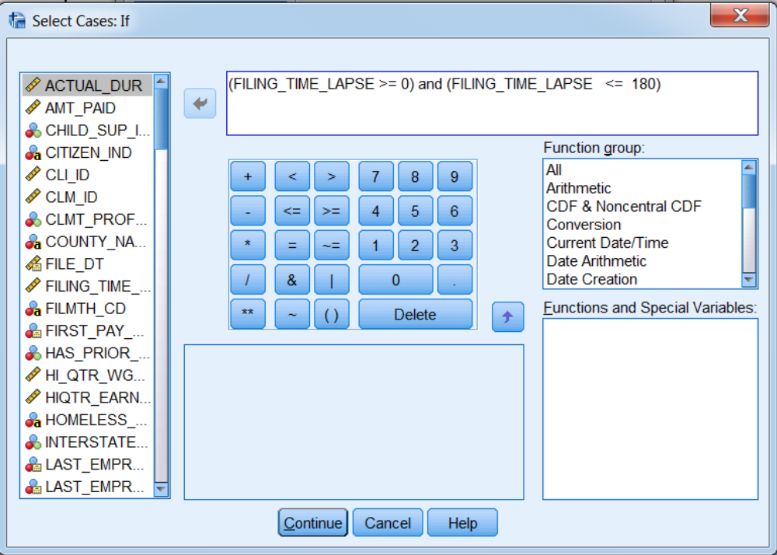
And Screen out Values Less than Zero or Greater than 180

Slide 25
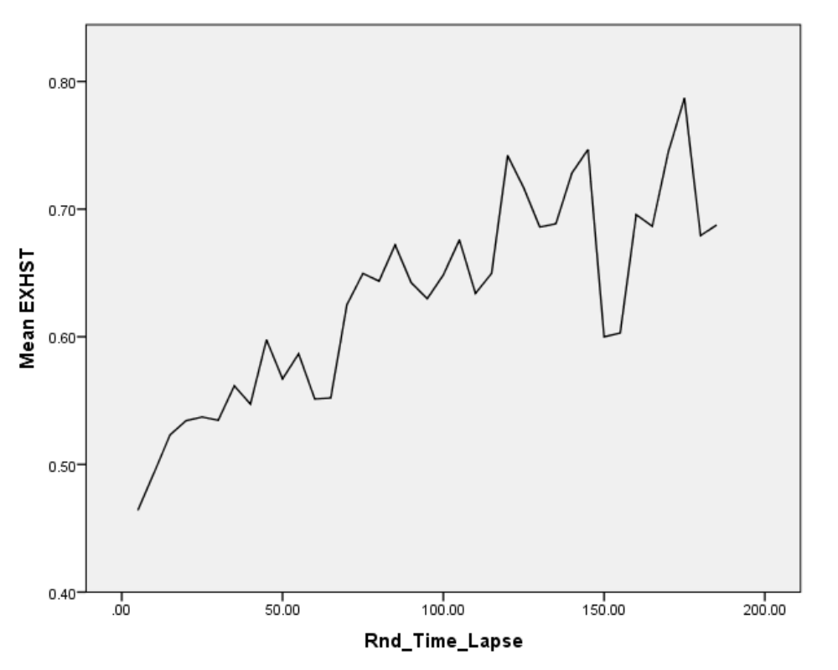
The Scatter Plot Resembles the Plot in Quadrant 4 of the Ladder of Re-Expression

Slide 26
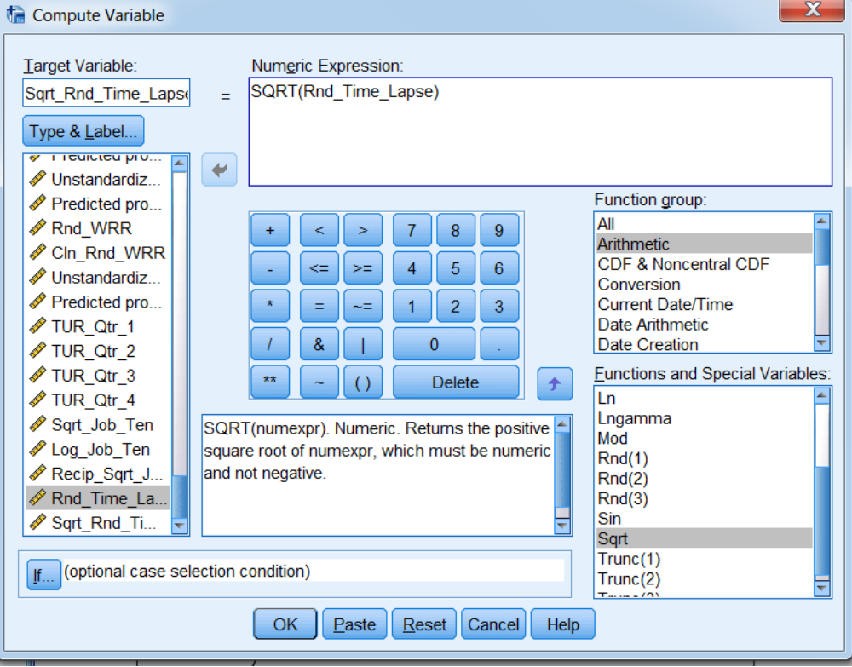
The Ladder of Re-Expression Suggests a Square Root Transformation

Slide 27
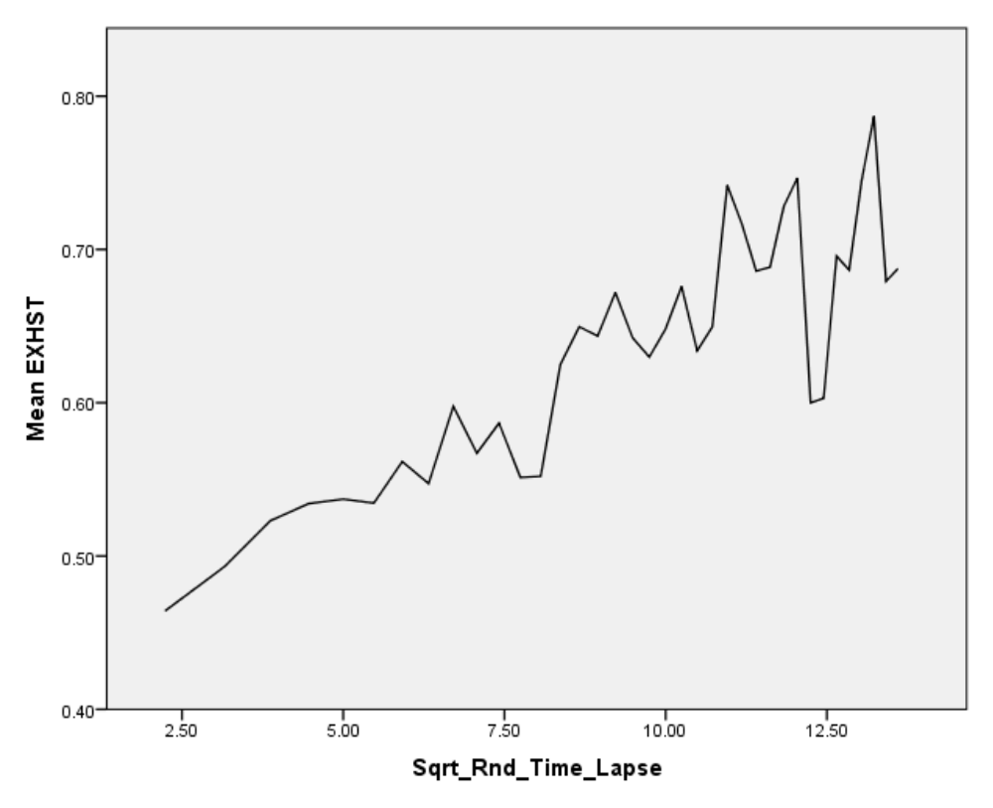
Using the Square Root Produces a Much More Linear Plot

Slide 28
COLLINEARITY

Slide 29
DEFINE: COLLINEARITY
Collinearity exists if the independent variables included in the model are:
Correlated among themselves
Correlated with other independent variables that are related to the dependent variable but omitted from the model
Carefree example -- more bedrooms implies lower sales price

Slide 30
CONDITIONS FOR UNIQUE ESTIMATION OF REGRESSION COEFFICIENTS
Sample size > number of parameters
No exact linear relationship among the predictor variables
When condition 2 is violated, we have perfect collinearity. -- When is the only time you will get perfect collinearity?
When predictors are completely uncorrelated, we have no collinearity. -- When is the only time you will get no collinearity?
When predictor variables are observational, we generally have a condition between these two extremes.

Slide 31
EFFECTS OF COLLINEARITY
Effect ascribed to a variable depends on what other variables are in the model
Variances of estimated regression coefficients increase, which results in reduced precision, decreased t-values, and wrongly signed coefficients
High collinearity does not generally have a major impact on the width of prediction intervals. However the following questions become much more difficult to answer:
  What is the relative importance of the different independent variables?
  What is the size of the effect of a given independent variable on the dependent variable?
  Can any independent variable be dropped from the model because it has little or no effect on the dependent variable?
  Should any independent variable not yet included in the model be included in the model?
If there is zero collinearity, the above questions are easy to answer, and model building is very simple. When collinearity exists, the above questions are difficult to answer, and model building can be very difficult.

Slide 32
COLLINEARITY DIAGNOSTICS
Simple correlation coefficients
Will not necessarily identify relationships that involve more than one predictor variable
Tolerance
Tolerance = (1-R2(j)), where R2(j) is the multiple coefficient of determination for the regression of Xj on the remaining predictor variables
Low tolerance values indicate a high degree of collinearity
Variance inflation factor (VIF)
VIF = 1/tolerance
A VIF > 10 suggests a high degree of collinearity
Eigenvalues of the correlation matrix
A small eigenvalue indicates a high degree of collinearity
The corresponding eigenvector identifies the variables that are collinear

Slide 33
EXAMPLE 1: DATA FILE IS COLLIN1
Revenue = 50,000 + 1.00*Population + 20.00*Advertising + ε
where ε is normally distributed with a mean of 0 and a standard deviation of 12,500
REV1 | REV2 | REV3 | POP1 | POP2 | POP3 | ADV
3475000 | 3475500 | 3075000 | 500000 | 500000 | 100000 | 150000
3234800 | 3484800 | 3084800 | 250000 | 500000 | 100000 | 150000
3086000 | 3486000 | 3086000 | 100000 | 500000 | 100000 | 150000
2496000 | 2246000 | 2246000 | 500000 | 250000 | 250000 | 100000
2243600 | 2243600 | 2243600 | 250000 | 250000 | 250000 | 100000
2115400 | 2265400 | 2265400 | 100000 | 250000 | 250000 | 100000
1552400 | 1152400 | 1552400 | 500000 | 100000 | 500000 | 50000
1285800 | 1135800 | 1535800 | 250000 | 100000 | 500000 | 50000
1125200 | 1125200 | 1525200 | 100000 | 100000 | 500000 | 50000
Which regression has zero collinearity? High positive collinearity? High negative collinearity?
Verify collinearity using the correlation matrix

Slide 34
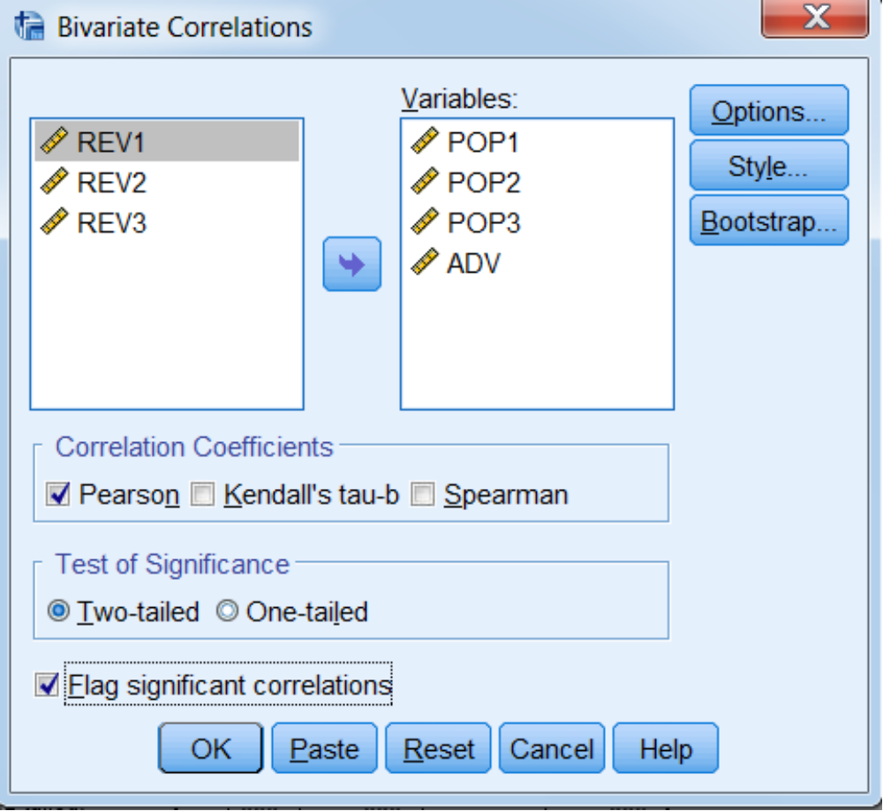
Can Use the Correlate Procedure to See all of the Correlations Between the Independent Variables

Slide 35
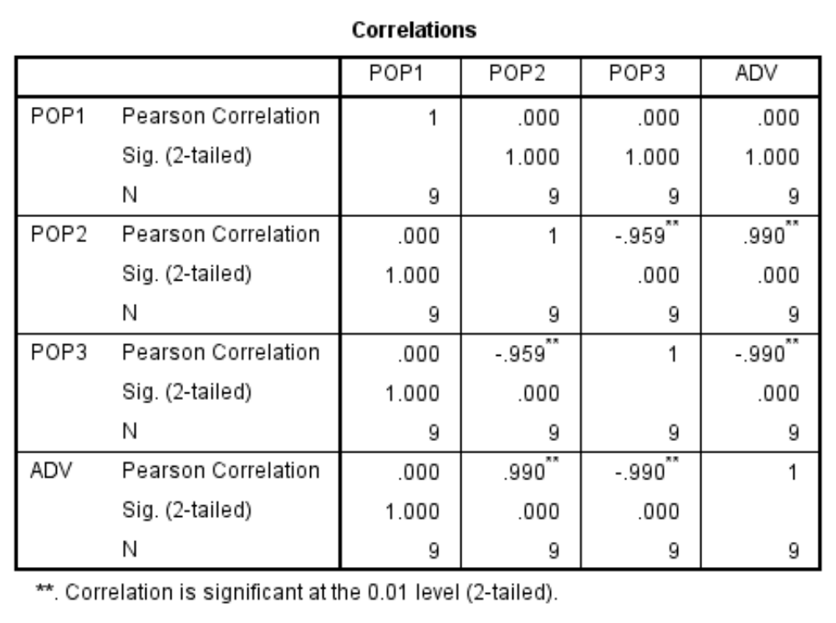
The Correlations Between Population and Advertising Range from Zero to Plus .990 to Minus .990

Slide 36
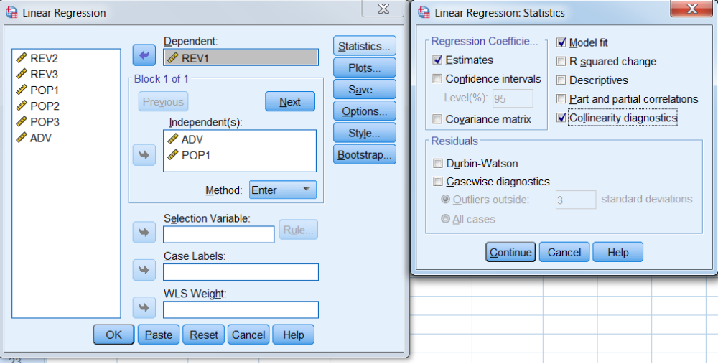
How to Get the Collinearity Diagnostics in Linear Regression

Slide 37
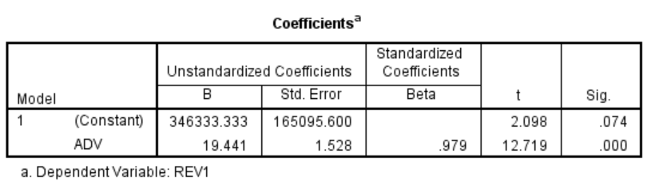
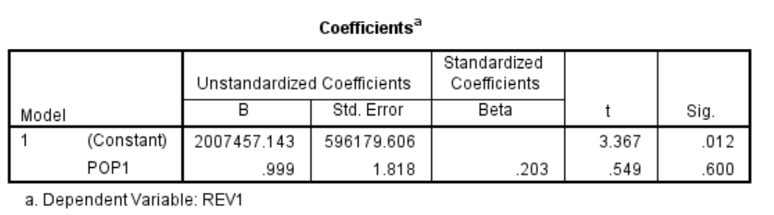
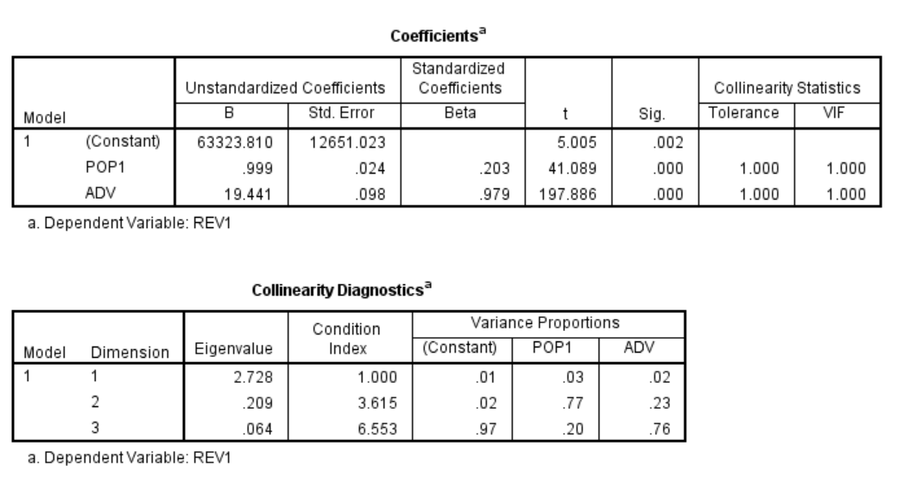
Y = REV1
*Note that when the correlation is zero, the coefficients do not change as additional variables are added to the model.

Slide 38
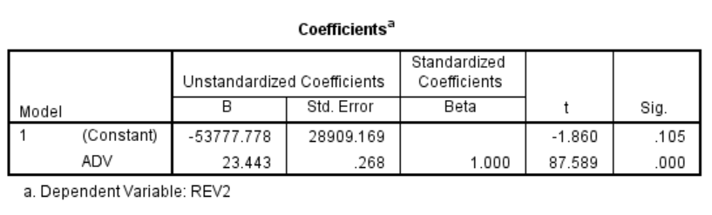
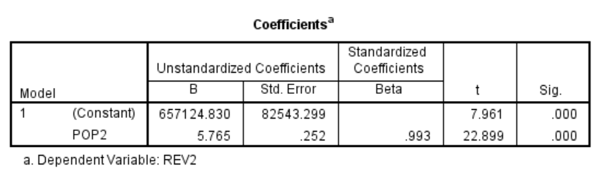
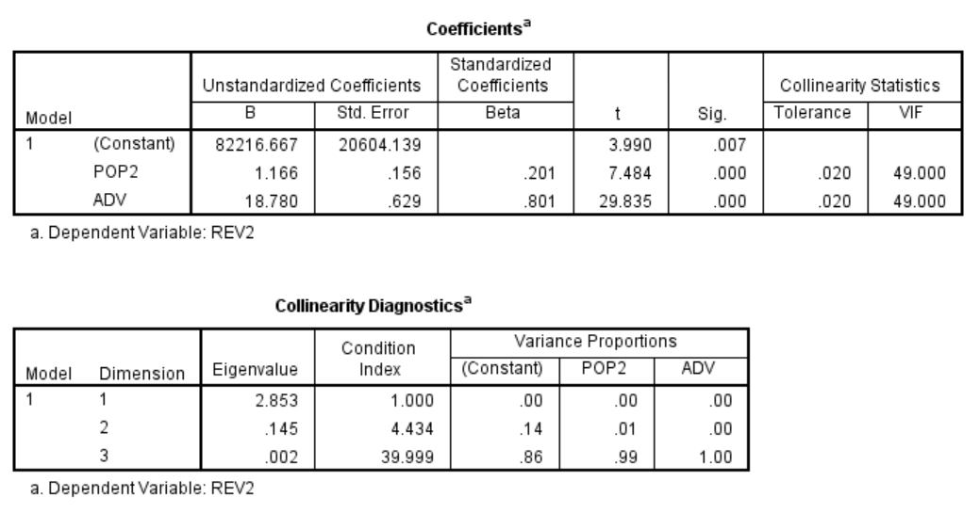
Y = REV2
* Note that when the correlation is positive, the coefficients can change dramatically as additional variables are added to the model.

Slide 39
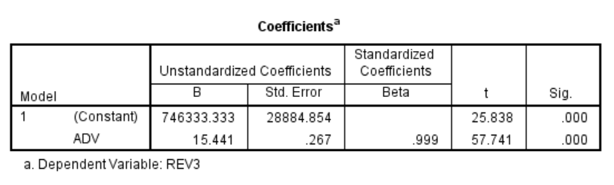

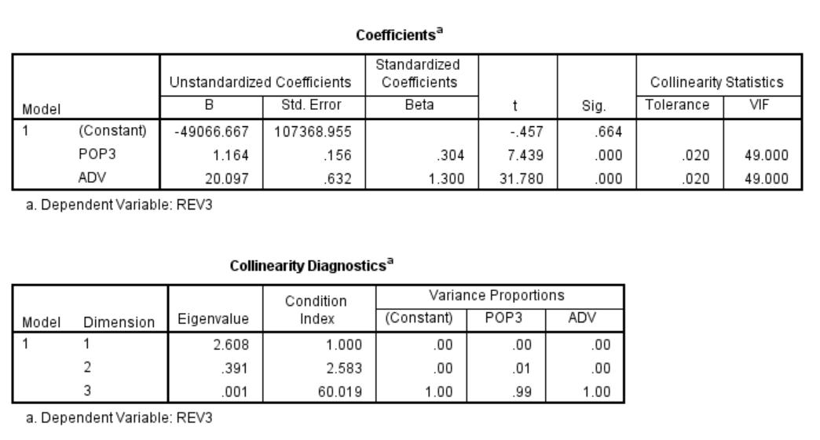
Y = REV3
* Note that when the correlation is negative, even the sign of the coefficients can change as additional variables are added to the model.

Slide 40
EXAMPLE 2: DATA FILE IS COLLIN2
When collinearity exists, it may be necessary to have both variables in the model before either variable appears to be significant.
Spending = 50,000 - 1080*Age + 0.9*Income + ε_{s}
where ε_{s} is normally distributed with a mean of 0 and a standard deviation of 250
Income = 5,000 + 1200*Age + ε_{i}
where ε_{i} is normally distributed with a mean of 0 and a standard deviation of 1000

Slide 41
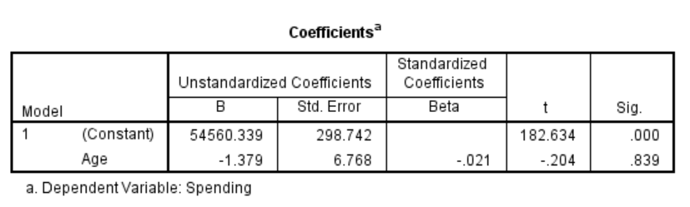
Y = SPENDING, X = AGE
Age by itself does not appear to be significant

Slide 42
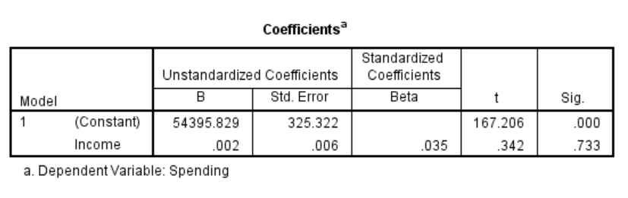
Y = SPENDING, X = INCOME
Spending by itself does not appear to be significant

Slide 43
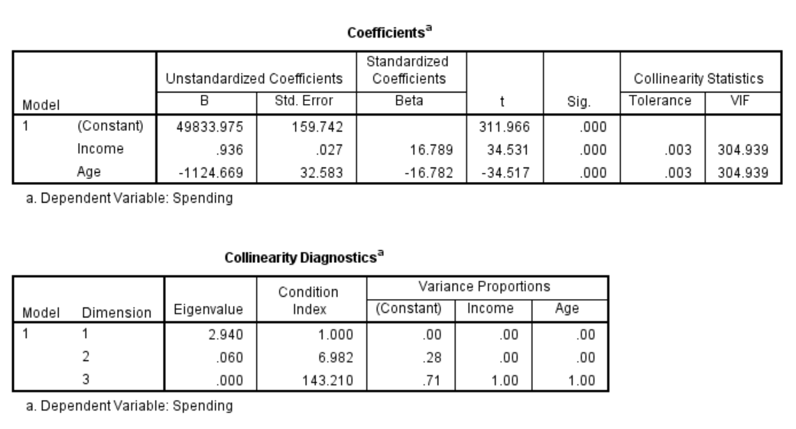
Y = SPENDING, X = INCOME, AGE
When both variables are in the model,
both are highly significant

Slide 44
Because of collinearity, you cannot build a model one variable at a time

