Slide 1
Model Evaluation and Validation
Profiling Methods Seminar
April 2016

Slide 2
What makes a good model?
Evaluating Model Fit and Forecast

Slide 3
Model Fit
A model can be described as a good “fit” if:
  The summary of the distance between the actual and predicted values is small
    or
  The summary of the measures of the distance between y̅ and ŷ are small
By fit we mean that the model predictions correspond to the actuals

Slide 4
Assessing Model Fit
Hosmer-Lemeshow Test
Test of goodness of fit
  How well the predicted outcomes “fit” the actual outcomes
Observations are broken into groups or “deciles” based on estimated probability

Slide 5
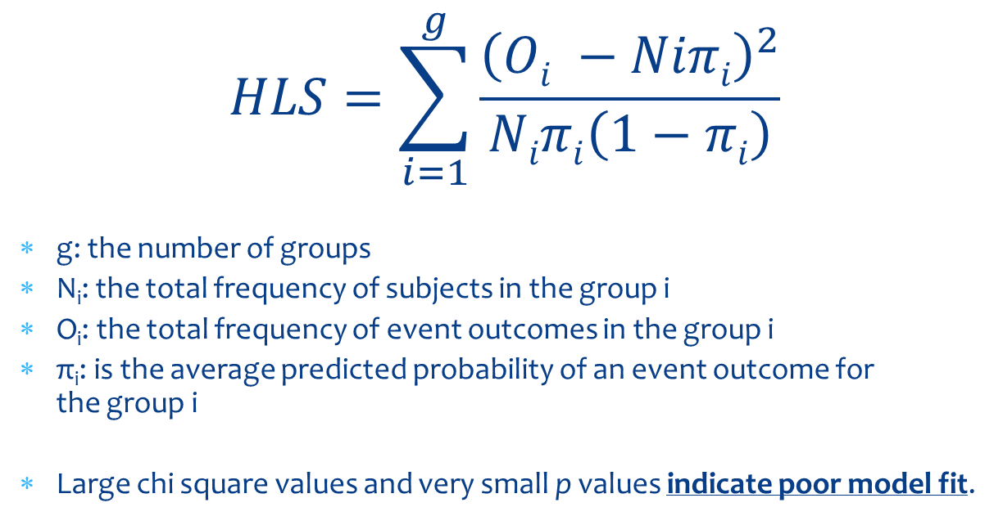
Hosmer-Lemeshow Statistic
$$HLS=\sum_{i=1}^{g}{\frac{{\left(Oi −Niπi\right)}^{2}}{Niπi\left(1−πi\right)}}$$
g: the number of groups
N_{i}: the total frequency of subjects in the group i
O_{i}: the total frequency of event outcomes in the group i
π_{i}: is the average predicted probability of an event outcome for the group i
Large chi square values and very small p values indicate poor model fit.

Slide 6
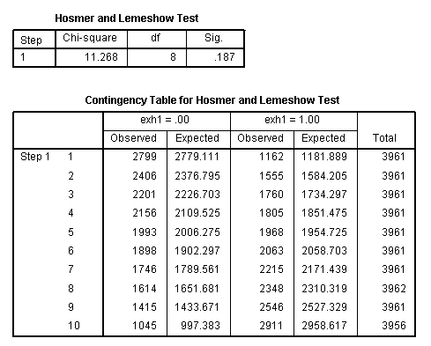
Hosmer-Lemeshow Statistic
Notes:
For each group, the number of observations expected → an average of the predicted probabilities is computed and multiplied by the total number of observations in the group
Done for both, exh = 0 and exh = 1

Slide 7
Hosmer and Lemeshow Test
Step | Chi-square |  | df | Sig.
1 | 11.268 |  | 8 | .187
Contingency Table for Hosmer and Lemeshow Test
 |  | exh1 = .00 |  |  | exh1 = 1.00 |  | Total
 |  | Observed |  | Expected | Observed | Expected
 |  |  |  |  |  |  |  |  | HL
Step 1 | 1 | 2799 |  | 2779.111 | 1162 | 1181.889 | 3961 |  | 0.477
 | 2 | 2406 |  | 2376.795 | 1555 | 1584.205 | 3961 |  | 0.897
 | 3 | 2201 |  | 2226.703 | 1760 | 1734.297 | 3961 |  | 0.678
 | 4 | 2156 |  | 2109.525 | 1805 | 1851.475 | 3961 |  | 2.19
 | 5 | 1993 |  | 2006.275 | 1968 | 1954.725 | 3961 |  | 0.178
 | 6 | 1898 |  | 1902.297 | 2063 | 2058.703 | 3961 |  | 0.019
 | 7 | 1746 |  | 1789.561 | 2215 | 2171.439 | 3961 |  | 1.934
 | 8 | 1614 |  | 1651.681 | 2348 | 2310.319 | 3962 |  | 1.474
 | 9 | 1415 |  | 1433.671 | 2546 | 2527.329 | 3961 |  | 0.381
 | 10 | 1045 |  | 997.383 | 2911 | 2958.617 | 3956 |  | 3.04
 |  |  |  |  |  |  | H-L Statistic |  | 11.27
Expected = Predicted → Avg. Probability Score per group x total in Group
HL → (Observed - Expected) Squared divided by expected for all 1's
H-L Statistic → Sum of all rows of HL
Notes:
To get the number of the expected exhaustions in each group or decile, multiply the groups average probability score within each decile by the total number of claimants in the decile.
The number not expected (predicted) to exhaust = total # in decile – expected exhaustees.

Slide 8
Issues with the Hosmer-Lemeshow
Test cannot necessarily indicate a good fit, can only fail to indicate a poor fit
Indicates model fit, but can overlook model forecast
We are generally less concerned about the fit of the entire model vs. fit within the targeted population (top 30% of scores)

Slide 9
Additional Review Measures
Sensitivity and Specificity Analysis
Sensitivity – Gives the true positive rate – if a claimant is an exhaustee, how often will the model indicate an exhaustee?
Specificity – Gives the true negative rate – if a claimant is not an exhaustee, how often will the model indicate non-exhaustion?

Slide 10
Predicted Versus Actual
 | Condition Absent | Condition Present
Predicted Absent | true negatives | false negatives
Predicted Present | false positives | true positives
Notes:
SPSS presents a chart that pays out the predicted versus actual outcomes based on the logistic regression model specs used.
Predicted values are split based on a predicted probability of 50% → cases above 50% are considered to have the condition (in our case exhaustion) present, while cases below have the condition absent

Slide 11
Indices of Test Performance
Including Sensitivity and Specificity
TPF | True Positive Fraction (Sensitivity) | TP/ (TP+FN)
FNF | False Negative Fraction (1-Sensitivity) | FN/ (TP+FN)
TNF | True Negative Fraction (Specificity) | TN/ (TN+FP)
FPF | False Positive Fraction (1-specificity) | FP/ (TN+FP)
PPV | Positive Predicted Value | TP /(TP +FP)
NPV | Negative Predicted Value | TN/(TN+FN)
LR⁺ | Likelihood Ratio of Positive Results | TPF / FPF
LR⁻ | Likelihood Ratio of Negative Results | FNF/TPF

Slide 12
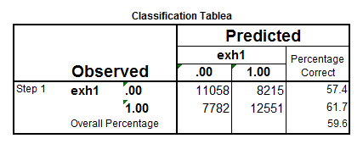
Likelihood Ratios
LR → Likelihood Ratio
LR+ → probability of a positive outcome (exhaustion) given a positive predicted probability (in this case a >= 50% likelihood of exhaustion)
LR- → probability of a negative outcome (non-exhaustion) given negative predicted probability
Notes:
this applies to the entire profiled population so while it looks at the overall model performance, it does not tell us exactly how we are doing with the targeted population. We will look further into the targeted population review shortly.

Slide 13
Using ROC Curves for Analyzing Model Performance
ROC → Receiver Operating Characteristics
An ROC Curve plot provides a simple, visual graphic for assessing overall model performance
Shows the tradeoff between model performance with regards to sensitivity and specificity
  ROC Plots the True Positive Rate against the False Positive Rate
Simple interpretation – the more area below the ROC Curve (AUC = area under curve), the more accurate the model and vice-versa
An ROC curve sitting directly on the diagonal line indicates a model that is no better than random chance alone

Slide 14
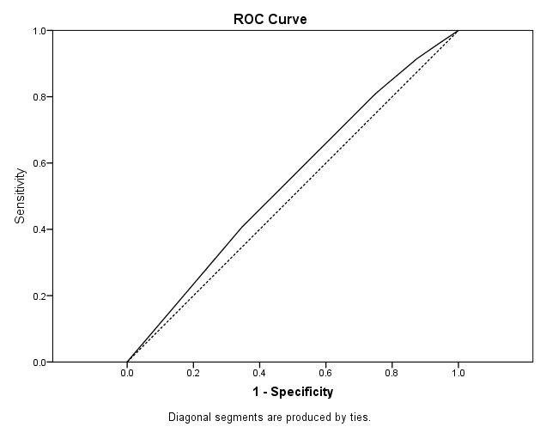
Sample ROC Curve in SPSS – Based on the Categorized Tenure Variable from Utah Model Specs

Slide 15
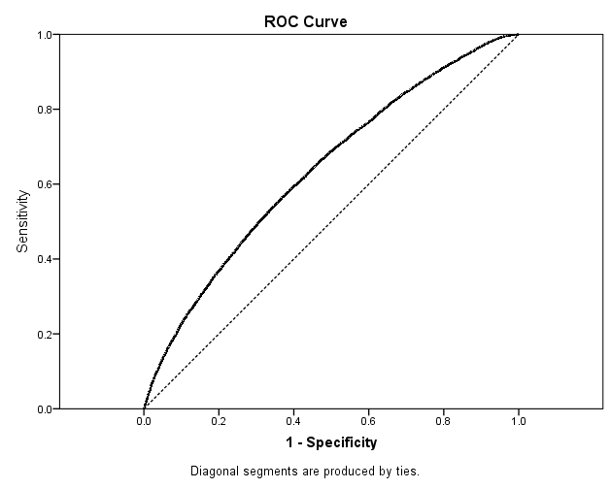
Sample ROC Curve in SPSS – Based on Existing Utah Model Specs

Slide 16
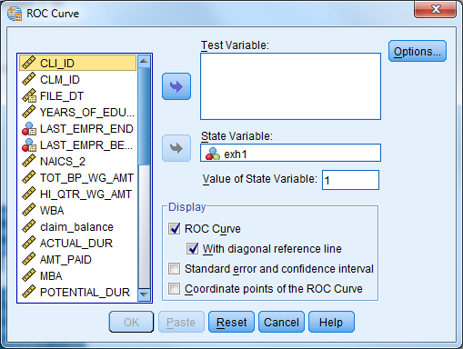
Preparing an ROC Curve in SPSS
Select Analyze → ROC Curve
Test Variable
  Predicted Probability
    (Saved pscore)
State Variable
  Outcome/Condition
    Exhaustion Variable
  Value of State Variable
    1 for condition present
    1 = Exhaustion
Select ROC Curve Box
  Also, if desired – select w/ diagonal to include the reference line

Slide 17
Assessing Model Performance using Decile Analysis
Compute 10 equal sized groups (deciles) based on predicted probabilities from smallest to largest
Each decile contains 10% of the total cases based on the predicted probability
  In SPSS, sort by pscore → number each sorted case → psort =case number divided by total number of cases → break out into 10 equal sized groups where psort < 0.1 = group 1, through psort >= 0.9 = group 10…
Use crosstabs to plot groups by the exhaustion variable/

Slide 18
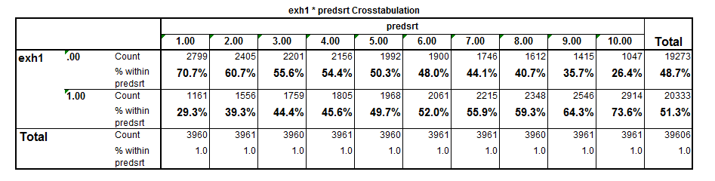
Example of Decile Analysis
Similar to the Hosmer-Lemeshow test
  Based on the predicted probability
  Breaks out the data into 10 equal size groups
  Compares relative likelihood of exhaustion based on probability score to actual incidences of exhaustion

Slide 19
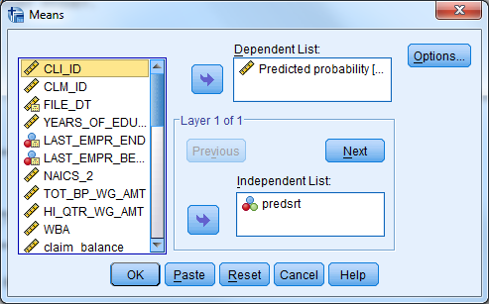
Alternative Calculation for Decile Analysis in SPSS
Use same Predicted Probability Score Grouping from before → select Analyze → Compare Means → Means
Enter pscore as the
  dependent
Group Name as the
  independent

Slide 20
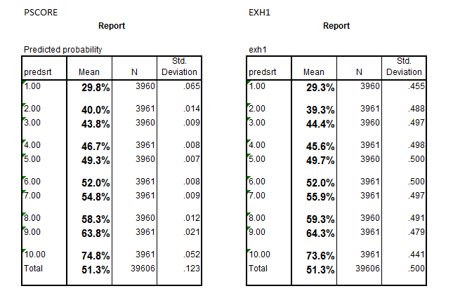
Compare Predicted Probability of Exhaustion to Actual Probability of Exhaustion by Decile

Slide 21
Assessing Model Performance within Targeted Population
Overall Model looks good, but what about our targeted population?
RESEA Goal is to provide services to roughly the Top 30% of claimants based on likelihood of exhaustion/long term unemployment
Using Decile analysis, we can focus in on the model performance within the top 30% of profiling scores

Slide 22
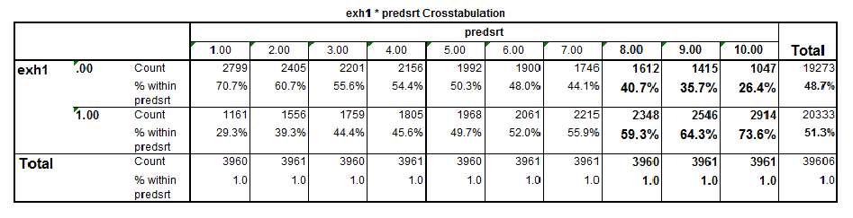
Decile Analysis cont.
The areas of particular interest are the top 3 deciles which represent the top 30% of predicted probabilities.
Represent the claimants that will be referred to services based on profiling scores

Slide 23
Decile Analysis – Interpretation
Model Predictions should correspond to actuals
Things to watch out for:
  Low correspondence b/w averages for predictions and actuals
  Different ranges of scores, contracted range of predictions
Decile analysis allows you to see how well model performs in the range of scores that will be targeted
  It is not uncommon to do a very good job of identifying claimaints likely to exhaust but not doing as well with those unlikely to exhaust and vice-versa
    Model may fit well but do a poor job of identifying the people you most want to identify

Slide 24
Additional Analysis using Deciles
Further analysis can be completed using the computed deciles to:
  confirm that the targeted population matches who the program is able to service
  help inform employment services decisions
In particular, the top 3 deciles can be further analyzed to better understand the characteristics of the population that will be referred

Slide 25
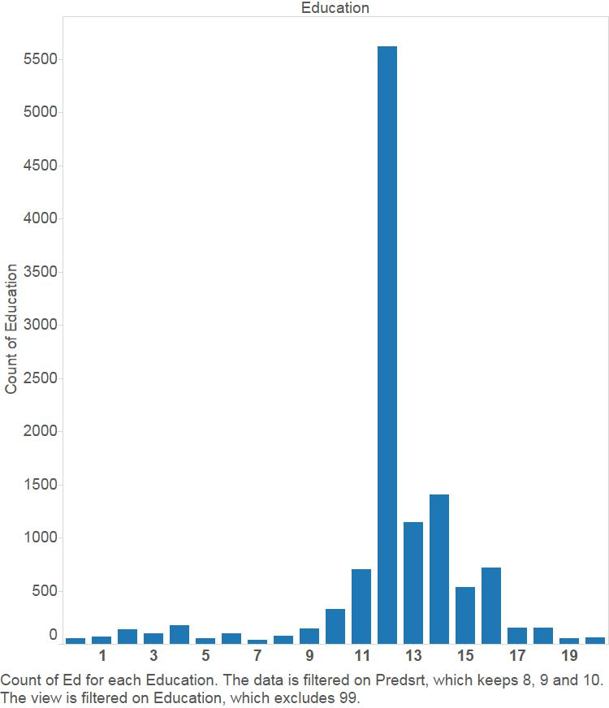
Top 3 Groups by Education
Notes:
Similar to the overall breakout with the exception of a smaller proportion of higher education claimants

Slide 26
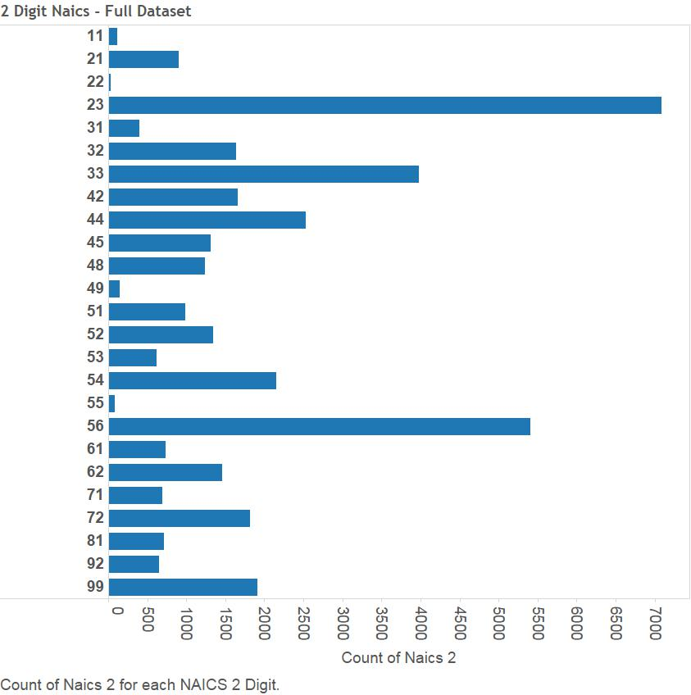
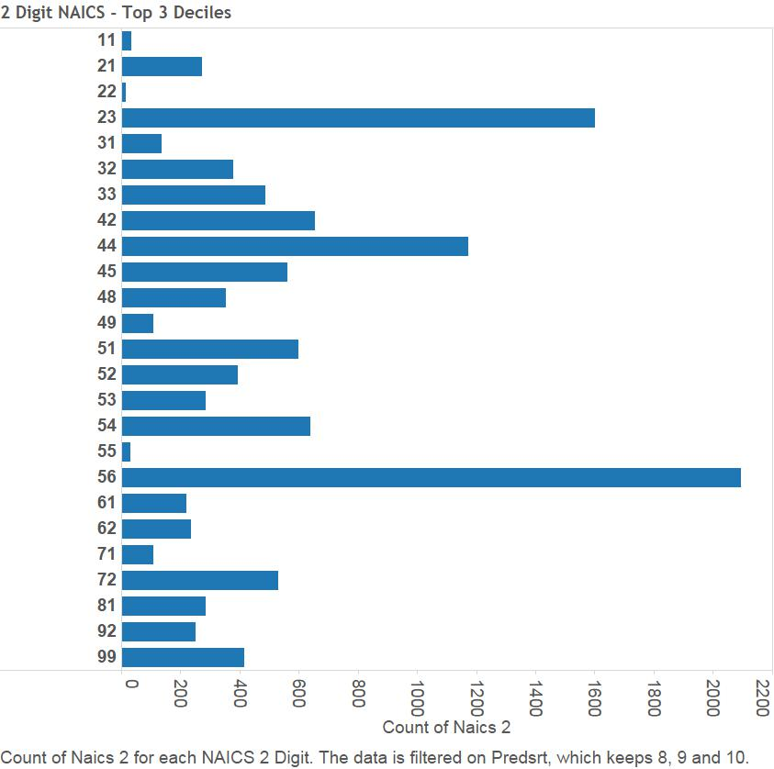
NAICS

Slide 27
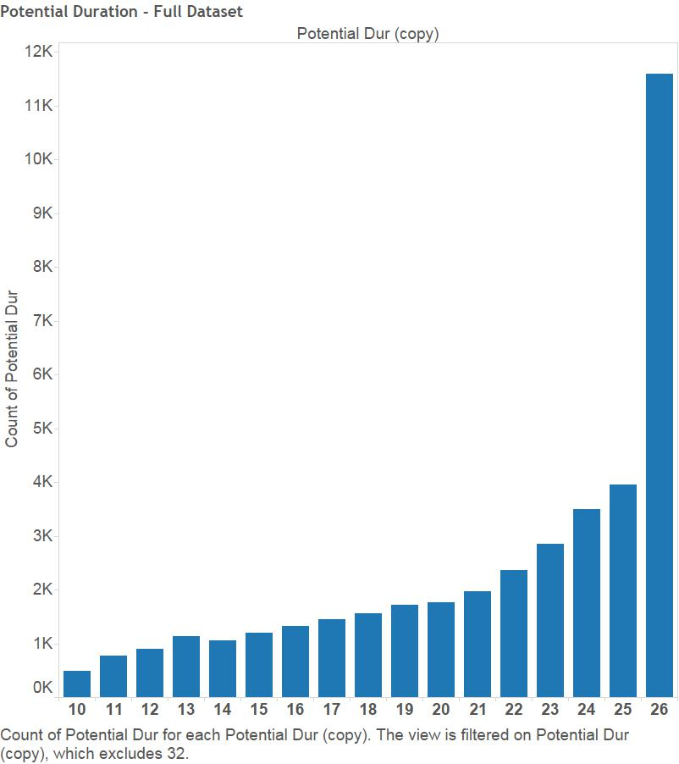
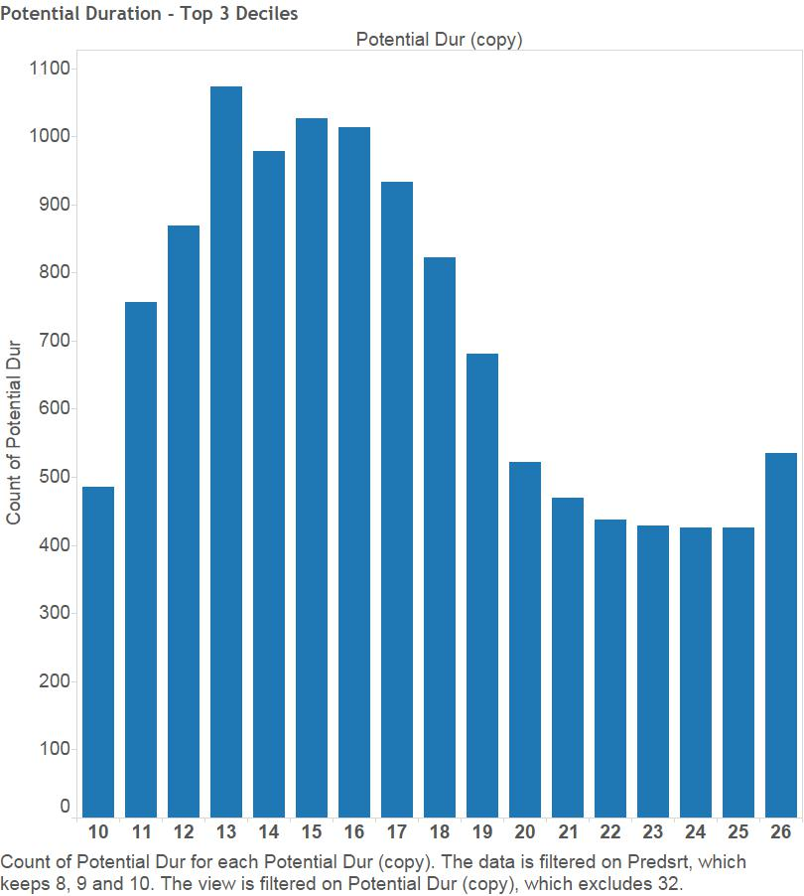
Potential Duration

Slide 28
Model Validation
Testing on different data

Slide 29
Validation Requirements
AT THE BEGINNING OF THE MODEL DEVELOPMENT PROCESS:
  Split data into 2 groups
    Group 1 = Model Build Dataset
    Group 2 = Model Validation Dataset
Once model is built on dataset 1, validate the model on dataset 2
Helps to identify an over-fit model

Slide 30
Over-Fitting a Model
A model that is over-fit too closely fits or resembles the sample dataset from which it was built, but will not properly reflect the overall population
Often including too many variables can lead to over-fitting

Slide 31
Steps to Model Validation
Following initial data prep/cleaning
  Compute a random number variable and sort entire dataset by that number
  Break data into 2 groups based on random number, can be 50%-50%, 2/3-1/3, 75%-10%, just be sure you have a reasonable number of cases in your second dataset
Put aside the second/validation dataset and build model using 1st dataset.
Generate model using 1st dataset and evaluate model performance
Once the model has been developed…

Slide 32
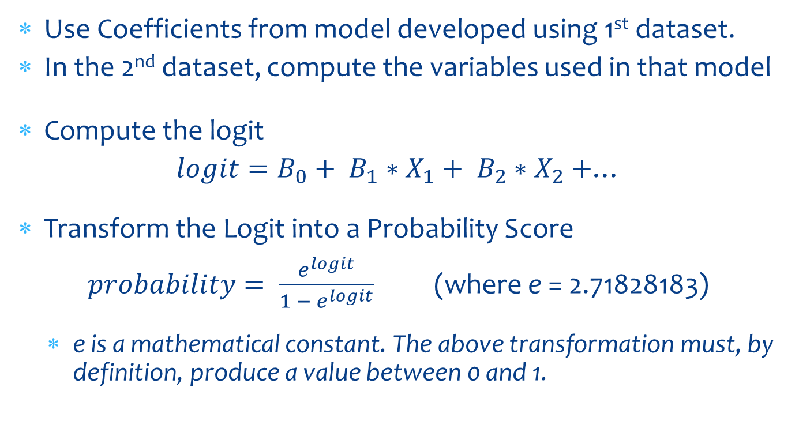
Validation
Use Coefficients from model developed using 1st dataset.
In the 2nd dataset, compute the variables used in that model
Compute the logit
$logit=B_{0}+ B_{1}∗X_{1}+ B_{2}∗X_{2}+$…
Transform the Logit into a Probability Score
$probability= \frac{e^{logit}}{1 − e^{logit}}$ (where e = 2.71828183)
  e is a mathematical constant. The above transformation must, by definition, produce a value between 0 and 1.

Slide 33
Computing the Logit
In SPSS, this is can be done by either:
  1. creating variables for each coefficient
  2. by directly entering the coefficients into the logit equation
    This is a bit more cumbersome with categorical variables which have different coefficients for each category.
  Categorical variables can be handled a few different ways
    Compute a coefficient variable based on the category (if education = 12, then ed_coef = .112, if education = 16, then ed_coef = .345, etc…
    Compute dummy variable (1/0) for each category, include each coefficient in the equation…

Slide 34
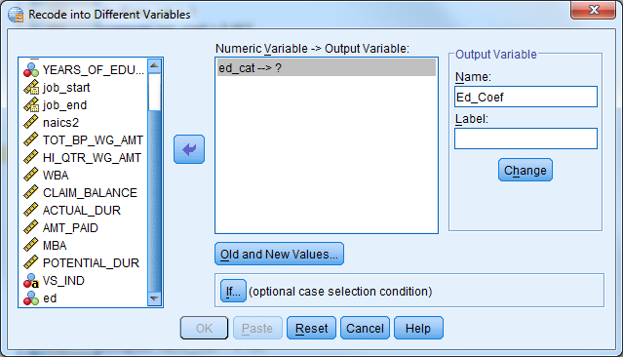
Computing the Logit
Logit = Constant(B₀) + (WRR * WRR_Coef) + (ED_Cat * ED_Coef) + etc…
Use Compute for
continuous variable
coefficients
Use Recode to
compute variable for
relative coefficients
for categorical variables

Slide 35
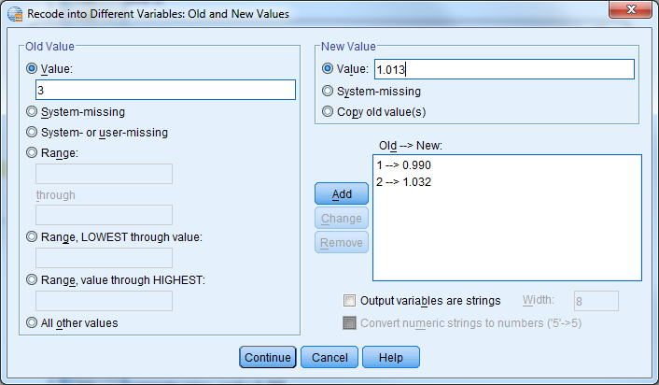
Computing the Logit cont.
Recode a new variable to include appropriate coefficient based on the categorical variable

Slide 36
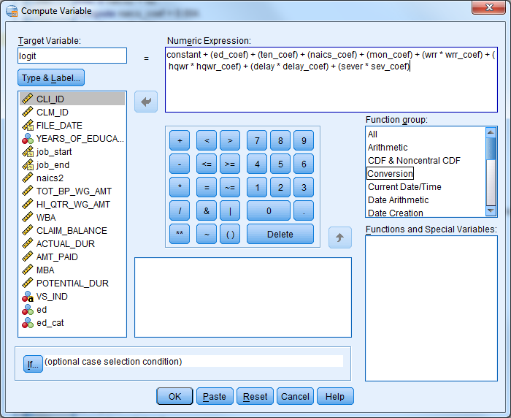
Computing the Logit cont.
Please note: the constant is the constant from the logistic regression equation (B₀,) which is different than the logit transformation.

Slide 37

Logit
The logit is not the Profiling Score, and clearly from the table below, it is not the probability of exhaustion either.
To get the Probability Score perform a logit transformation

Slide 38
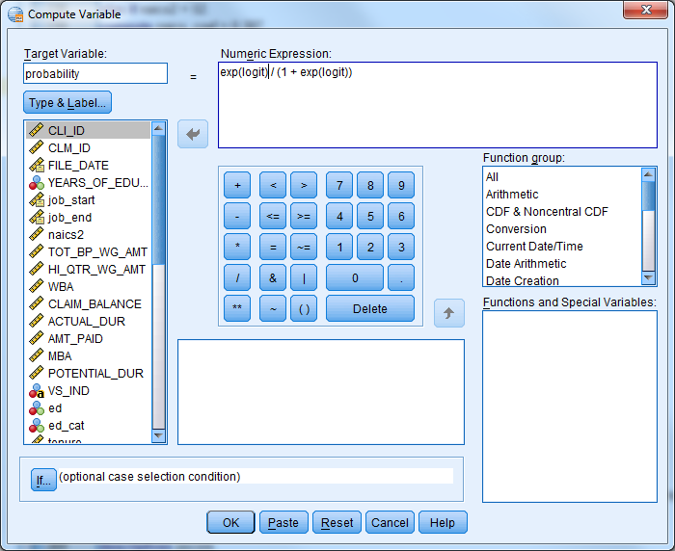
Computing the Probability Score

Slide 39

Probability Scores
Probability Scores (called pscores in table below) will range between 0 and 1 and represent the estimated percentage likelihood that a claimant will exhaust

Slide 40
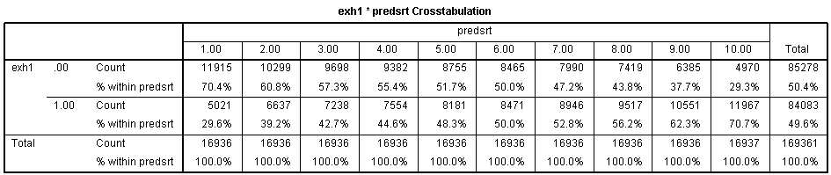
Perform Decile Analysis
Produce decile table based on validation dataset probability scores and look for inconsistencies compared to the decile table from the first dataset set and look for similar performance across the range of scores

Slide 41
Evaluation and Validation
The techniques covered in this session can be used to:
  Develop a new profiling model
  Test current model for ongoing QA
  Compare prospective models to current model
  Identify improvements in targeting to present to staff and help encourage continued review and on going maintenance of profiling model
  Identify key information to share with front line staff to better prepare for referred claimant population

