Slide 1
Continuing Model Maintenance
Maintaining Model Operation and Efficiency

Slide 2
The importance of Ongoing Maintenance
Changes in economic conditions
Changing state economy
Changes in state population
Changing administrative priorities regarding the targeted population
Changes in job center capabilities to serve particular types of claimants
Notes:
Recession – recovery – growth – etc…
(changing industries and occupational opportunities such as changes in the oil and gas industries impacting SD/ND/WY/etc.)
(changes in education level, changes due to industry and staffing shifts, etc.)

Slide 3
Assessing Model Performance Over Time
Decile analysis: Simple assessment technique
  Indicates model performance across the spectrum of scores
  AND mode importantly
  Indicates model performance for the targeted population
Using stats software, produce a standard decile table (crosstabs in SPSS) using the actual profiling scores from more recent claims (based on completed benefit year end dates)

Slide 4
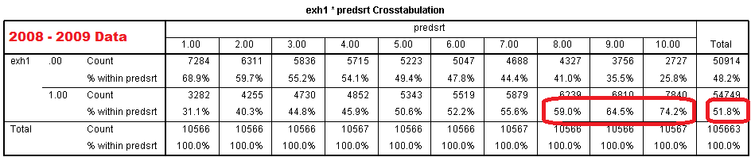
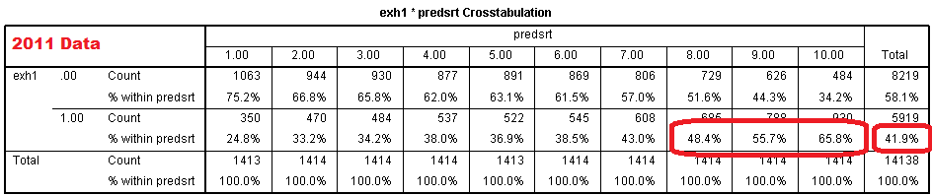
SPSS Crosstab – ‘08/’09 versus ‘11
Be sure to not get caught up in changes in the overall exhaustion rate. A 10% drop in the population exhaustion rate will likely correspond to a similar drop in rates across the decile table.
Notes:
decile tables like we’ve used previously.
I’ve got the initial one built on data from 2008 and 2009 data up top
Below I’ve used the model coefficients from the 08/09 model to compute profiling scores for the claims from 2011.
You can do the analysis using this chart, but for the purposes of this presentation we’re going to look at the same information in a few graphics

Slide 5
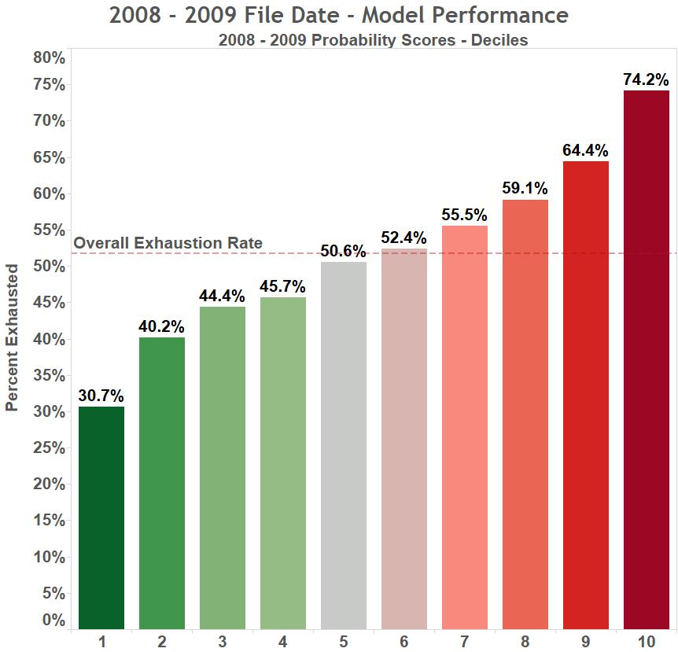
Notes:
Same here with slightly better spread in the middle ranges.
2008 and 2009 are the years which my mock model was built off of using the state’s variable specifications so this shows it’s a good model spec and itperforms well across the spectrum and performs extremely well in the deciles corresponding to higher probability scores.

Slide 6
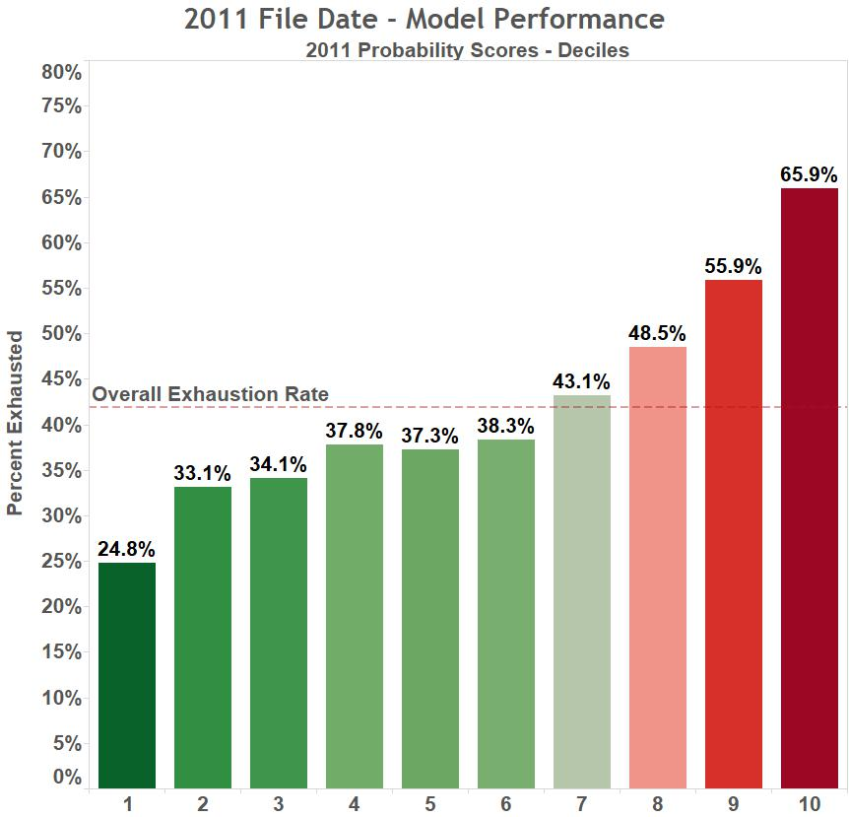
Notes:
Finally, the last year we have, the model still does a good job identifying the top 2 deciles, although the decile # 8 is dropping off while decile 7 is nearly the population average.

Slide 7
Notes:
Looking at the circled areas we see the separation is no longer as well defined between the lower deciles so the overall model performance is already dropping off.

Slide 8
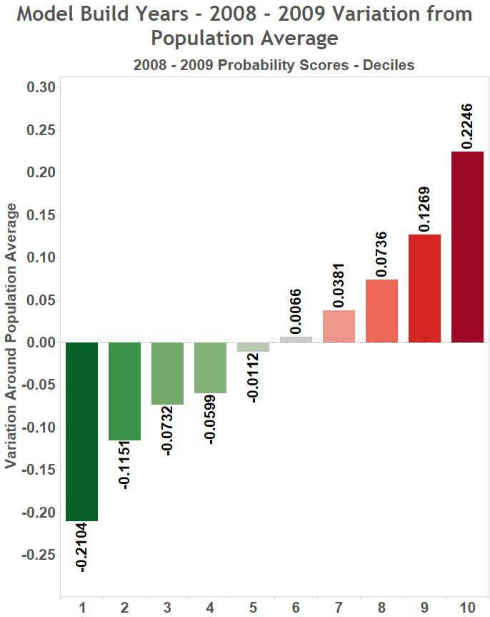
Notes:
Variation around the population mean gives a slightly better view of the changes in model performance over time.
2008 and 2009 – very good variation and constant growth between deciles.

Slide 9
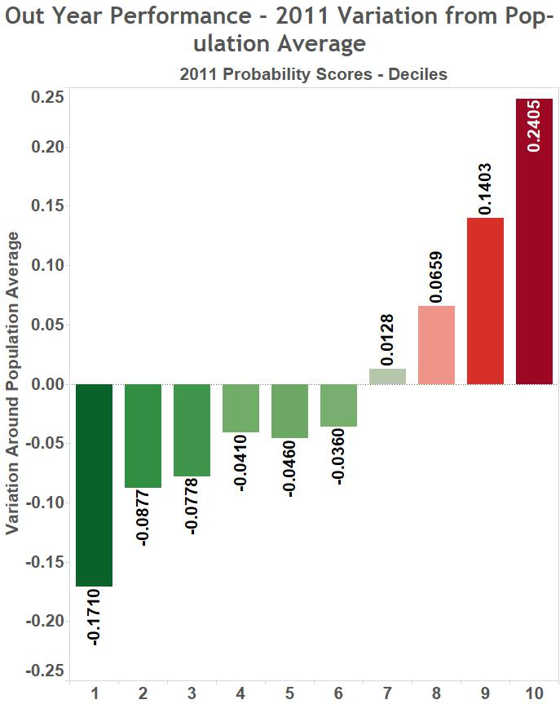
Notes:
2011, variation from one decile to the next is severely impacted.
Top 2 deciles still performing well although the performance will only continue to diminish.
Also RESEA is looking to serve the top 30% of profiling scores and we’re quickly getting into a range where many of that 30% will be identified by not much more accuracy than by random chance.

Slide 10
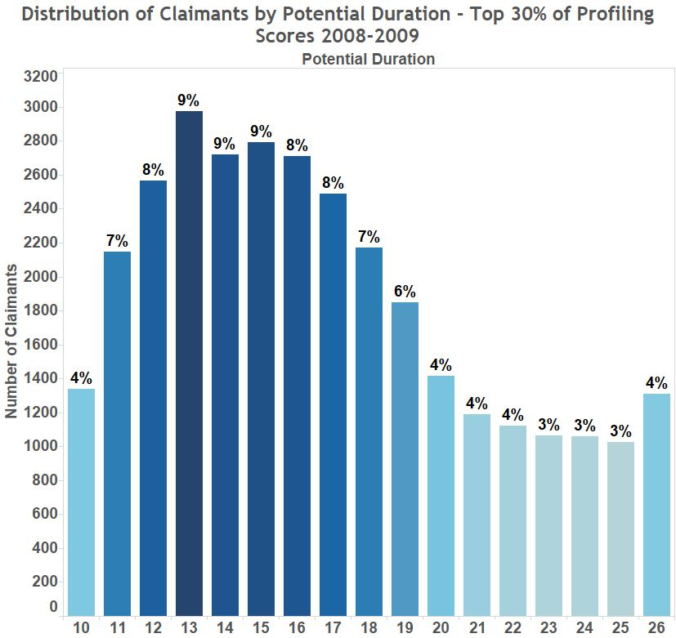
Notes:
Percent is the percent of claimants with each number of weeks of potential duration

Slide 11
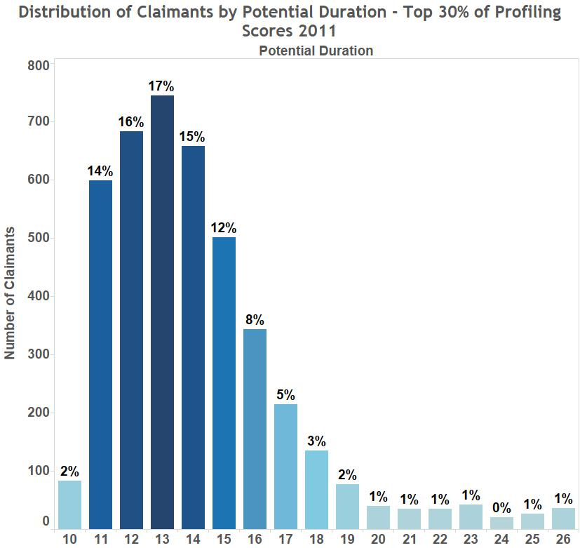
Our model is further focusing the targeted population on shorter term duration claimants already.
Notes:
This is likely in part due in part to decreasing overall survival rates and lower average durations due to economic improvement (less people getting to higher durations overall)
But also indicates a fairly significant shift in the targeted population
Either way, this indicates model updates are important to maintain optimal model performance

Slide 12
Things to Keep in Mind
Model is built using completed benefit year data
  1/1/2008 to 12/31/2009 filing dates in UT model example correspond to data that would be pulled no earlier than 1/1/2011
Model performance can deteriorate quickly, hence the 2 to 4 year coefficient update recommendations
  Particularly true during changing economic periods

Slide 13
Assessing Model Performance
Over Time
Feedback Loops
Ongoing process of communication and follow up to review program outcomes
  Communication with Front Line Staff
  Feedback from referred claimants
  Claims data analysis
    Descriptive tables to analyze characteristics and claim experience of referred claimants
  Analysis of 9048 and 9049 reports
Be sure to use this feedback when building new models!
Notes:
Model upkeep is not necessarily constant but should be an ongoing process
Feedback and communication with Employment Services offices very important
Find out if referred claimants match services being provided – do staff feel they are able to help the claimants being referred?
Could survey claimants about their experience with RESEA referral

Slide 14
Evaluation Process
Recommended:
  Develop a standard and scheduled evaluation process

Slide 15
Recommendations for Model Updates
Every 1 to 3 years
  Re-estimate coefficients
    Using more recent data, update model coefficients
    Generally a relatively quick and simple update
      data collection and clean up is most time consuming part
Every 3 to 6 years
  Investigate need to overhaul model
    Prior model variables may still hold, but improvements may still be available
    More involved update: requires more time and effort
    Timing Can vary depending on economic fluctuations over the time period.
Notes:
These are the ideal update time frames which may not always work in every state,

Slide 16
Process for Model Upkeep
Recommended: Make model updates part of the standard, scheduled process.
For example:
  Regularly scheduled model updates
    Every 3 years:
      Coefficient review and update if necessary
    Every 6 years:
      Model review and update including
        Model rebuild if a better model can be developed
        Coefficient re-estimation if a better model not available
Most important benefit of a defined Model Update Process:
  Buy-in: Programmer time, for data pull & model implementation
Notes:
Having a defined update process requires and insures buy-in from all involved parties, particularly programmers which in many states are difficult to schedule. Programmers often needed to retrieve data to build models, necessary for updating models particularly when implementing a completely new model.
Programmer time is often one of the major hurdles I hear about during model updating process
For data extraction and programming model updates and coefficient revisions
Scheduling via an integrated process would help alleviate many of these issues by including a standard set of expectations and schedules for all parties.

Slide 17
Re-estimating Model Parameters
Model Updating Process

Slide 18
Re-estimating Model Parameters
(Coefficients)
Duplicate original model (same variables) using more recent data
  Run a logistic regression using the same variable specifications on a more recent set of data
  Include a binary variable (1/0) to identify claimants referred to services
    Can help assess program impacts & control for impacts of services on claimants’ probabilities of exhausting
  Compare coefficients from the two models
    If there are significant differences, use the new model, otherwise old model can be retained
  Alternatively, you could estimate separate models for selected vs. not selected claimants & compare predicted probabilities
Notes:
Create variables

Slide 19
Re-estimation of Parameters
Particularly if coefficients are significantly different, be sure to evaluate re-estimated model performance
  Use Decile table analysis, Hosmer-Lemeshow, Sensitivity and Specificity and ROC Curve analysis as necessary
  Ensure current variable specifications are still appropriate
If evaluation of new model indicates poor performance consider building a new model from scratch

Slide 20
Model Rebuild
When Model Performance
  OR
Upkeep Schedule Dictates

Slide 21
Model Rebuild
Collect data and develop a new model following the seminar steps and guidance
Use the prior model’s variable specifications as a starting point
OR
Start from scratch and ignore old model to avoid any bias in the development of the new model

Slide 22
Final suggestions
Lookup tables for regression coefficients
  Simplifies implementation of re-estimated coefficients
Automated evaluation & model update processes
Data management and improvement
Training and/or “buy in” from front line staff

